Slide 1
Creative Solutions for Managing eResources Workflow
Laura Edwards and Kelly Smith
OVGTSL Conference
May 21, 2010

Slide 2
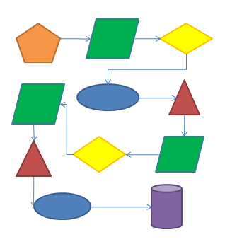
Workflow Tools
http://www.flickr.com/photos/geishaboy500/100043823
Notes:
2 basic components to successful eResource management

Slide 3
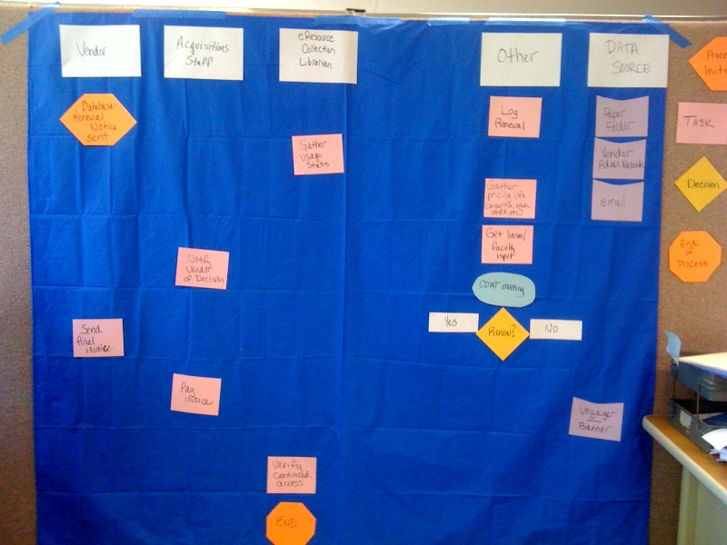
Process Mapping
Notes:
Process Mapping

Slide 4
Database “Before” Workflow
Vendor
Acquisitions Staff
eResource Librarian
Administrative Coordinator
Collection Dev. Cte.
Tools
Renewal Notice
Log Renewal
Paper Folder/File Cabinet
Email/phone w/vendor/consortia
Vendor Admin Sites
Investigate Pricing
Get Usage Stats
Renew?
SharePoint Meeting Minutes
Send Invoice & License
Notify Vendor
Yes/no
Maybe
Pay Invoice
Get input from Liaison/ Fac
Voyager & Banner
Approve payment
Verify Continued Access
End

Slide 5
Database “After” Workflow
Vendor/Agent
Acquisitions Staff
eResource Collection Librarian
Administrative Coordinator
Collection Dev. Cte.
Tools
Renewal Notice
Log Renewal
SharePoint Master eResources Excel File
Email/phone w/vendor/consortia
Investigate Pricing
Vendor Admin Sites
Get Usage Stats
Shared Network “N” Drive
Get input from Liaison/ Fac
Renew?
SharePoint Meeting Minutes
Notify Vendor
Send Invoice/ License
Yes/no
License?
Yes
Voyager & Banner
Sign License
No
Pay Invoice
Approve Payment
Notify eResource Access Librarian
Notes:
Goals:
~ more efficient
~ better tracking of historical decisions, etc.

Slide 6
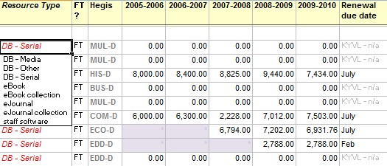
Database Tools
“The Sharepoint Spreadsheet” – Over 170 licensed eResources tracked
Notes:
Benefits of Sharepoint (Microsoft’s web-based collaboration tool)
good for creating single tracking documents that are updated by multiple people
only one person can edit at a time – prevents version problems
web-based – accessible from anywhere
private and secure – login authenticated using campus credentials
flexible – can add columns, tabs, etc., as needed
small learning curve – staff already know how to use Excel
basic alerts built in – can get email notification when files for which you’ve set up an alert have been edited

Slide 7
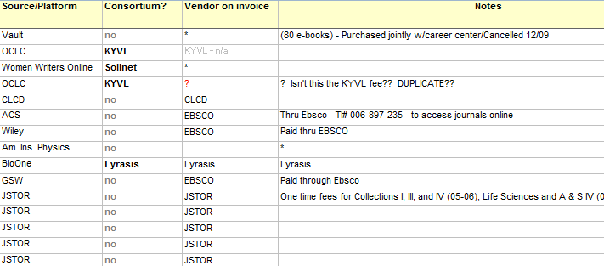
Database Tools
“The Sharepoint Spreadsheet” – Over 170 licensed eResources tracked
Notes:
Drawbacks of Sharepoint:
Interface has some glitches – sometimes users end up in endless login loop
Folder/file structure not easily changed. Cannot move files from one folder to another.

Slide 8
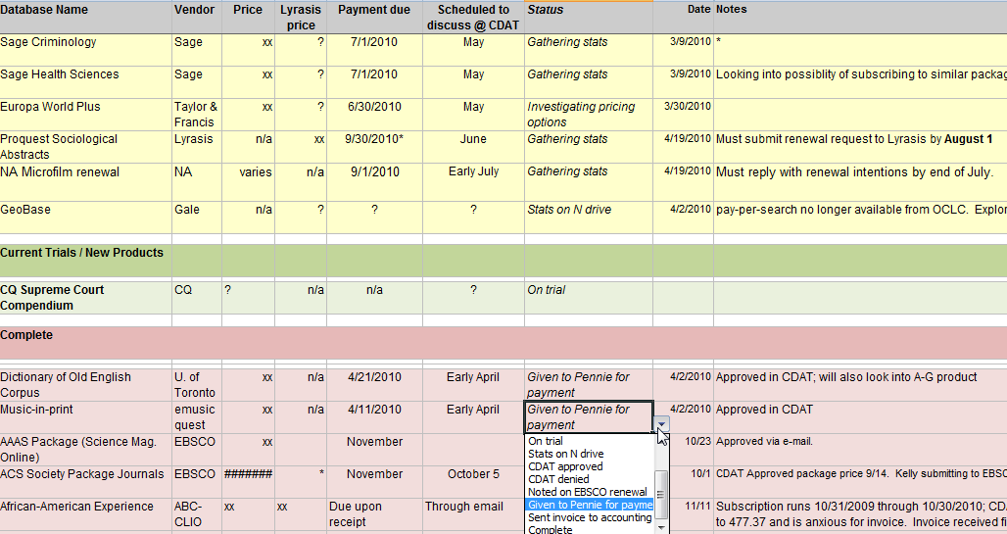
Database Tools
“The Sharepoint Spreadsheet” – Renewals Tab
Notes:
Separate tab to track a specific workflow - renewals

Slide 9
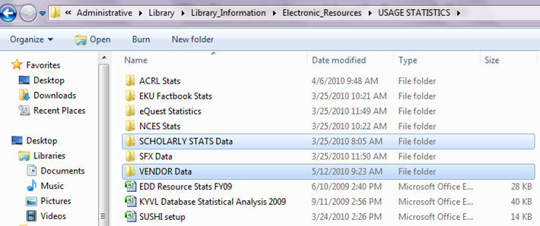
Database Tools
“The N Drive” – Usage Stats Folder
Notes:
Ndrive (our shared network drive)
Benefits to this tool
Good for storing and organizing sets of files = virtual file cabinet.
Drawbacks
There’s not a way to tell if someone else is currently editing, so when multiple people edit N drive documents, there’s a potential for version conflicts.
Not available from the web. Can use VPN to access, but this is more complicated.
For stats, no way to pull reports. Files are static. We will soon be tracking all of this in SFX’s USTAT service, which includes Sushi cabability as well as other more advanced reporting tools.

Slide 10
eBooks “Before” Process
Vendor
Acquisitions Staff
eResource Collection Librarian
eResource Support Staff
Tools
Paper Folder/File Cabinet
eBook order placed
eMail
Discover that record is needed.
Invoice in Voyager
Vendor Admin Sites
Voyager & Banner
OCLC
Import and edit MARC record file
MarcEDIT
End

Slide 11
eBooks “After” Process
Vendor
Acquisitions Staff
eResource Collection Librarian
eResource Access Librarian
eResource Support Staff
Tools
eBook order placed
Paper Folder/File Cabinet
Import and edit MARC record file
MarcEDIT
Notify eResource Librarian
eMail
Voyager & Banner
Vendor Admin Sites
Log Import file information
N Drive
OCLC
Notify Co-workers
eMail
eMail
Activate SFX Portfolios
Invoice in Voyager
SFX
Update non/NetLibrary holdings in OCLC
End
Notes:
Support staff integration? More complexity involved.

Slide 12
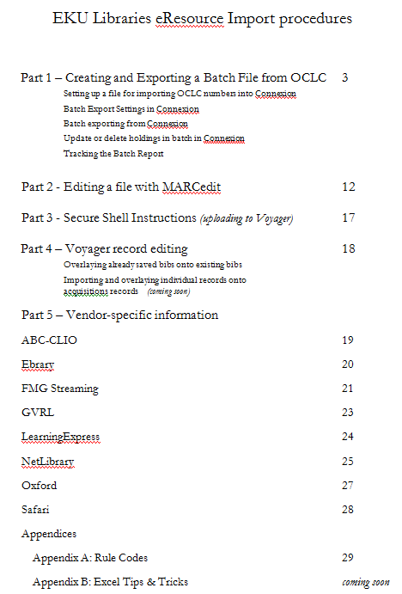
eBook Tools
Sharepoint Manual
Notes:
Having all the information about eBooks in one place is invaluable.
Details the differences between vendors.

Slide 13
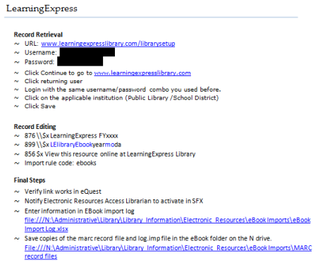
eBook Tools
Sharepoint Manual
Notes:
Example of vendor details
Record Retrieval details
Record Editing details
876 field for tracking fiscal year ebook purchases. is pulled into holdings record during bulk import.
899 field for tracking record file import names
856 field is pulled into holdings record during import
Process/follow through reminders.

Slide 14
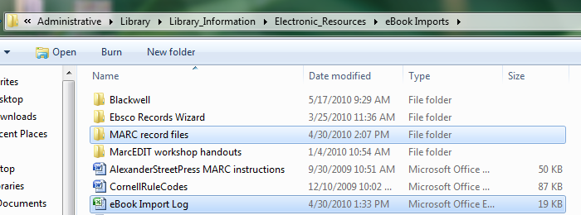
eBook Tools
N Drive
Notes:
N drive used for logging data and storing files. Simpler than using Sharepoint because Sharepoint requires more time consuming upload process. Shared drive is just drag and drop.

Slide 15
eBook Tools
N Drive Import Log
Notes:
~Recently standardized the file names.
~Can quickly sort and get numbers for reporting by publisher, etc.

Slide 16
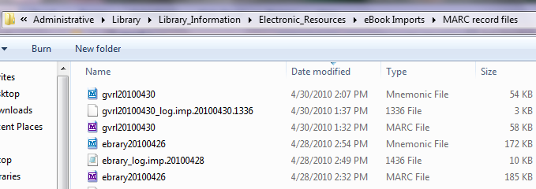
eBook Tools
N Drive Record File Folder
Notes:
~Use the Voyager import log to derive list of Bib numbers to forward to Acquisitions Staff
~Use the marcrecord file to derive list of isbns for uploading to SFX

Slide 17
Journal Renewals Process
Data Source
eResource Collection Librarian
eResource Access Librarian
eResource Support Staff
Liaisons
Tools
Renewal cycle begins
Serial Change spreadsheet
Voyager
Compile print usage data
Gather online usage data
Scholarly Stats
eResource Librarians meet with Liaisons
Make notes (access issues, alternate availability, etc.)
Voyager
Vendor websites
Renew, cancel, or change format
Submit changes to Ebsco
Ebsconet
SFX
Activate / deactivate online
Make notes in Acquisitions module
Begin closeout process

Slide 18
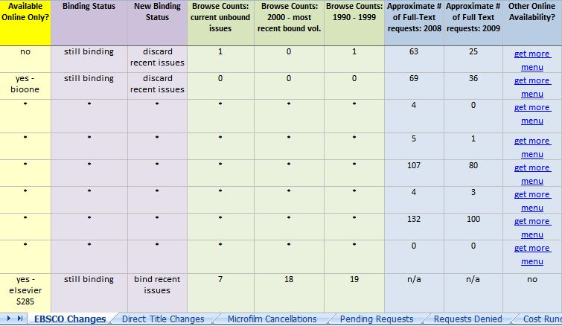
Sharepoint Serial Change List
eJournal Tools
Notes:
Serial change list is based on report generated from Ebsco
Includes data liaisons can use to make decisions – will be maintained list to list so data does not need to be re-entered
Helps cont. resources team track close-outs, online activations, reasons for cancellation

Slide 19
Sharepoint Title Change List
eJournal Tools
Notes:
Serial workflow list tracks title changes (cancellations, print to online, title changes)
Used to be one title per document, printed out – who was keeping track of these?
decided that spreadsheet more efficient, keeps info in one place, helps cont resources staff member with binding
Problems – yet another spreadsheet to keep track of, confusion over who marks each title complete in the spreadsheet (staff member who touches title last not comfortable)

Slide 20
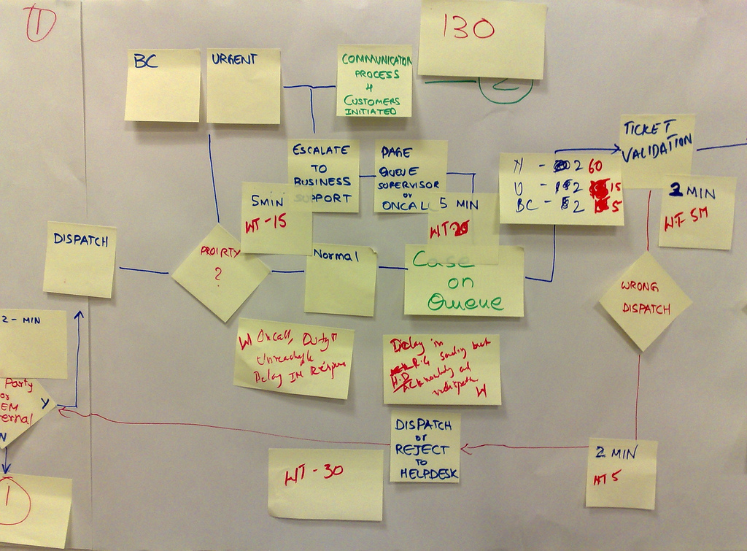
Next Step: How to *Manage* workflows
Image credit: http://www.flickr.com/photos/38033723@N00/3285689600/
Notes:
Next step: Identifying a tool that helps manage the workflow.
Discuss failure of most ERM systems to achieve this. Typically ERMs are containers for “stuff” that require a lot of manual entry. “Ticklers” and “Reminders” are not adequate substitutes for actual workflow management.
We are exploring 2 possibilities:
FOOTPRINTS TICKETING SOFTWARE
Benefits:
“free”
Will allow us to track workflow from staff member to staff member.
Central space to store correspondence about a resource – can get stuff out of hidden email folders.
Drawbacks:
Extended set-up time – relying on campus IT to get it started
Does not talk to existing library tools.
ERM ESSENTIALS
Benefits:
Integrates some existing tools (EBSCOnet)
Built on existing knowledge base – limits need for manual entry
Reporting functions
Will eventually have usage stats service integrated in the software.
Drawbacks:
$$
Non EBSCO purchased material requires manual entry

Slide 21
Thank You!
Laura Edwards
Electronic Resources Access Librarian
Eastern Kentucky University Libraries
laura.edwards@eku.edu
Kelly Smith
Electronic Resources Collection Librarian
Eastern Kentucky University Libraries
kelly.smith2@eku.edu

