Slide 1
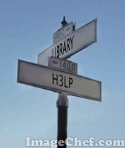
Julie George and Cindy Judd Eastern Kentucky University
Reference Service with LibraryH3lp

Slide 2
Our Story
LibraryH3lp – Basic
Perspective of patrons calling and staff answering the calls.
LibraryH3lp – Advanced
Widgets, Gateways, Queues, Users, and more.
Your Questions and Comments
Overview of Today’s Presentation

Slide 3
IM@EKU
Spring 2007
Fall 2006
Meebome: required shifts, PR push
GAIM:
volunteers,
min. PR
Changes needed: staffing model, IM aggregator, transcripts
Initiate our IM service
Introduce
LibGuides
2008
Fall 2007
Introduce IM widget
Meebome: required shifts, more widgets
Changes needed: IM hours, more widgets, stats form
Meebome: required shifts, more widgets
Changes needed: flexible staffing, easier stats
Fall 2009
Spring 2010
LibraryH3lp:
keep meebome widgets; change to LH3lp widgets in Spring
LibraryH3lp:
staff at ref.desk; add LH3lp widgets; add SMS service
Future?

Slide 4
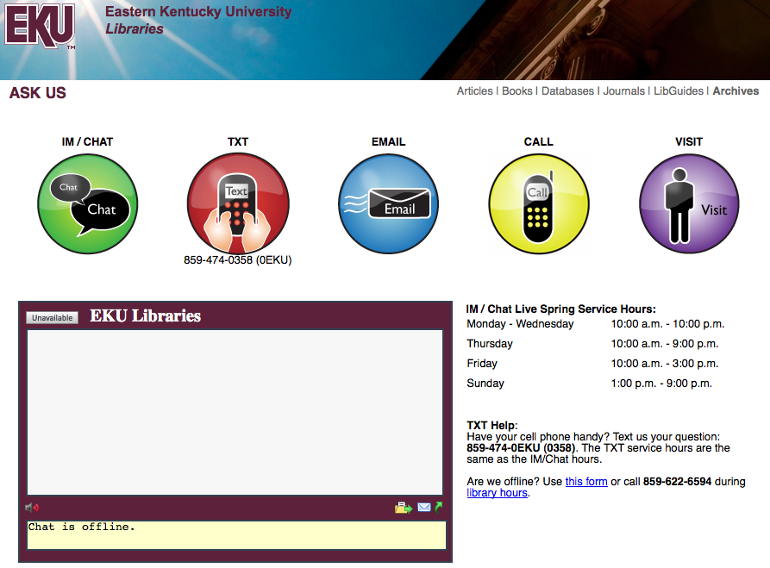
LibraryH3lp – Patron View – Widget

Slide 5
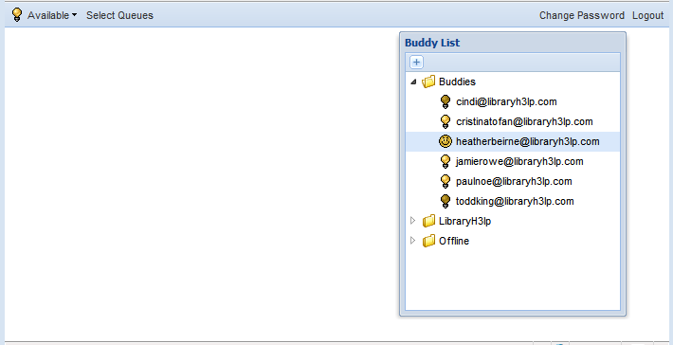
LibraryH3lp Web Client
LibraryH3lp – Staff View

Slide 6
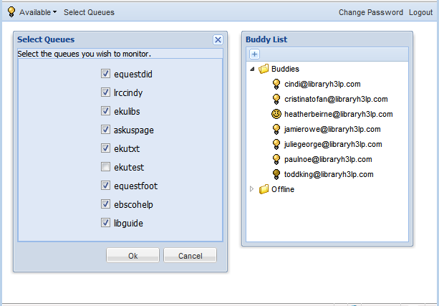
LibraryH3lp – Staff View – Login (Queues)

Slide 7
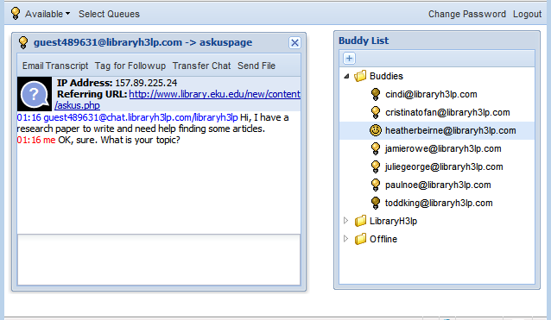
LibraryH3lp – Staff View – Answering

Slide 8
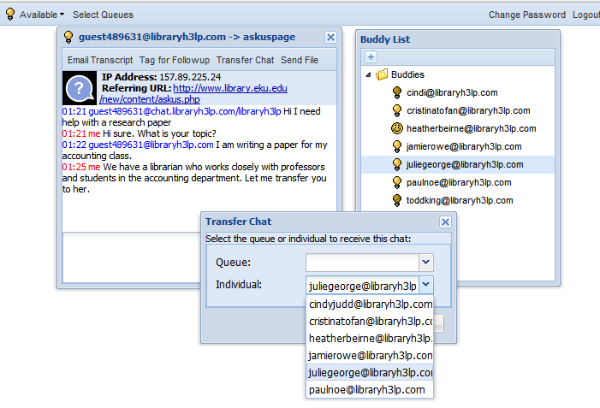
LibraryH3lp – Staff View – Transferring

Slide 9
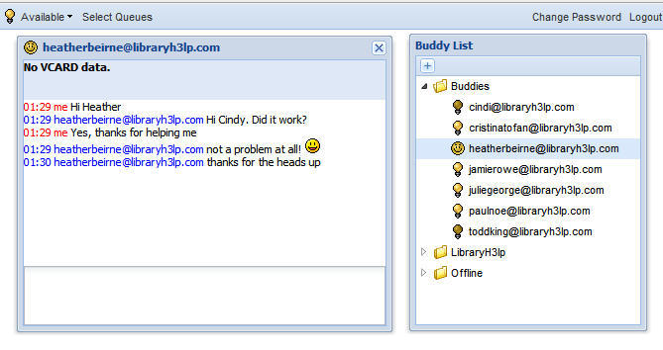
LibraryH3lp – Staff View – Staff to Staff

Slide 10
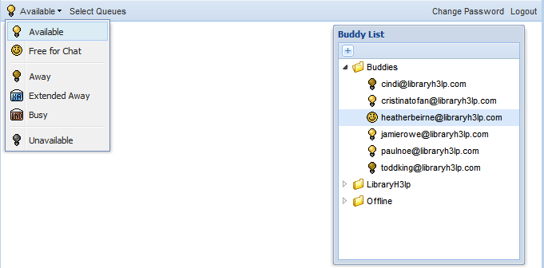
LibraryH3lp – Staff View – Status

Slide 11
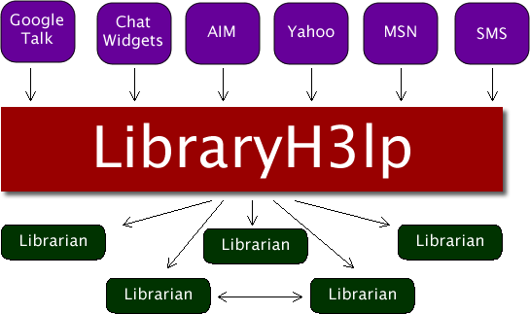
LibraryH3lp – Simple Overview

Slide 12
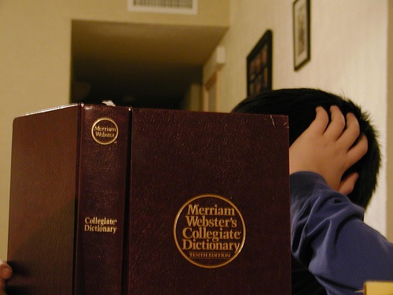
LibraryH3lp Terms
Notes:
http://www.flickr.com/photos/jaboney/390315232/

Slide 13
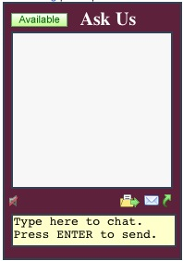
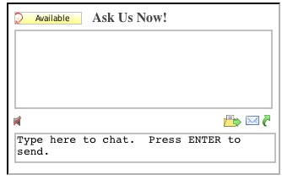
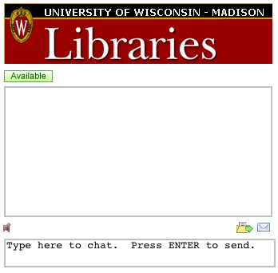
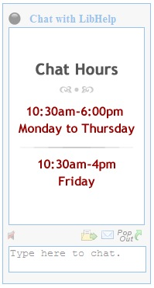
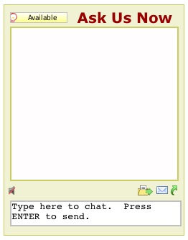
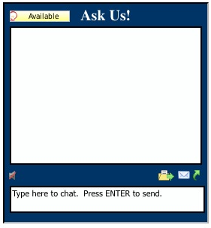
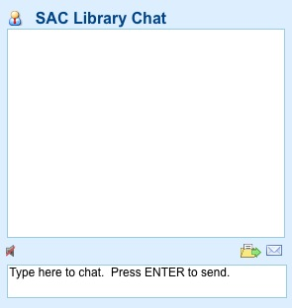
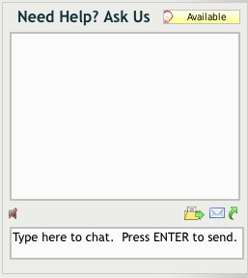
Widgets
a box on a web page in
which patrons type questions
LibraryH3lp Terms
Notes:
Either the patron puts a question into a widget or...

Slide 14
Routes IM or SMS traffic to a queue
Gateway
LibraryH3lp Terms
Notes:
Gateway = connects a service to libraryh3lp (accepts questions from IM/SMS services and puts them in queue.)
http://www.flickr.com/photos/kristi–san/160577974/
Libraryh3lp uses gateways in a manner similar to meebo: a way of routing all a library’s IM traffic into libraryh3lp.
Gateways connect a service to libraryh3lp by accepting questions from IM/SMS services and putting them into a queue
...or a patron asks a question via their own IM client or via SMS on their cell phone.

Slide 15
Queue
Routes
questions to
users
LibraryH3lp Terms
Notes:
http://www.flickr.com/photos/anjin/141922192/
A Queue acts as a traffic control tower, routing questions from patrons to multiple librarians monitoring a queue. The first person to respond “owns” the question. Any library h3lp user can belong to more than one queue. A widget can only serve one queue.
Given all these pieces, how do they work together to enable patrons to ask questions?

Slide 16
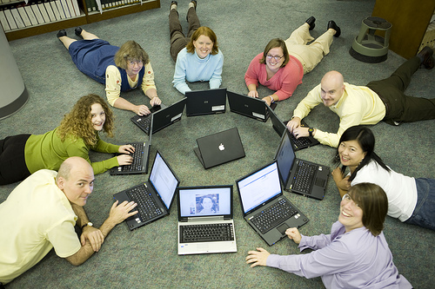
Users = Library Staff
LibraryH3lp Terms
Notes:
Users in the context of this presentation are library staff.

Slide 17
So how does it work?
LibraryH3lp
Notes:
http://www.flickr.com/photos/sunface13/2597074553/
Given all these pieces, how do they work together to enable patrons to ask questions?

Slide 18
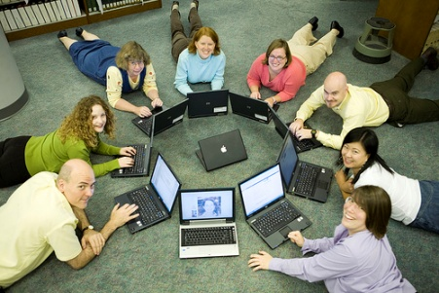
Question –> Widget –> Queue –> Users
LibraryH3lp – Call Routing
Notes:
Option 1: A question is typed into a widget, which gets put into a queue that users are monitoring. The first user to answer the question then “owns” it.

Slide 19
Question –> Widget –> Queue –> Users
Question –> IM –> Gateway –> Queue –> Users
LibraryH3lp – Call Routing
Notes:
Option 2: A question is typed into an IM client or into a TXT message on a cell phone, is routed through a gateway to a queue, which then routes to all users monitoring that queue.

Slide 20
Question –> Widget –> Queue –> Users
Question –> IM –> gateway –> queue –> Users
Question –> Widget –> User
LibraryH3lp – Call Routing
Notes:
Option 3: A question is typed into a widget that does not go into a queue but directly to a user. The catch with this approach is that transcripts are only retained when there is a queue involved.

Slide 21
Question –> IM/Widget –> gateway –> queue
–> user –> user or queue
–OR–
LibraryH3lp – Call Routing: Transfers
Notes:
Option 2: A question is typed into an IM client or into a TXT message on a cell phone, is routed through a gateway to a queue, which then routes to all users monitoring that queue.

Slide 22
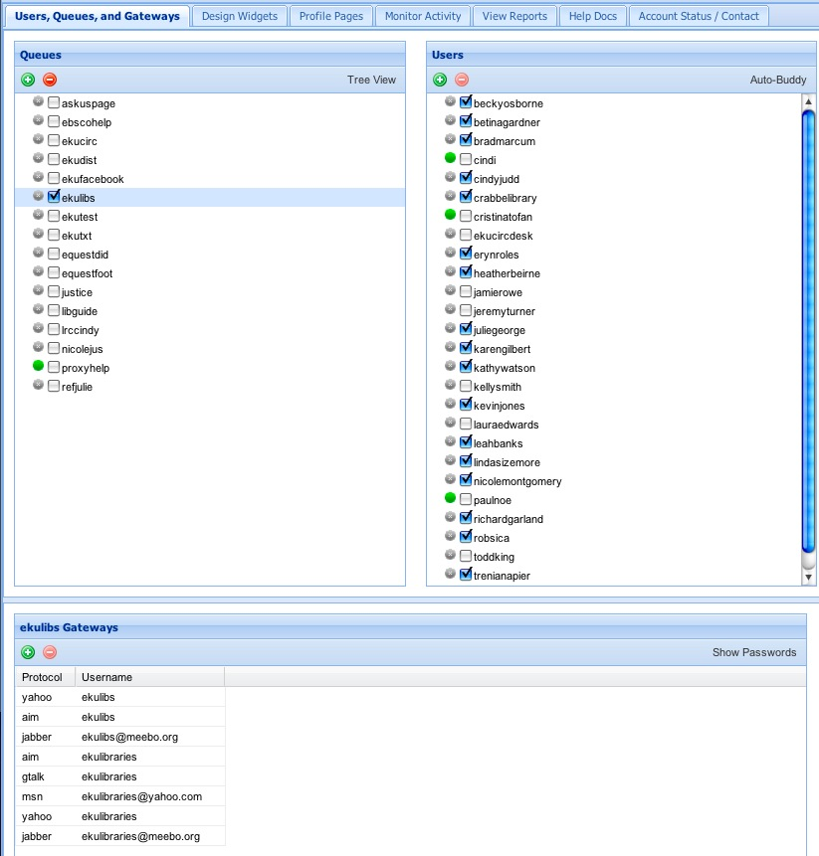
queues
LibraryH3lp – Administration Module
Notes:
screenshot with added stuff to show what a queue is, gateway, user, etc.
just an introduction of what this looks like – map the terms that were just illustrated onto the real life look of libraryhelp.

Slide 23
queues
gateways
LibraryH3lp – Administration Module
Notes:
screenshot with added stuff to show what a queue is, gateway, user, etc.
just an introduction of what this looks like – map the terms that were just illustrated onto the real life look of libraryhelp.

Slide 24
queues
users (library staff)
gateways
LibraryH3lp – Administration Module
Notes:
screenshot with added stuff to show what a queue is, gateway, user, etc.
just an introduction of what this looks like – map the terms that were just illustrated onto the real life look of libraryhelp.

Slide 25
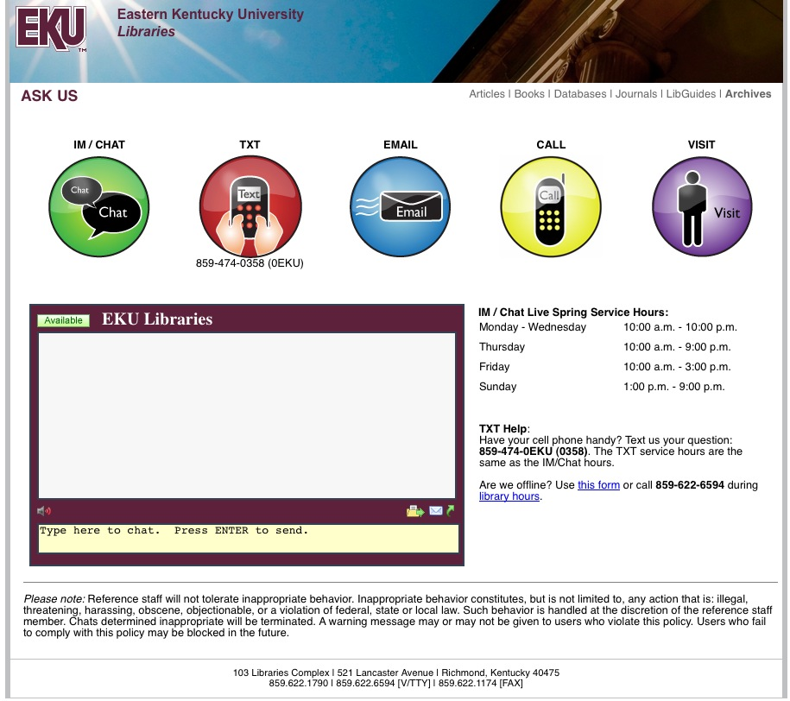
Library homepage LibGuides
EBSCO databases Library OPAC
Individual librarians’ Facebook
webpages
IM: ekulibraries
LibraryH3lp – How Users Get to Us
Notes:
EKU
widgets in libguides, catalog, ebsco
pop–up widget with ask us page
adding SMS

Slide 26
LibraryH3lp – How We Staff Our Service

Slide 27
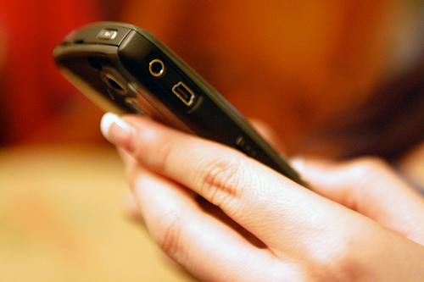
LibraryH3lp – New Txt-Us Service

Slide 28
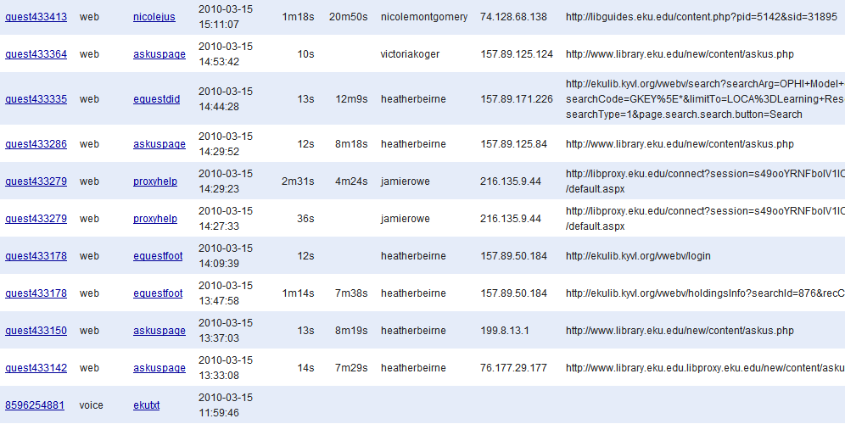
Sample Report of the LibraryH3lp Transactions on 3/15/10
LibraryH3lp – Other Ways We Use Queues

Slide 29
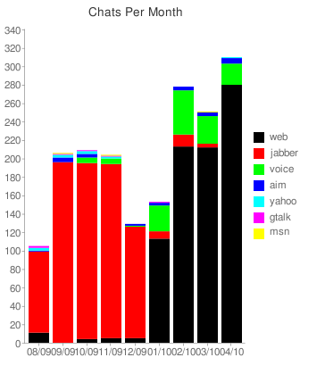
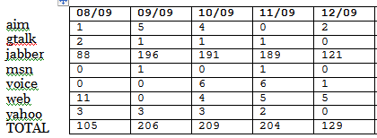
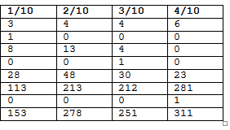
LibraryH3lp – The Impact of Queues

Slide 30
LibraryH3lp Blog: http://libraryh3lp.blogspot.com/
LibraryH3lp Documentation/FAQ: http://libraryh3lp.com/docs/h3lp
LibraryH3lp Google Group http://groups.google.com/group/libraryh3lp
LibraryH3lp Twitter http://twitter.com/libraryh3lp
LibraryH3lp – URLs

Slide 31
Reference Service with LibraryH3lp

Slide 32
“Torii Sunset, Miyajima” cc:by-nc-nd | http://bit.ly/dCXFEk
“Changi Airport Air Traffic Control” cc:by | http://bit.ly/dvwWAU
“LuMaxArt FS Collection Orange0010” cc:by-sa | http://bit.ly/amLszD
“LuMaxArt FS Collection Orange0029” cc:by-sa | http://bit.ly/a484x8
“Workgroup SpectrumG03515” cc:by-sa | http://bit.ly/bLsCwq
“Read a book ((@^f&&@!!” cc:by-nc | http://bit.ly/aTLkRU
“Texting” cc: by-sa | http://bit.ly/b3nsLb
“Questions” http://bit.ly/d8FPgS
All other images by the presenters or used with permission
Image Credits

Slide 33
Kentucky Library Association
Spring 2010 Conference
Julie George
Reference Team Leader
Email: Julie.George@eku.edu
Chat: http://libguides.eku.edu/profile.php?uid=1298
Cindy Judd
Learning Resources Center Team Leader
Email: Cindy.Judd@eku.edu
Chat: http://libguides.eku.edu/profile.php?uid=1777
Contact Us

