Slide 1
CLEAN UP YOUR ACT! A Voyager Acquisitions/Serials Overhaul for Greater Efficiency
Kelly Smith, Eastern Kentucky University
Amy Tabb, Eastern Kentucky University
2010 KLA/KSMA Joint Conference
September 16, 2010

Slide 2
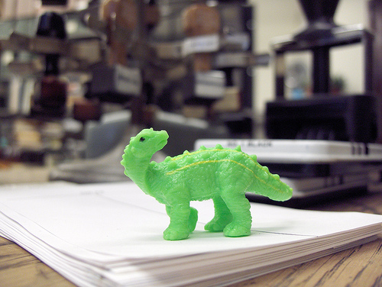
Problems with serial records @ EKU
Outdated fund codes
Rollover problems
EDI Invoicing problems
Record mismatches
Ordering problems
Inaccurate reports
Banner out of alignment with Voyager
www.flickr.com/photos/11099704@N02/42261842
Notes:
Electronic titles were haphazardly assigned to fund codes – there was no consistency, and there was overlap and duplication in the fund structure.
2) Commitments for continuing resources did not rollover correctly.
3) Order records were often not attached to the current cataloging record but instead to older versions of the title.
4) Lack of granularity prevented us from pulling applicable reports when gathering data to report to ACRL and other agencies
5) Occasionally, titles were renewed that were supposed to have been canceled.

Slide 3
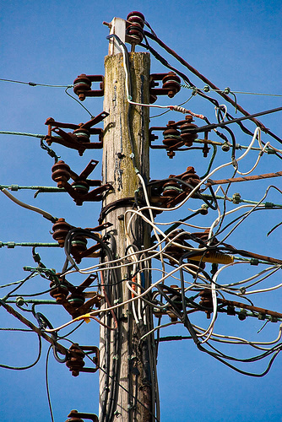
Causes
Print mindset
Dysfunctional processes
No documentation of processes
Banner structure not parallel with Voyager structure
www.flickr.com/photos/townendphotography/4133696990/
Notes:
Fund codes became outdated as new formats emerged but the staff handling acquisitions did not rethink the structure of the fund code. New categories were tacked on rather than integrated. There was no attempt to track the formats of existing or new serial titles.
2) Problems related to the rollover, record maintenance, and mistaken renewals all stemmed primarily from an outdated workflow in which acquisitions and continuing resources staff had two separate sets of workflows and procedures rather than an integrated process. Additionally, staff who had been employed the longest relied on processes and procedures they had developed in their heads and never documented.

Slide 4
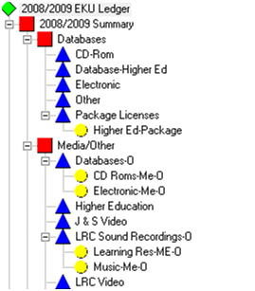
Ledger Structure Overhaul FY2010
SC=Serials Combo
SE=Serials Electronic
SF=Serials Fiche/film
SP=Serials Print
ME=Monograph Electronic
MK=Monograph Kit
MM=Monograph Media
MP=Monograph Print
Notes:
We decided to tackle the fund structure first to get a better handle on how things were being purchased.
Previous ledgers, including the example here from the 2008/2009 fiscal year, were based on print resources, with extra funds tacked on to account for media.
There was much duplication in the ledger, which included categories for media, video, and sound recordings.
Previous ledger allocated money to each discipline in serials. Starting in 2009/2010, we used reporting funds to track the disciplines and their spending habits, and kept the money in one big bucket called “Serials.” This made it much easier to pay invoices without having to transfer money to a certain discipline if it had run out of funds due to additions or price increases.
To allow for more granular reporting, specifically in relation to electronic resources and online periodicals, reporting funds were added to the 2009/2010 ledger.
The reporting funds for serials are SC (serials combo), SE (serials electronic), SF (serials fiche), and SP (serials print).
The reporting funds for monographs are ME (monographs electronic), MK (monographs kit), MM (monographs media), and MP (monographs print).
Subject liaisons may now spend any of their allocation on media, rather than having money specifically allocated in a separate media fund.

Slide 5
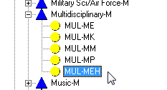
Ledger Structure Refining FY2011
2009/2010 EKU Ledger
2010/2011 EKU Ledger
Notes:
For the current fiscal year we made additional refinements – adding additional reporting funds under ILL to address new expenditures such as pay per view. We also added an “h” designator for one-time spend eresources with ongoing hosting fees.

Slide 6
Aligning the Acquisitions, Serials Check-in, and Cataloging Records Phase 1: Exploration
Pre-rollover clean-up
Attached order records to the correct cataloging records
Added components
Added a price to the p.o.
www.flickr.com/photos/twit2art/2860928844/
Notes:
After fund restructuring in the spring, we knew we would have to roll manually because there was no way to map the previous fund assignments to the new ledger – we would have to make the new assignments one by one for over 1500 continuing resource titles. We used this as an opportunity to try to clean up the records based on the assumption that perhaps the records needed to have components added in order to rollover. We took a Voyager acquisitions webinar training which seemed to confirm this. We spoke with librarians at several other institutions who said that whether something would roll was “unpredictable.” We decided to test out our assumption anyway, so during fall 2009 and spring 2010 we manually rolled all serial titles, adding components to them and making sure that a price was entered on p.o. so that commitments could be tracked – in the past, some of these p.o.s had line item prices entered and some were zeroed out.

Slide 7
Aligning the Acquisitions, Serials Check-in, and Cataloging Records Phase 1: Exploration
Post-rollover observations
Still had rolling problems (see handout)
Some continuing resources had been marked as “firm” order types
Vendor IDs not entered consistently
www.flickr.com/photos/twit2art/2860928844/
Notes:
After spending several months completing this clean-up project, we did a rollover and analyzed the results. We found that there were still problems with the roll and we identified additional problems as well. We identified and took screenshots of several titles that did not roll correctly. We asked our Voyager administrator to restore to pre-roll status, and then did several different types of tweaks on the titles we had identified to see which would result in a successful roll. Then we did the rollover again and checked each title to see what happened. You can see a few of our examples on the handout.

Slide 8
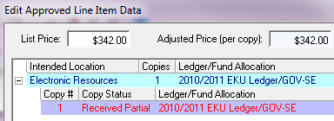
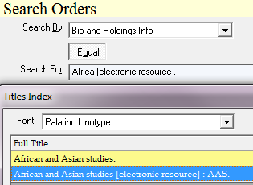
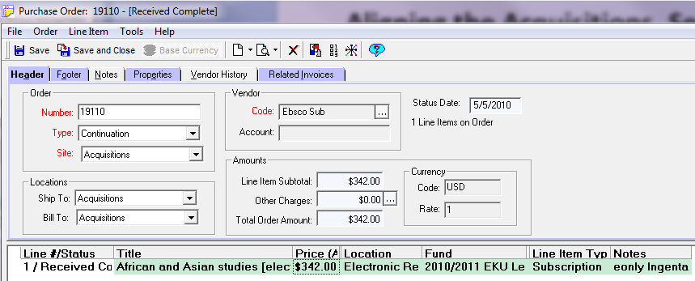
Aligning the Acquisitions, Serials Check-in, and Cataloging Records Phase 2: Fixing the problems
Notes:
Using EBSCAN document, systematically going through each title to:
Verify order records attached to correct cataloging records (e to e; p + e to p; etc.)
Enter List Price if needed
Manually roll things that didn’t roll correctly into correct fiscal year
.. And…Next slide

Slide 9
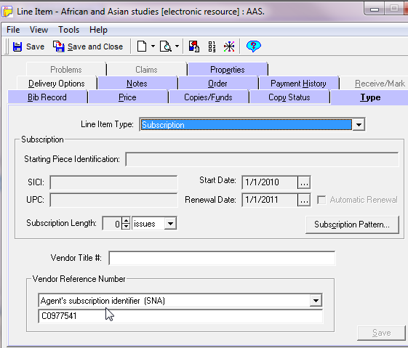
Aligning the Acquisitions, Serials Check-in, and Cataloging Records Phase 2: Fixing the problems
Notes:
Enter new Vendor ID number on type tab.
And… next slide

Slide 10
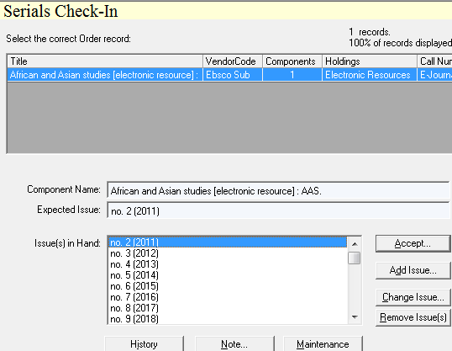
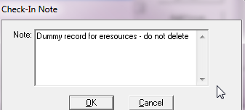
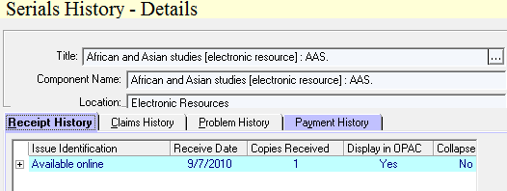
Aligning the Acquisitions, Serials Check-in, and Cataloging Records Phase 2: Fixing the problems
Notes:
Perhaps most importantly, made sure to set up check-in patterns for EVERYTHING – including for eresources. Although leaving a p.o. in approved/sent status will allow it to roll, if any invoice is ever accidentally received and there are no expected issues, the p.o. will stop rolling. We set these up as annual renewals on Jan 1.
Cue arrow: Edit and display recent checked in issue with “Available Online”

Slide 11
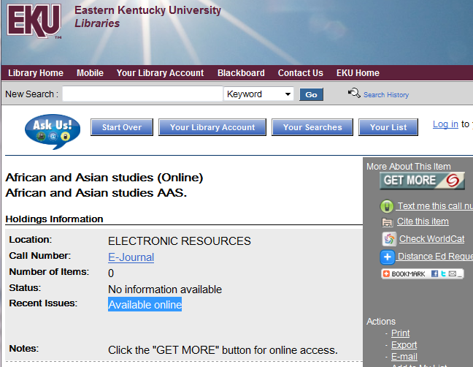
Aligning the Acquisitions, Serials Check-in, and Cataloging Records Phase 2: Fixing the problems
http://ekulib.kyvl.org/vwebv/holdingsInfo?bibId=813800
Notes:
“Checked in” issue will display as “Available online” in catalog.

Slide 12
How the changes improved workflow…

Slide 13
…fixed annual rollover process (we think)
http://www.flickr.com/photos/davehamster/4019175764/
Notes:
1) More titles are moving to online only, so we are creating new POs to show a more accurate picture of what is being paid for, rather than continue to pay for an electronic resource on an old print record. We will see in July how effective it was.

Slide 14
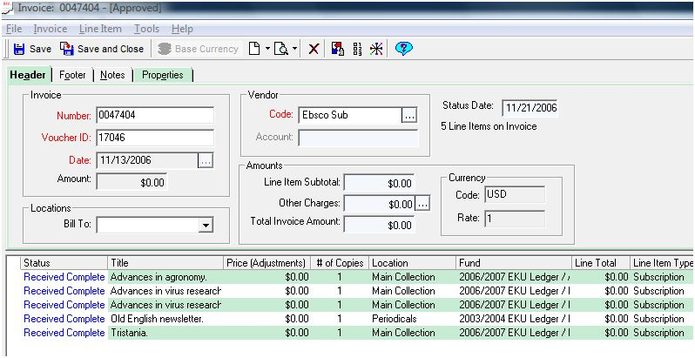
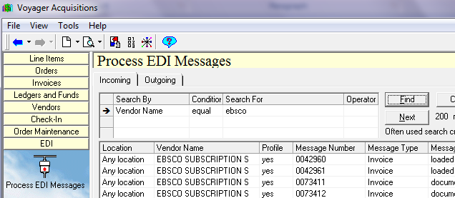
…fixed EDI invoicing (we think)
Notes:
EDI invoicing for the 2008/2009 fiscal year was difficult.
Many of the line items on the renewal list invoices did not pull in the title on the current fiscal year.
I had to then manually roll each of those line items into the current fiscal year so that I could pay the invoice in Voyager.
There were 934 lines with prices on 27 EBSCO invoices. There were perhaps a dozen or more on each invoice that required a manual roll into the correct fiscal year.
These lines did not roll because the POs were not set up correctly.
Fiscal year 2008/2009 was still print oriented.
545 titles on the invoices were print.
136 titles on the invoices were print + online.
259 titles on the invoices were online only.
We hope that updating all the vendor IDs will alleviate this problem.

Slide 15
…resulted in better reporting capabilities
ACRL Question 22. One-time electronic resource purchases. Report expenditures that are not current serials (i.e. are non-subscription, onetime, or monographic in nature) for software and machine-readable materials considered part of the collections. Examples include periodical backfiles, literature collections, one-time costs for JSTOR membership, etc. ..
ACRL Question 23. Ongoing electronic resource purchases. Report subscription expenditures (or those which are expected to be ongoing commitments) for serial publications whose primary format is electronic and for online searches of remote databases such as OCLC FirstSearch, DIALOG, Lexis-Nexis, etc. Examples include paid subscriptions for electronic journals and indexes/abstracts available via the Internet, CD-ROM serials, and annual access fees for resources purchased on a “one-time” basis, such as literature collections, JSTOR membership, etc. ..
ACRL Question 26. Document Delivery/Interlibrary Loan. Report expenditures for document delivery and interlibrary loan services (both borrowing and lending). Include fees paid for photocopies, costs of telefacsimile transmission, royalties and access fees paid to provide document delivery or interlibrary loan. Include fees paid to bibliographic utilities if the portion paid for interlibrary loan can be separately counted..
*/&-#?! !
Notes:
Previously had no way to track this kind of granular information using Voyager – had to go by information on Excel spreadsheets, etc.

Slide 16
…resulted in better reporting capabilities
Notes:
Can pull reports and sort based on whatever criteria we need. Structure is more flexible.
We pulled a report based on invoices paid in the 2009/2010 fiscal year that had the fund codes D (database), ME (monographs electronic), SC (serials combo), and SE (serials electronic).
The report produced 915 line items paid for in that fiscal year. According to the report, we spent:
D--$488,494.59
ME--$64,324.17
SC--$34,620.41
SE--$376,211.83
We can compare these numbers to other Voyager reports, spreadsheets, and other reporting sources to see how accurate our reporting funds are. These numbers will be helpful when reporting to ACRL.

Slide 17
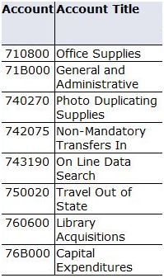
...and better reconciliation between Voyager and Banner
Banner structure
Fiscal Year 2009/2010
Banner structure
Fiscal Year 2010/2011
Notes:
To allow for better reconciliation between Voyager and Banner, we worked with the Banner and accounting offices to add more granularity to the Banner structure of the library’s materials budget.
These new sub accounts in Banner correspond more closely to how our ledger in Voyager is structured.
The sub accounts will make it easier to search Banner for specific payments or problems.

Slide 18
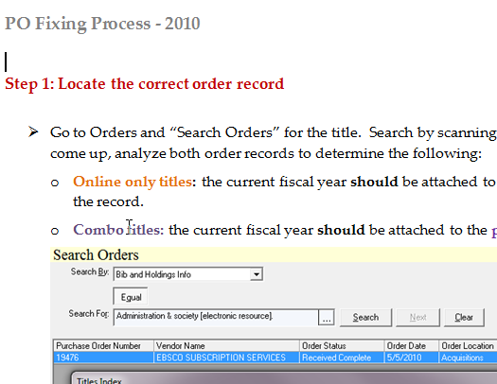
…improved communication & teamwork
Notes:
Improved communication btwn teams. Collaborating to establish more efficient workflows. Cross training acquisitions / serials.
Things are no longer “accidentally” ordered that have been canceled.

Slide 19
Thank you!
Amy Tabb
Library Specialist I
EKU Libraries
http://people.eku.edu/tabba/
Amy.Tabb@eku.edu
Kelly Smith
Continuing Resources Team Leader
EKU Libraries
http://libguides.eku.edu/profile/KellySmith
Kelly.Smith2@eku.edu

