Slide 1
Representing eJournals in the Library Catalog
Trying to Fit a Square Peg in a Round Hole?
Kelly Smith
kelly.smith2@eku.edu
Eastern Kentucky University
Brick & Click Libraries – Maryville, MO
November 2, 2007

Slide 2
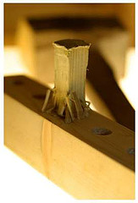
eRecords
The basic problem:
*Overwhelming number of online titles*
Additional problems:
Problems with vendor records
Same title with multiple vendors
Single vs. multiple record approach
Notes:
We’re all familiar with the problems faced when cataloging eJournals – I’m just going to briefly highlight them.
Daunting number of titles
Not possible to keep up-to-date manually, given the dynamic nature of online resources. How do we manage these records in a new way?
Problems with vendor records
Inconsistent quality
Need for local information
Volatility
No standard method
Same title with multiple vendors
If you’re bulk importing vendor records, you end up with multiple eRecords. What to do? You can’t just choose one over the others because the coverage may not overlap.
Single vs. multiple record approach
Single record not consistent with standard cataloging practice that separates formats
Multiple record confusing for patrons
In this presentation, I’d like to take you through the evolution of our attempts to solve these problems at EKU, talking a little bit about what worked and what didn’t work, and then I’d like to open up the discussion to find out your experiences.

Slide 3
MIXED RECORD APROACH EKU Experience - Part 1
Notes:
Added separate eHoldings records onto existing print Bibliographic records
Imported individual eBibliographic records if we didn’t hold the print already
3. Bulk imported EbscoHost records

Slide 4
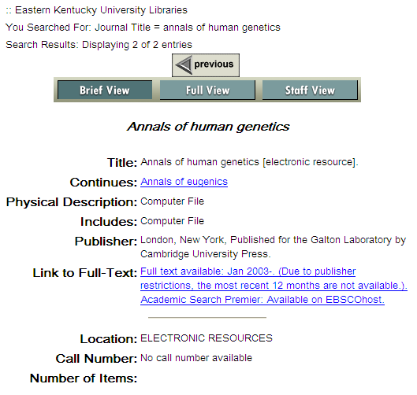
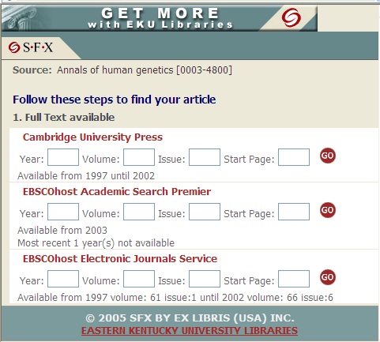
SINGLE RECORD
SEPARATE RECORD
Notes:
Problems with the mixed records approach:
Confusing for patrons – No connection between the catalog and our SFX openURL linker. Some availability information easy to miss - adds another layer of complexity to serial records. Very long records.
Accuracy- Difficult to keep links, availability information up-to-date, particularly on the single records.
In addition to the problems with linking, the records needed cleaning up. “1 copy received” - “cancelled 2003” - etc.

Slide 5
SEPARATE RECORD APROACH EKU Experience - Part 2
Notes:
Removed eHoldings from print Bib records and added separate eBib records
Still attempted to bulk import EbscoHost records
(Mold outbreak title)

Slide 6
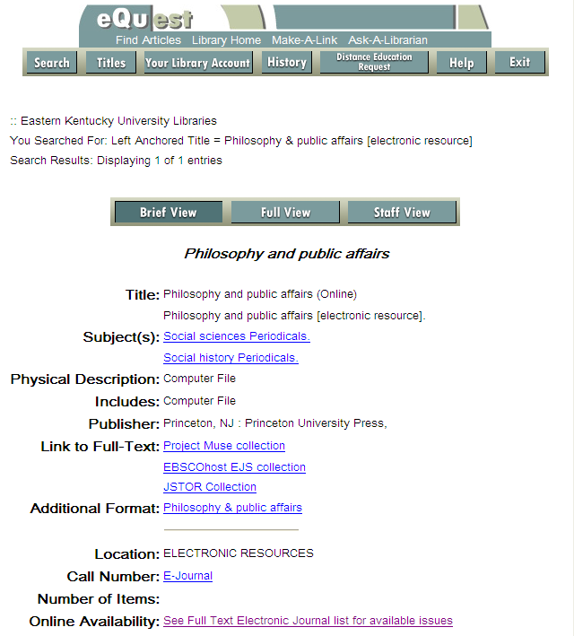
Print record
eRecord:
Notes:
Both records
Activated 776 linking field to connect print and electronic – “Additional Format” field
Added a call number to fix Voyager glitch
Print Record:
Added a note to call attention to online access
eRecord:
Linked to each journal collection
Added a hyperlink to our SFX Full Text Journal A-Z list to provide availability information – see next slide, then come back to this
Problems with this:
Still somewhat difficult to keep up-to-date
Confusing for patrons
Cluttered display
“Too many clicks” to find information

Slide 7
SFX A-Z List (linked from eRecord)
Notes:
So – all this availability information is not apparent in the catalog
>Go back to previous slide

Slide 8
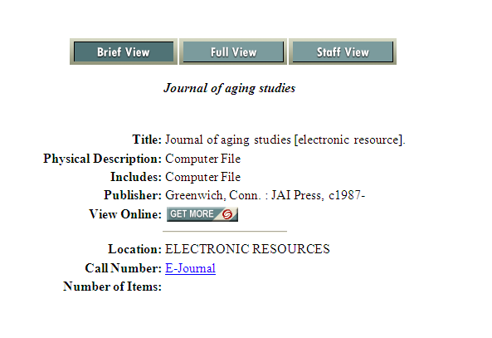
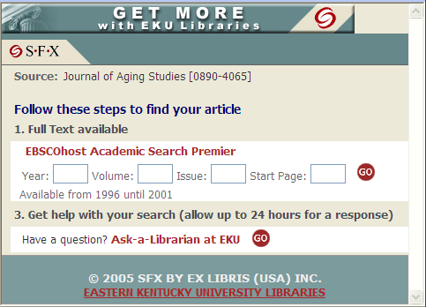
Dynamic Approach
EKU Experience - Part 3 (Implementing 2007)
Notes:
We recently found a solution that moves us back to a single record approach.
Several months ago, I noticed that Georgia Tech libraries had their SFX button integrated into the catalog record. We started to emulate their approach, manually adding the SFX “Get More” button to the 856 field instead of a direct link to the resource. Links and holdings are dynamically updated in SFX.
2. This allows us to remove the electronic bib and/or holdings records if we have something in both print and online format, because the online availability is updated dynamically through SFX.

Slide 9
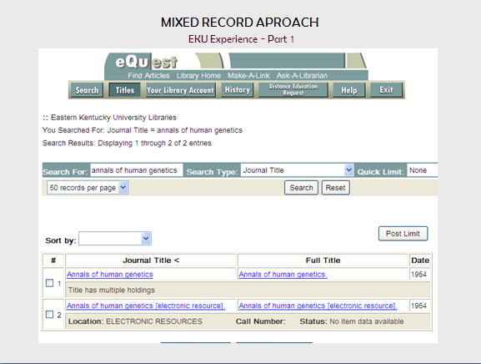
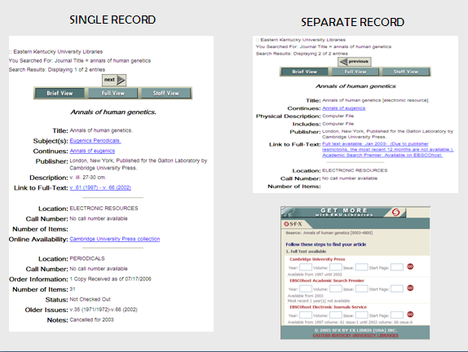
Remember this? …
Notes:
Patron had to view possibly 4 different screens to figure out how to get access to the particular issue they were in search of.

Slide 10
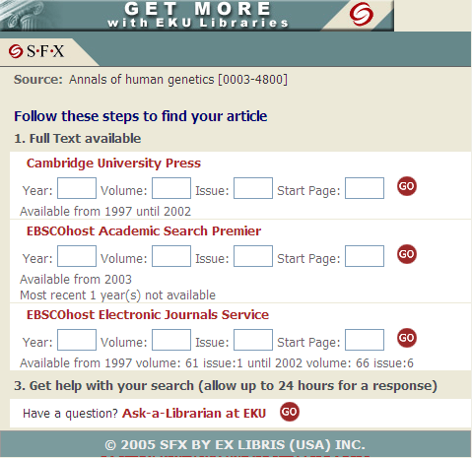
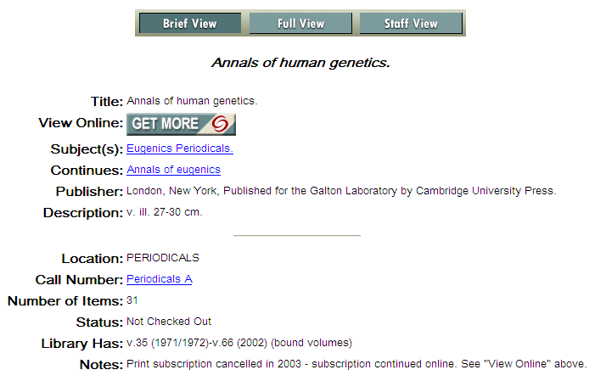
Isn’t this better? …
Notes:
After implementing the addition of the SFX button to our catalog by adding it to the 856, we discovered another refinement. Texas A&M University Libraries had implemented a programming solution that allowed Voyager to query the SFX database for all records with an ISSN field. This is truly dynamic – it doesn’t even require us to put the button address in the 856 field.
To further clarify our display, we also cleaned up some of the language
Added “View Online” for people not familiar w/get more button
Changed “Older Issues” to “Library Has” with “bound volumes” note. Since we also have “older issues” online, as well.
Expanded online access note to help patrons understand that our online access is by subscription and not just a “free” online resource.

Slide 11
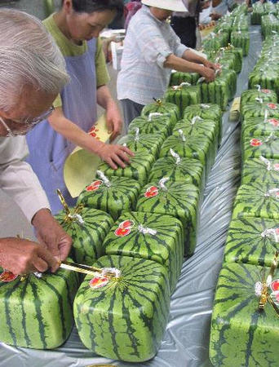
Problems solved with the Dynamic Approach…
No updating of links or holdings is required in the catalog. All updating is done in SFX.
Hopefully, the information is more clear and straightforward for patrons.
The display is much less cluttered.
But there are still glitches to work out…

Slide 12
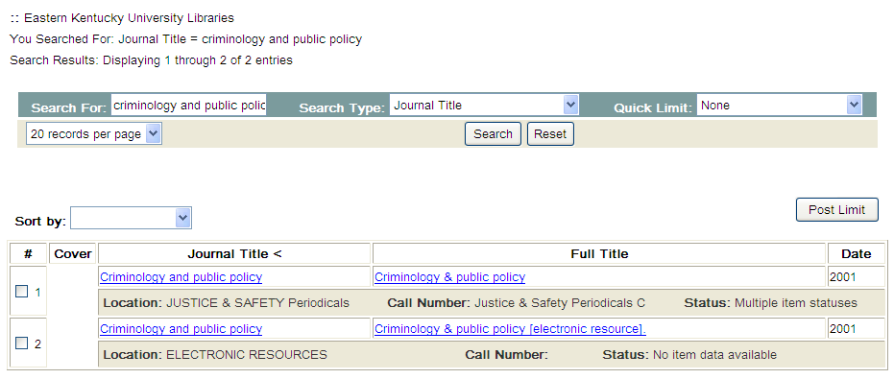
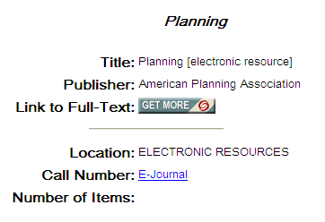
Aggregator records – to add or not to add?...
No indication in results list locations of electronic holdings…
Ebscohost generated record:
SFX generated record:
Notes:
GLITCHES
What to do about aggregator records? Aggregator database records that are generated by SFX and include the button. Elaborate deduping system may be necessary. Need to work out with systems administrator.
2) Results lists to not indicate existence of online holdings. Need programming solution. See Georgia Tech Libraries

Slide 13
Dynamic button glitches…
Notes:
Get more button not working the same for every record

Slide 14
The Future of eJournals at EKU
Next steps:
Work out glitches
Full journal list?
See University of Illinois at Springfield
Sort out impact of discovery tool
Unknown:
Introduction of non-MARC formats (FRBR) & new standards (RDA)?

Slide 15
Thank you!
Kelly A. Smith
Serials and Electronic Resources Librarian
EKU Libraries
Richmond, KY
Kelly.Smith2@eku.edu
http://www.library.eku.edu/
http://librarian1-5.blogspot.com/
Notes:
Questions? Comments? Your solutions?

Slide 16
Image Credits
Bibliography
"Cataloging Electronic Resources/Electronic Resources Display in the OPAC Task Force: Final Report." Illinois Library Computer Systems Organization. 8 Feb. 2005. Illinois Library Computer Systems Organization. Accessed 16 May 2007 <http://www.ilcso.uiuc.edu/Reports/iuagcater/040419_cater_final.pdf>.
Kemp, Rebecca. "Catalog/Cataloging Changes And Web 2.0 Functionality: New Directions for Serials." William Madison Randall Library. 12 Mar. 2007. Randall Library, University of North Carolina Wilmington. 16 May 2007 <http://library.uncw.edu/web/faculty/kempr/Kemp-Catalog-Web-2-0-2007-03-12.pdf>.
http://www.catalystconsulting.com/Principles.html
Accessed May 16, 2007
http://www.flickr.com/photos/m00by/453462303/
Accessed May 16, 2007
http://www.theharrowgroup.com/articles/20020923/20020923.htm
Accessed May 16, 2007
http://www.seabrooks.com/content/services/development.aspx
Accessed May 16, 2007
http://www.flickr.com/photos/rmc1969/156747508/
Accessed May 16, 2007

