Slide 1
Worst Case Scenario!
Julie Silver George and Clay Howard
Eastern Kentucky University Libraries

Slide 2
What do we know?
Notes:
Julie

Slide 3
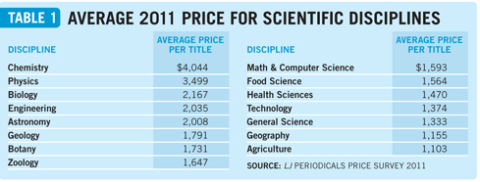
Journal Subscription Costs
Notes:
Julie
Costs of journals-both print and online are rising at a staggering rate

Slide 4
Library Budgets and
Materials Budgets
Notes:
Julie
Library and materials budgets are flat-at best

Slide 5
Money from State Government
Notes:
Julie
Money from state government is DOWN. 2003
EKU President Doug Whitlock “the percentage of financial resources the University receives from the state will likely continue to diminish. “We must not count on state appropriations keeping up with inflationary factors and enrollment growth.”
EKU’s budget used to be 75% from the state-25 from tuition and fees. Today it is 35% from the state and 65% from tuition and fees.

Slide 6
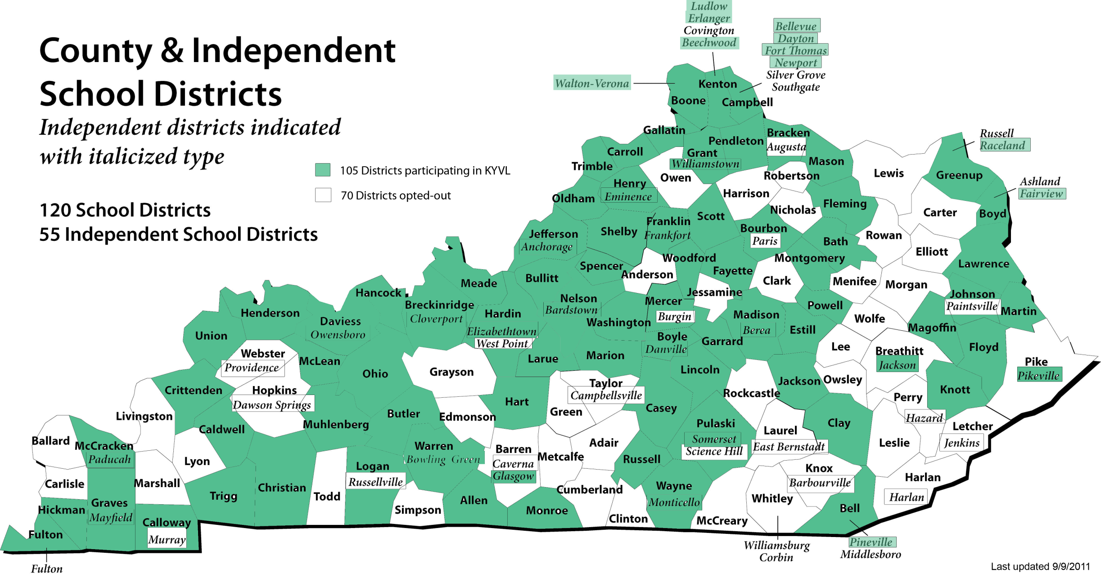
KYVL access
Notes:
Julie
Not everyone in the Commonwealth has access to Databases through KYVL. Some public libraries and public school systems chose NOT to have access
Thanks to Betsy Hughes from KYVL for this data

Slide 7
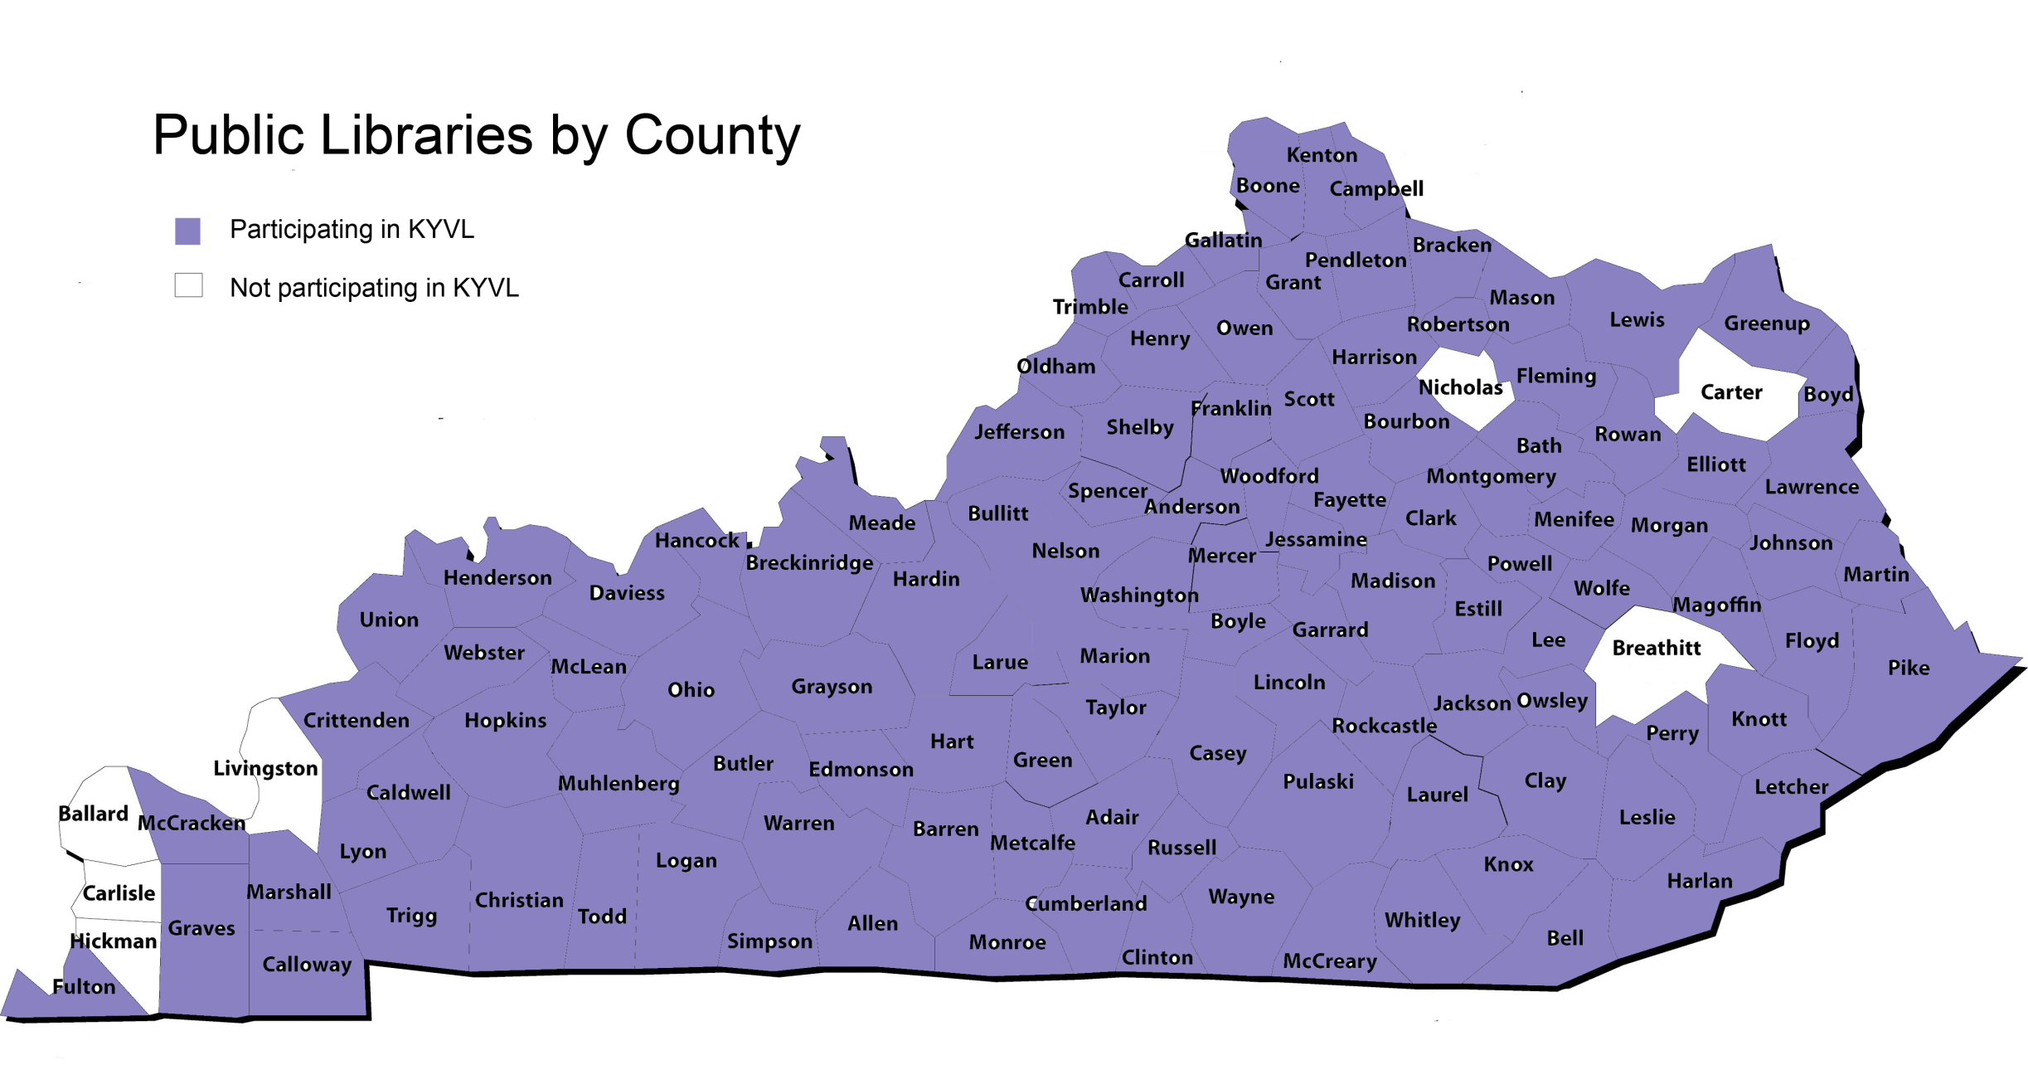
KYVL Access
Notes:
Julie

Slide 8
What Students Don't Know-Inside Higher Ed
"they were basically clueless about the logic underlying how the search engine (Google) organizes and displays results.“
"just because you've grown up searching things in Google doesn't mean you know how to use Google as a good research tool.“
“Students regularly used JSTOR to try to find current research on a topic”
“frequently students would be so discouraged they would change their research topic to something more amenable to a simple search”
“showed a complete lack of interest in seeking assistance from a librarian”
“students mentioned Google 115 times-more than twice as many as any other database”
Notes:
Julie
Article from August 22nd

Slide 9
Information Literacy
ACRL Standards
QEP initiatives
EKU- Critical Thinking
Morehead-Clear Thinking
UK Multimodal Communication Across the Curriculum
NKU Active learning and Critical thinking
Notes:
Julie
We think about Information literacy

Slide 10
So, what are WE doing?
Notes:
Clay

Slide 11
50 minute library instruction sessions
navigating the library website
searching library catalog
call numbers
physical location of things in the library
choosing the right database
finding the right database
how to type in what you’re looking for
boolean operators…
controlled vocabulary
subject headings
reading a results page in the database
how to get to full text
how to ILL
how to find the article in print
differences in scholarly v popular
evaluating information
how to ask for help from librarian
what else?
Notes:
Clay
What is truly a transferable skill?
What is global and what is local?
Should we be focusing on those local things?
What is valuable to the student? What will they be able to transfer to their personal life?
We spend a great deal of time on the “searching” aspect and that is only one piece of one ACRL standard

Slide 12
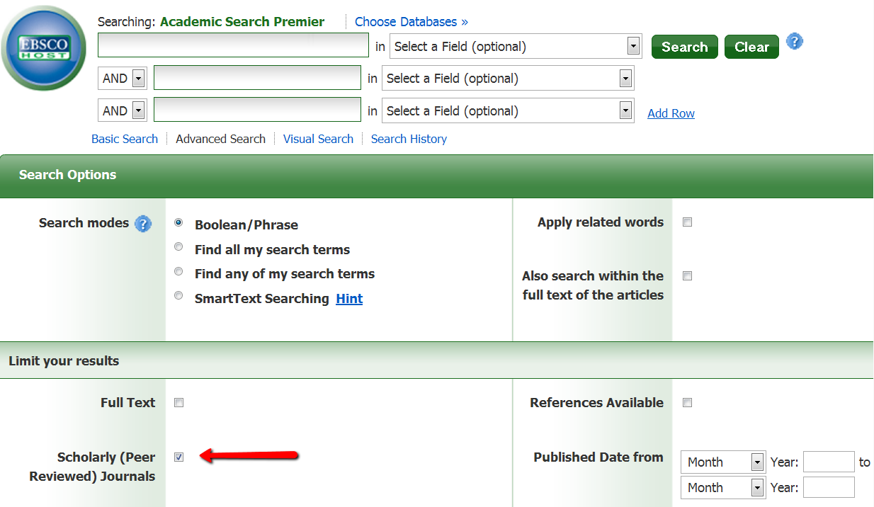
I am setting my students up for failure if this is all I teach them about finding reliable information.
Notes:
Clay
This is not all we are teaching them about evaluating resources but is this the only thing they take away? Probably.
Why? Because it is easy and makes sense.

Slide 13
Then…
Notes:
Clay
They graduate and what happens

Slide 14
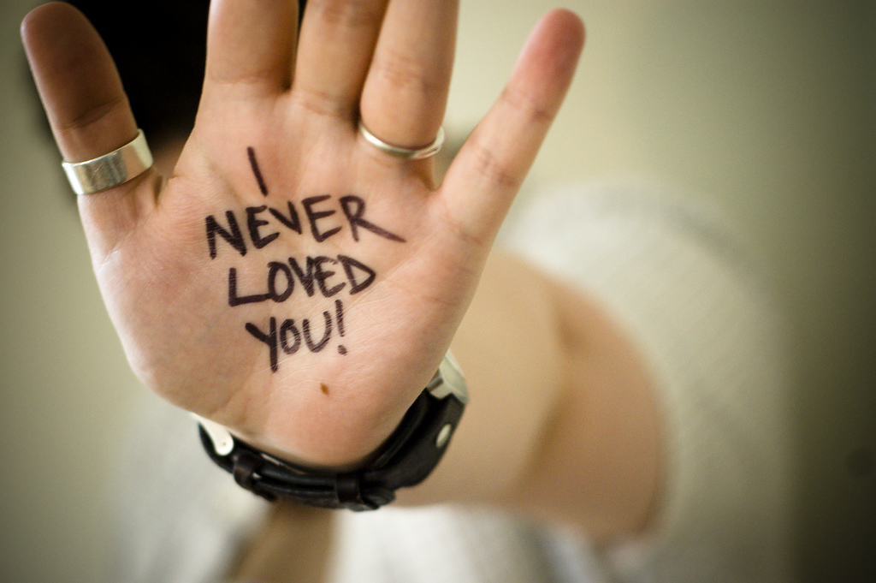
Notes:
Clay
We act like we never loved them-totally cutting them off
We teach them how to and upon graduation-we cut them off
Need info all the time
on the job
personal lives

Slide 15
Solution?
Notes:
Julie
Stop teaching how and where to click
Stop teaching local and focus on global
Teach the importance of creating a search statement
Teach the importance of evaluating information
Stop buying subscription databases????

Slide 16
What do they have access to?
Notes:
Clay
Will they go to the public library to research car seats??? Probably not.
What are some of your favorite open source resources?

Slide 17
Open Source
Pros
Cons
Notes:
Clay
What are the arguments against Google Scholar? Are they still accurate? Do they even matter to undergrads? How is this database better than Google Scholar?
2. Assuming the subscription product is better, is the advantage worth the money and resources that would have to be devoted to it?
The question used to be, is Google Scholar as good as this database? Now the tables have turned: See Chen's "The Declining Value of Subscription-based A&I Services in the New Knowledge Dissemination Era" March 2010 Serials Review:
Are commercial A&I services able to retrieve enough unique contents to justify their costs compared with all kins of free resources and services on the Web, including but not limited to Google Scholar.

Slide 18
How do we teach these global skills and still call it library instruction?
Notes:
Julie
Obstacles: faculty are expecting you to teach databases-Google and Wikipedia bad. They want us to talk about the value of the library resources-books, scholarly databases.
Teach Evaluating information skills and then have them find information at different sources and have them tell us why the source is good or bad
Wikipedia
Google Scholar
Google
???
Talk about different types of information: books, scholarly articles, conference proceedings…
No blogs, random websites in Google
So, if we had no access to these subscription databases-could we survive? Could we still offer library instruction? Could we still call ourselves librarians?

Slide 19
Creative Commons Photos
Slide 3
Slide 4
Slide 12
Slide 13

