Slide 1
CCC’s Get It Now Service as a Collection Development Strategy Pat New and Kelly Smith Eastern Kentucky University Libraries KLA/KSMA Joint Conference September 21, 2012
Slides at: http://tinyurl.com/cccKLA12

Slide 2
Why Get it Now?
Notes:
Quick turnaround time for article requests – hours vs. days. I requested an article last week that was fulfilled via Get it Now. I got the article 43 minutes after requesting it. Additionally, EKU has been moving toward a patron driven acquisitions collection philosophy and this brings that to the article level. We are able to provide articles “just in time.”

Slide 3
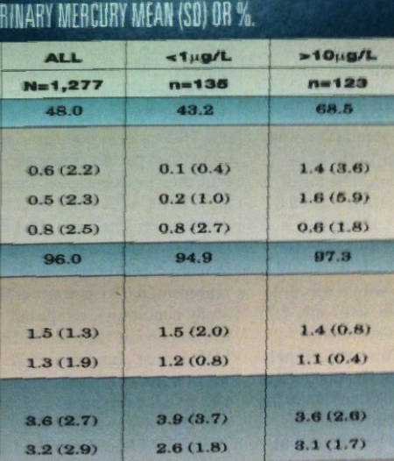
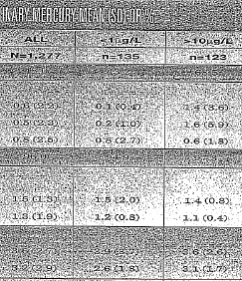
Why Get it Now?
Notes:
The ability to offer our patrons high quality, full-color PDFs from journals to which we cannot afford a subscription. This has been especially helpful for patrons in disciplines who need clear copies to be able to read graphs and other image-based article features. In the past, when patrons requested that we add subscriptions to these multi-thousand dollar journals, we could only apologize and offer inferior scanned ILL copies. Purchasing at the point of need rather than “just in case” makes much more sense for us in these cases. We can offer access to a broader range of content than we could otherwise if we had to pay for the full subscription.

Slide 4
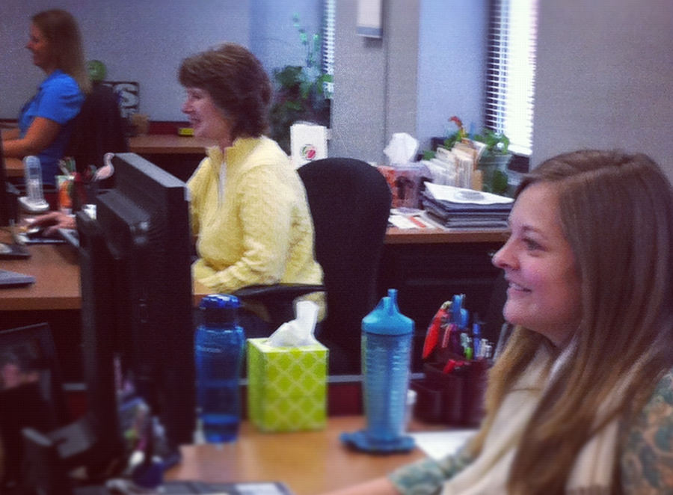
Why Get it Now?
Notes:
The fact that they offered a mediated option was essential. This allows us to monitor requests and pull back on orders depending on budgetary needs.

Slide 5
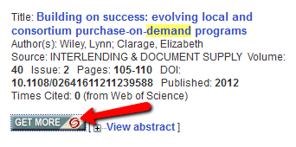
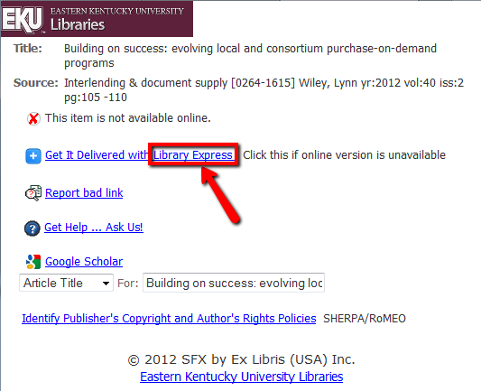
Why Get it Now?
Notes:
Although it is mediated, we are still able to offer our patrons quick turnaround time and ease of use due to seamless integration with our SFX menu and Illiad.

Slide 6
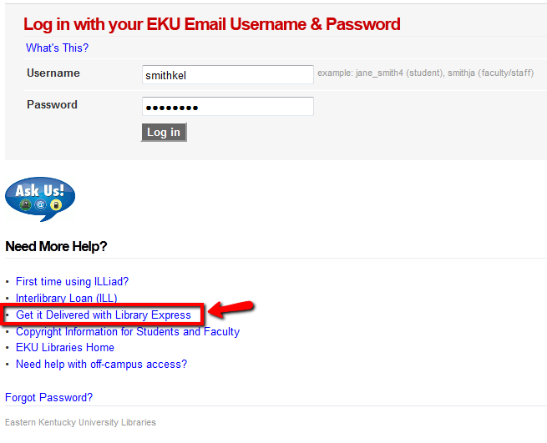
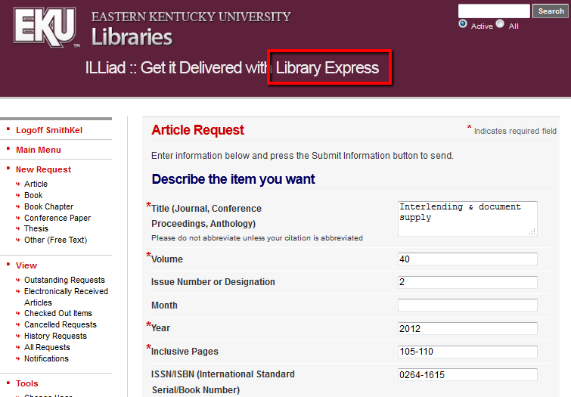
Why Get it Now?
Notes:
We use consistent branding that our patrons are familiar with. They cannot tell when a request is delivered via Get it Now or traditional ILL. They don’t have to fill in a different form or use a different login from any of our other document delivery services.

Slide 7
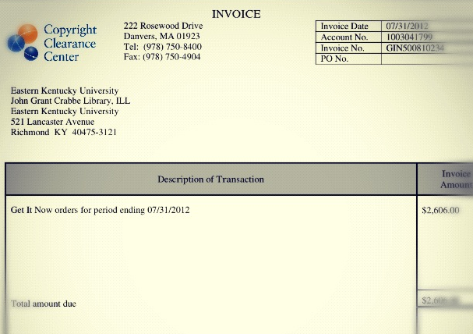
Why Get it Now?
Notes:
There are monthly invoices rather than a use-it-or-lose-it deposit accounts. With the token deposit accounts, in some years we predicted incorrectly and didn’t have enough deposited and in other years we deposited too much.

Slide 8
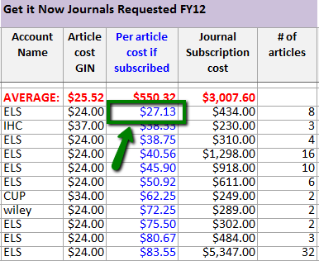
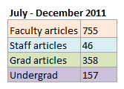
Why Get it Now?
Notes:
We saw this service as an additional way to inform future purchasing decisions, with detailed reporting indicating to the article level what was requested by faculty, staff, grad students, and undergraduates.
To help fund the service, we identified a number of low use journals that would have been canceled anyway and earmarked those funds for Get it Now
After one year, we have only identified one journal for which it will make economic sense for us to add a subscription, but with new publishers being added all the time to the service, that opportunity will only grow. It has also confirmed our decisions against adding subscriptions for other journals.

Slide 9
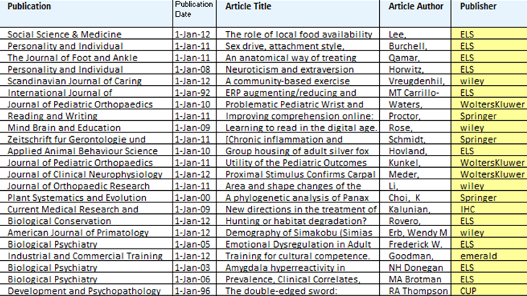
Why Get it Now?
Notes:
Seeing the articles that are being requested gives us a better understanding of the specific topics that are of interest to our patrons. This informs not only serial decisions but also points to potentially new areas for monograph acquisitions.

Slide 10
Current CCC Publishers/Prices (Sept. 2012)
AAAS
American Diabetes Association - $22
American Occupational Therapy
American Society of Clinical Oncology (ASCO)
American Society for Microbiology
American Society for Nutrition (ASN)
Am. Speech-Language-Hearing Association
Ammons Scientific
Bentham Science - $34
BioScientifica
Brill - $39
British Medical Journal - $30
Cambridge University Press - $34
The Company of Biologists - $39
Elsevier - $24
Emerald - $24
Expert Reviews - $35
Future Medicine - $35
Future Science - $35
Informa Health Care - $37
Wiley - $24
Massachusetts Medical Society - $30
Nature Publishing Group $25
Physicians Postgraduate Press - $50
RCN Publishing Company
Springer - $29
Wichtig Editore
Wolters Kluwer Health - $24
Notes:
Finally, Get it Now offers a single, centralized location for ordering pay-per-view articles. New publishers are gradually being added. Formerly, we had multiple, publisher-based token accounts. This is simpler for our workflow.

Slide 11
Implementation ~ Lessons Learned
Duplicates
Invoicing
Pre-pub vs. Post-pub
ISSN
One contact email
Feedback
http://tinyurl.com/implementationjpg
Notes:
Duplicates in beginning – talked with them – they gave refund – no longer an issue
Bad about invoicing at first. This has also improved.
People will request pre-pubs, but requests get canceled. If it is ordered on the print version, it won’t go through. If the order is placed on the online version, it goes through. Post pub, it is the opposite – order must be placed on print version
Has to have an issn embedded in the request
CCC will only accept one institutional contact email and it has to be tied to an actual person – it can’t be an email monitored by multiple people
CCC has been responsive to suggestions and the product has matured quickly

Slide 12
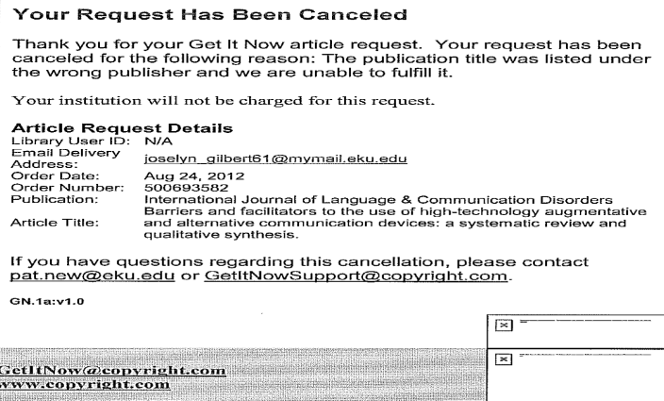
Implementation ~ Lessons Learned
Unfulfilled requests

Slide 13
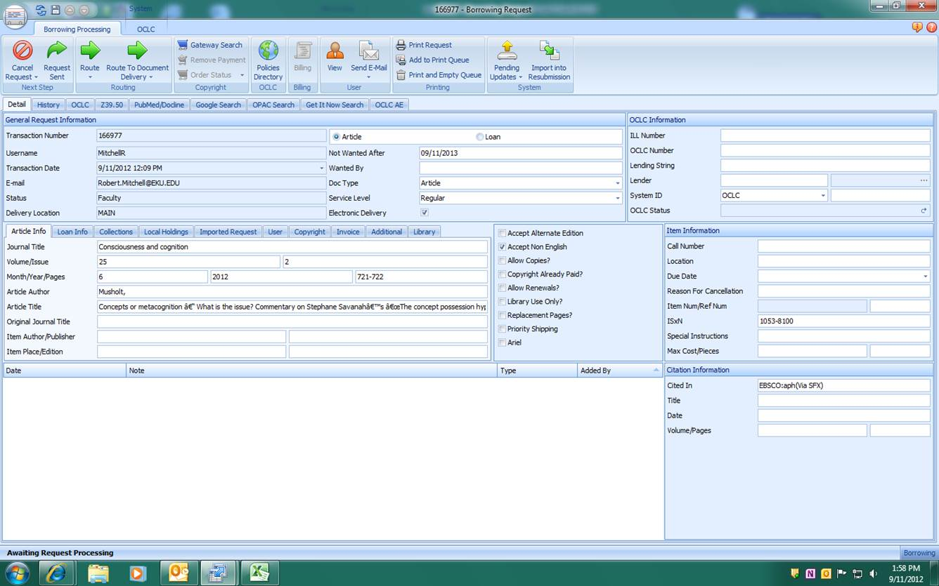
Overview of the Illiad Fulfillment Workflow
Detail Record Showing “Get It Now” Search Add-on

Slide 14
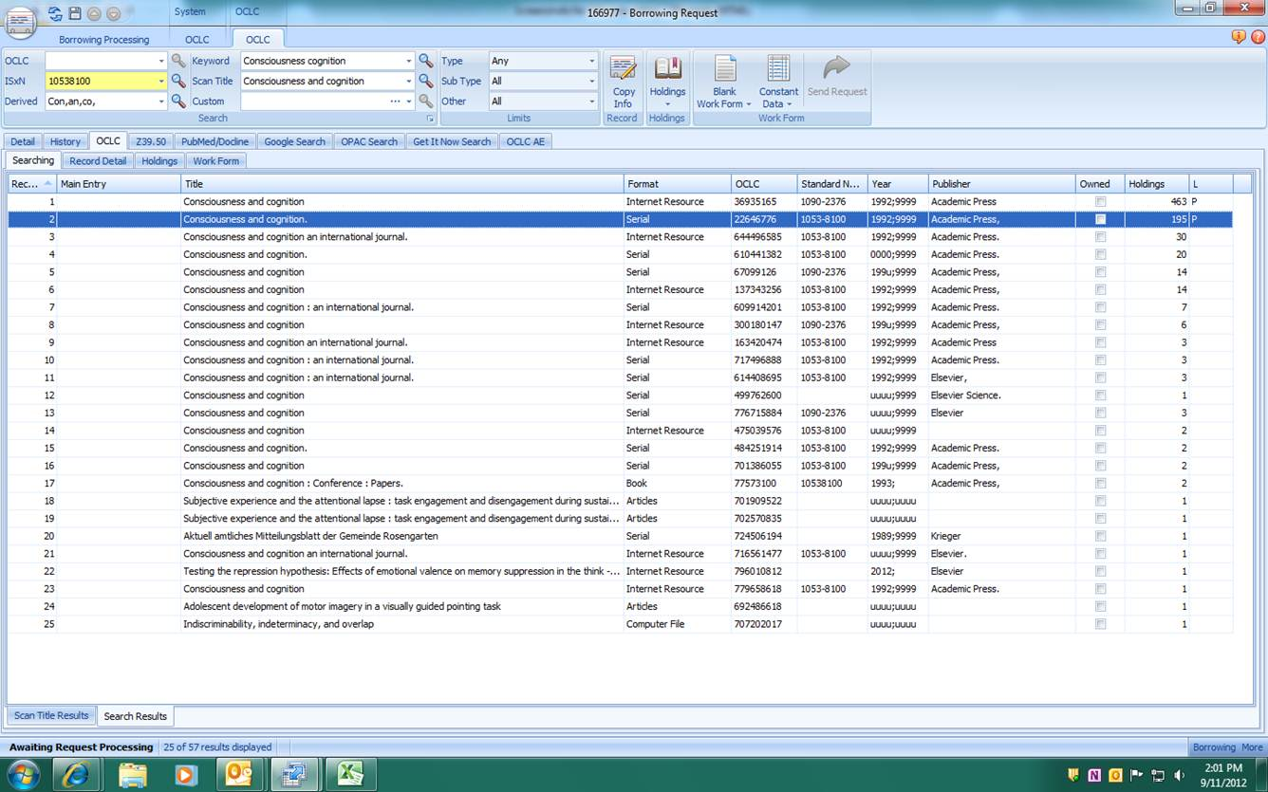
Search OCLC to Verify Ownership
Overview of the Illiad Fulfillment Workflow

Slide 15
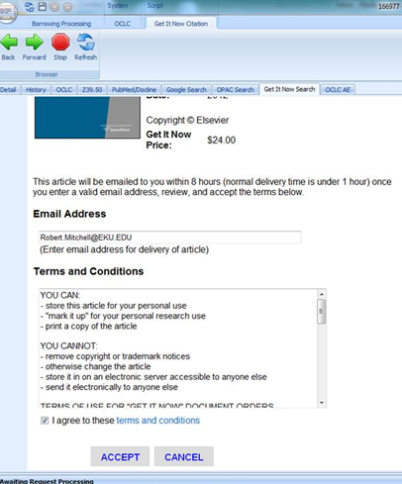
Not Owned
Click on GIN search tab to view order screen with pricing.
To proceed, click on Accept button at the bottom.
An order screen will briefly appear before returning to Detail Record
Overview of the Illiad Fulfillment Workflow

Slide 16
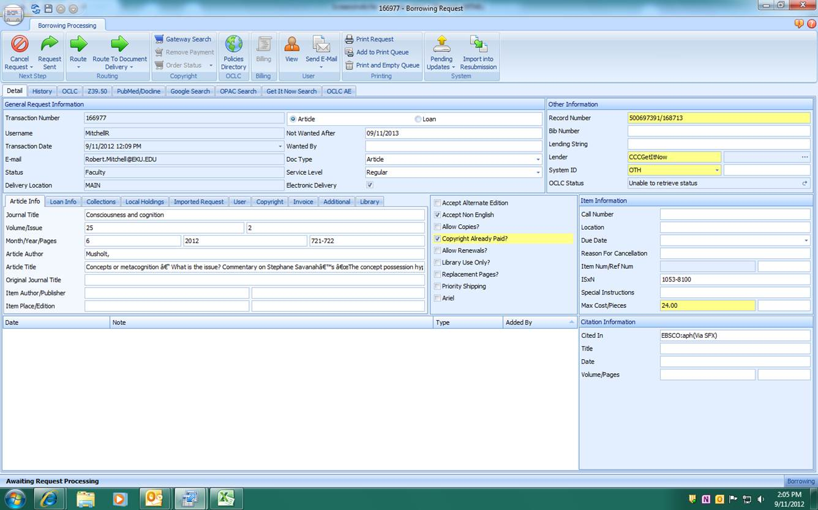
Order Information & Price Displayed
Record will be marked Copyright Already Paid.
At this point, click to save the information.
Overview of the Illiad Fulfillment Workflow

Slide 17
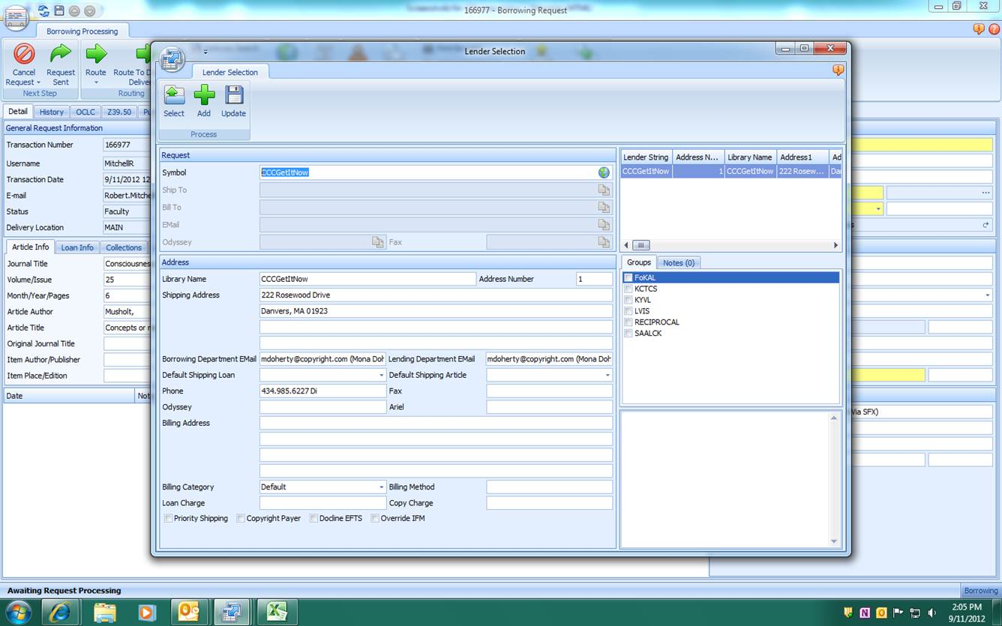
Select CCCGetItNow as the Supplier (You will have already set up the supplier record before processing GIN orders.)
Overview of the Illiad Fulfillment Workflow

Slide 18
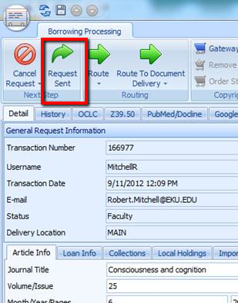
Deliver Article
If articles are to be delivered to patron Odyssey accounts, change status to Request Sent.
If articles are to be delivered via email, change status to Request Finished.
Overview of the Illiad Fulfillment Workflow

Slide 19
Benefits
Seamless integration with Illiad, Odyssey, and SFX
Workflow – one place for ordering
Financial flexibility for providing journal access
Enables article-level patron-driven purchasing
Helps with collection development decisions
Responsive customer service
Flexible
Can limit to specific publishers
Can set caps
Mediated or unmediated
Can limit by user type
(fac, grad, etc.)
Managed via Illiad or
OpenURL link resolver
Limitations
Little documentation
Only available for non-profit institutions
Can be hard to predict expenditures
One individual staff email for all notifications is frustrating
Conclusions

Slide 20
Pat New Interlibrary Loan Team Leader Eastern Kentucky University Libraries pat.new@eku.edu
http://www.flickr.com/photos/23679420@N00/545653437/
Kelly Smith Coordinator of Collection Services Eastern Kentucky University Libraries kelly.smith2@eku.edu

