Slide 1
GIST Joining ILL, Acquisitions, & Collection Development at Eastern Kentucky University
Current
Model
Amazon, YBP, OCLC, etc.
ILLIAD
Voyager
Patron Request
ILL
Collection Development
Acquisitions
What is GIST?
The “Getting It System Toolkit” is an ILLIAD add-on that supports patron driven acquisitions by streamlining ILL/ACQ/CD workflows
Why GIST?
Collection Development policies at EKU are transitioning to PDA for both print and electronic resources. Transferring ILL requests into purchases (when appropriate) aligns with this new philosophy.
Currently we are using inefficient paper processes when passing requests from ILL to Acquisitions, and also canceling a lot of requests
GIST automates tedious processes, allowing patrons to receive materials faster and staff to focus on tasks requiring human intervention
GIST provides opportunities for new avenues for collection development and assessment
ILL
Collection Development
Acquisitions
New
Model
GIST
Patron Request
Voyager

Slide 2
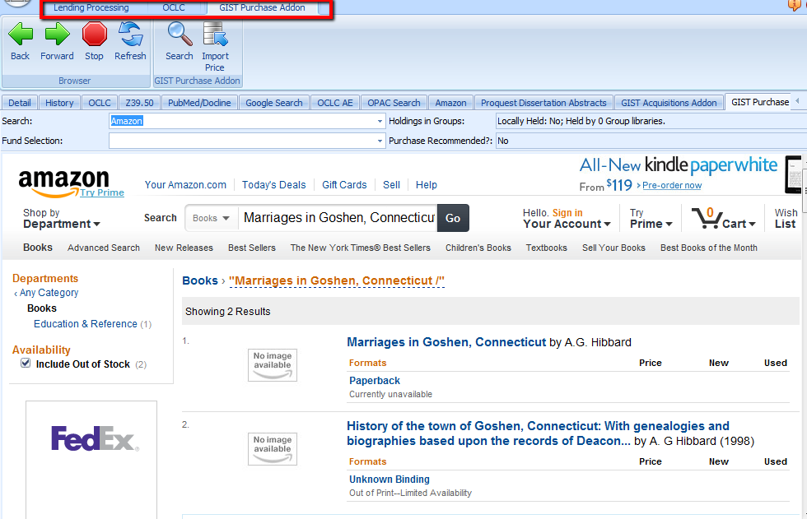
Technical Implementation
Add Gist tables to the database
4 addons – Connexion, Acquisitions, Gist for Web, Amazon
Obtain API Keys from OCLC & Amazon
Register Procard for Amazon addon
The EKU Experience
Implementation has been slower than expected due to hosted ILLIAD server.
Waiting for OCLC to complete necessary coding adjustments to fix javascript bugs.
Next Steps
Work out remaining technical bugs
Establish new processes and workflows
Possibly additional addons: BWB, Oasis??, etc.
Train acquisitions staff to use ILLIAD/GIST
After GIST for ILLIAD is running smoothly, implement GIST Gift & Deselection Manager
Potential Projects
Use GIST GDM to verify whether a request is a textbook – if so, place on reserve rather than purchase.
Set subject-based collection strategies using the Gist Database Conspectus
Perform item-by-item deselection or use the batch analysis tool to create custom deselection reports for large weeding projects.
Identify items that are available in HathiTrust. Remove over physical items from government documents and other collections that are available in HathiTrust.**
** Idea from Mary Barker, Evans Library, Florida Institute of Technology posting on OCLC-Cat listserv, Sept. 11, 2013.

Slide 3
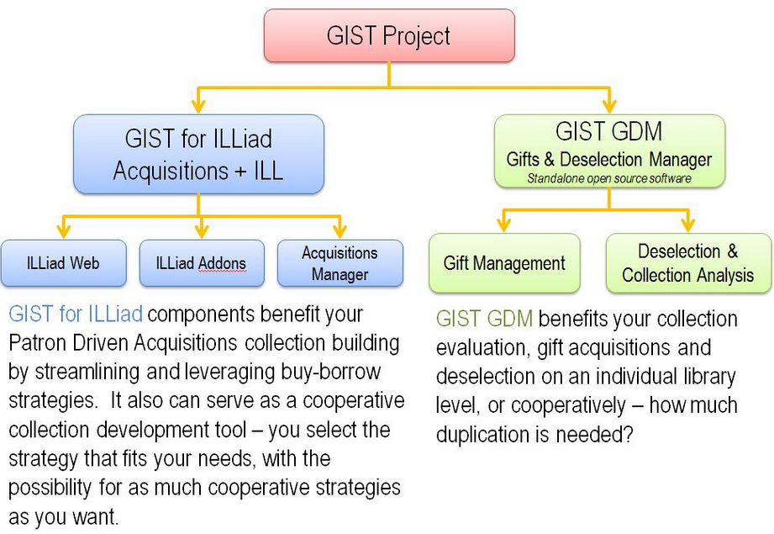
http://www.gistlibrary.org/wp-content/uploads/2011/09/GIST-Project1.jpg

Slide 4
http://www.slideshare.net/gettingitsystemtoolkit/gist-for-illiad-webpages

Slide 5
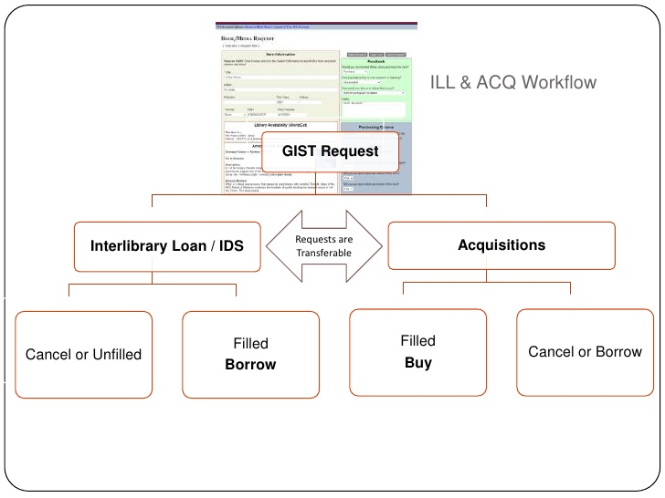
http://www.slideshare.net/gettingitsystemtoolkit/gist-for-illiad-webpages

Slide 6
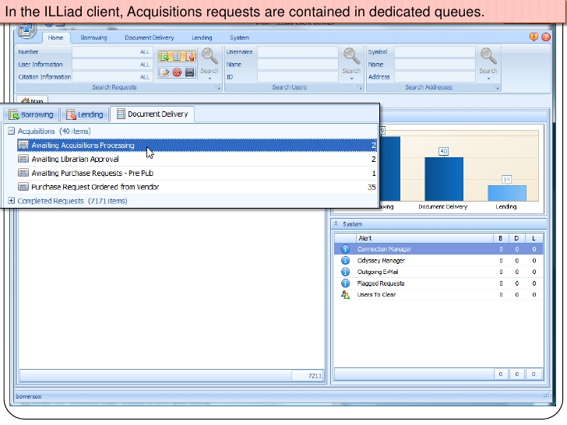
http://www.slideshare.net/gettingitsystemtoolkit/gist-for-illiad-webpages

Slide 7
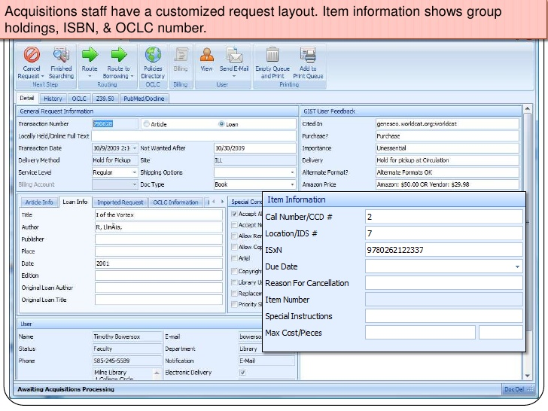
http://www.slideshare.net/gettingitsystemtoolkit/gist-for-illiad-webpages

Slide 8
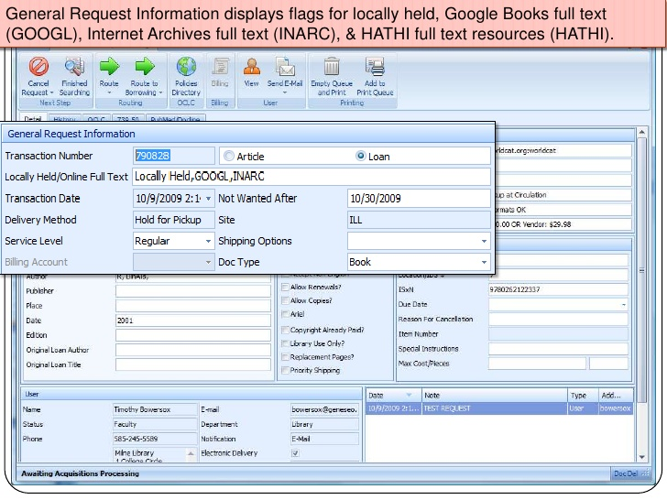
http://www.slideshare.net/gettingitsystemtoolkit/gist-for-illiad-webpages

Slide 9
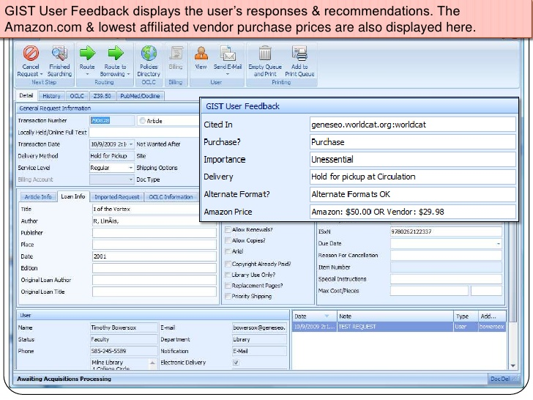
http://www.slideshare.net/gettingitsystemtoolkit/gist-for-illiad-webpages

Slide 10
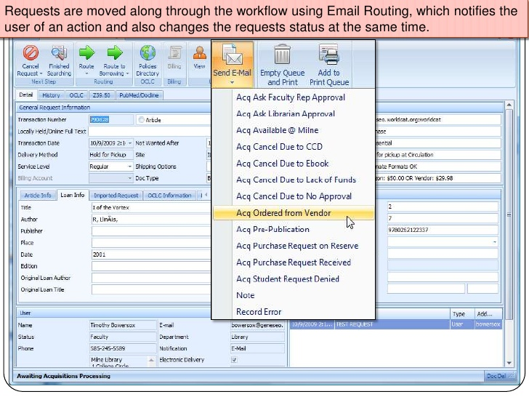
http://www.slideshare.net/gettingitsystemtoolkit/gist-for-illiad-webpages

Slide 11
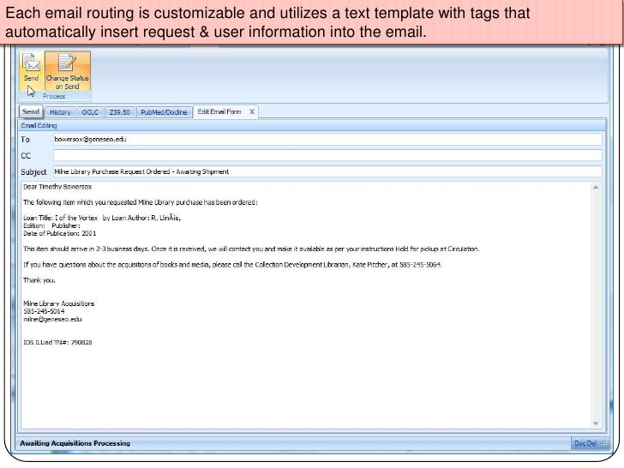
http://www.slideshare.net/gettingitsystemtoolkit/gist-for-illiad-webpages

Slide 12
http://www.slideshare.net/gettingitsystemtoolkit/gist-for-illiad-webpages

Slide 13
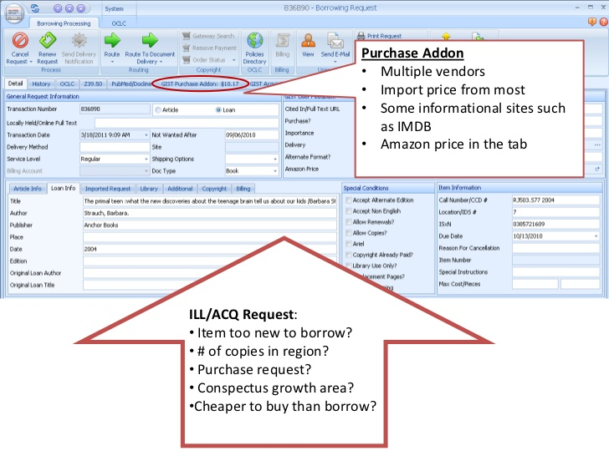
http://www.slideshare.net/gettingitsystemtoolkit/gist-acquisitions-manager-preview-2011-illiad-conference

Slide 14
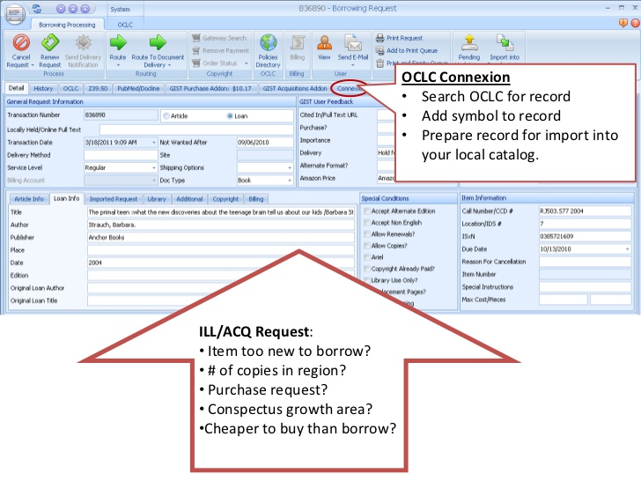
http://www.slideshare.net/gettingitsystemtoolkit/gist-acquisitions-manager-preview-2011-illiad-conference

Slide 15
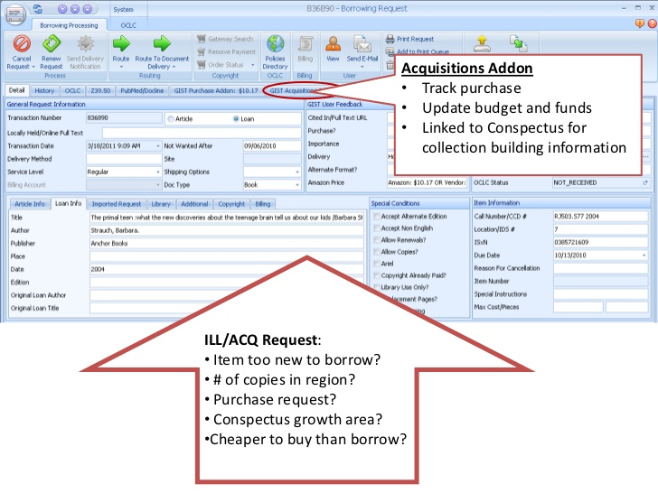
http://www.slideshare.net/gettingitsystemtoolkit/gist-acquisitions-manager-preview-2011-illiad-conference

Slide 16
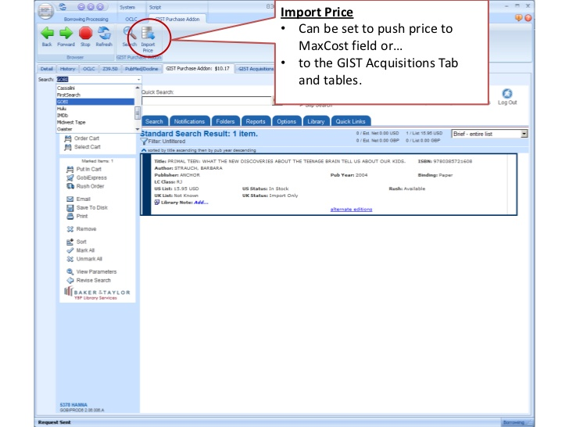
http://www.slideshare.net/gettingitsystemtoolkit/gist-acquisitions-manager-preview-2011-illiad-conference

Slide 17
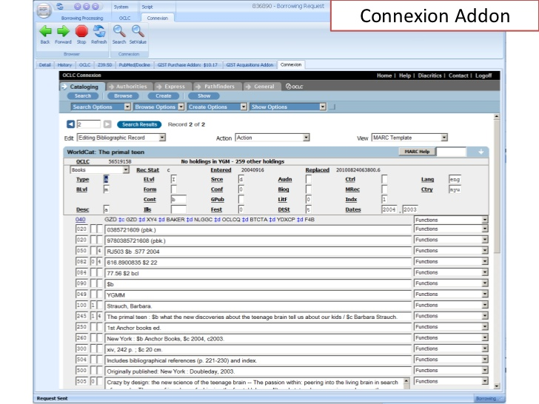
http://www.slideshare.net/gettingitsystemtoolkit/gist-acquisitions-manager-preview-2011-illiad-conference

Slide 18
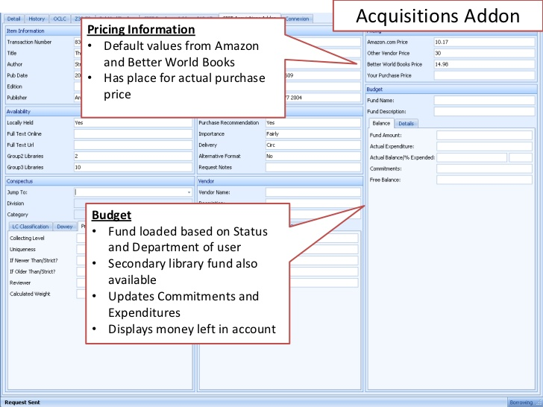
http://www.slideshare.net/gettingitsystemtoolkit/gist-acquisitions-manager-preview-2011-illiad-conference

Slide 19
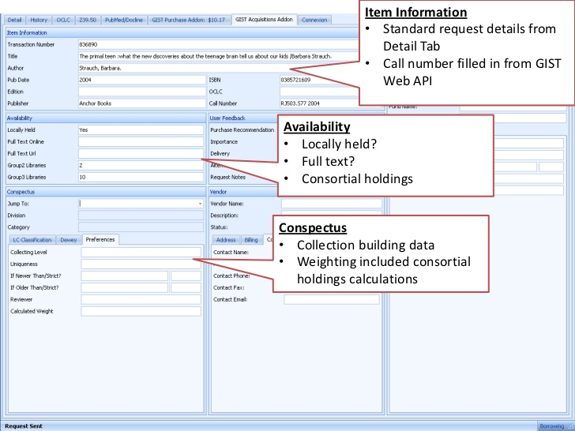
http://www.slideshare.net/gettingitsystemtoolkit/gist-acquisitions-manager-preview-2011-illiad-conference

Slide 20
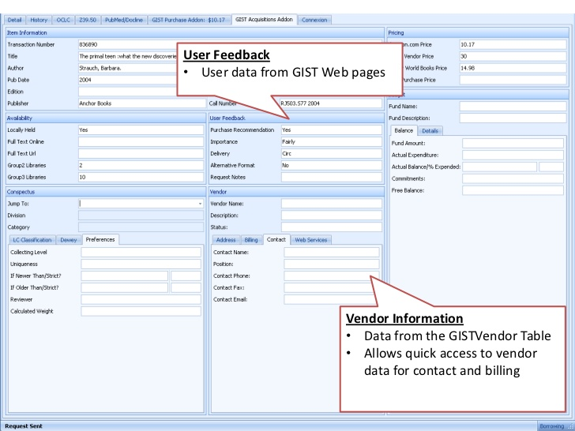
http://www.slideshare.net/gettingitsystemtoolkit/gist-acquisitions-manager-preview-2011-illiad-conference

Slide 21
Thank you!
Kelly Smith
Coordinator of Collection Services
Eastern Kentucky University Libraries
kelly.smith2@eku.edu
For More Information
http://www.gistlibrary.org/

