Slide 1
Electronic
Swiss Army Knife
Deploying an online reference service
as an interdepartmental multi-use tool
http://tinyurl.com/libanswersateku
OVGTSL Conference
May 23, 2017

Slide 2
Jens Arneson
Online Resources Librarian
Eastern Kentucky University Libraries
jens.arneson@eku.edu
Laura Edwards
Team Leader - Discovery, Metadata, and Analysis
Eastern Kentucky University Libraries
laura.edwards@eku.edu
Kelly Smith
Coordinator of Collections and Discovery
Eastern Kentucky University Libraries
kelly.smith2@eku.edu

Slide 3
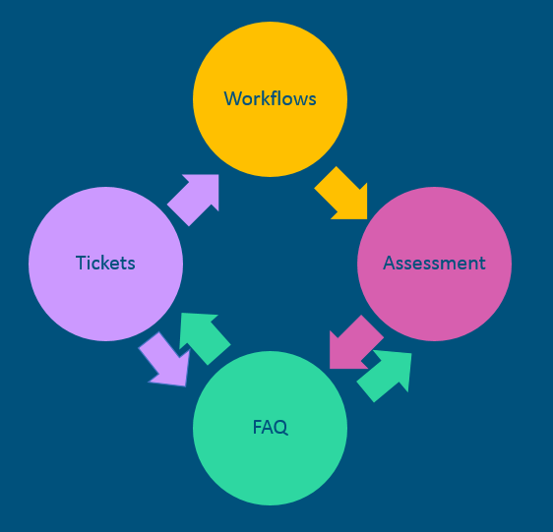
Notes:
Kelly [45 sec]
LibAnswers, developed by Springshare primarily as a Chat Reference service, can be applied in so many different ways - both internally and public facing.
At EKU, we adopted the product about a year and a half ago with the intention of also using it as an eResource ticketing service
Since implementation, it has transformed our collection services workflow by giving us a truly collaborative workspace.
Today, we’re going to highlight 4 aspects of the system, and the ways that these functions can inform each other and enable us to improve services for students and faculty.
We’re going to move somewhat quickly so that we can hopefully do a live demo.

Slide 4
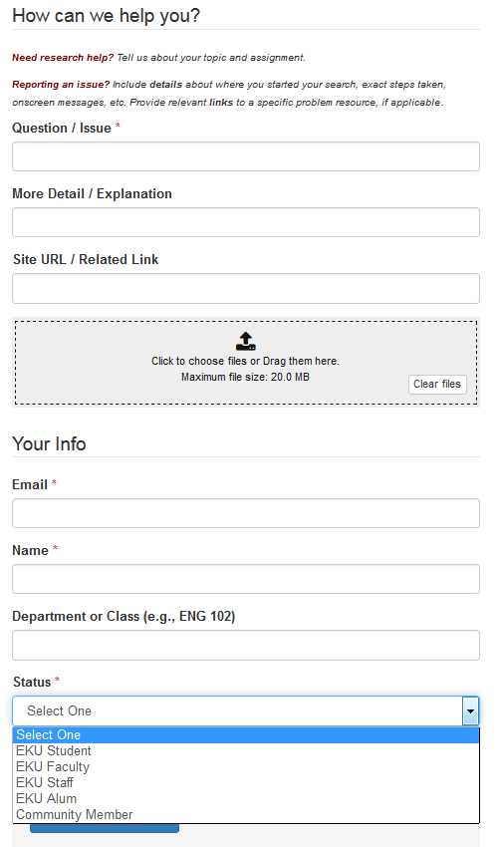
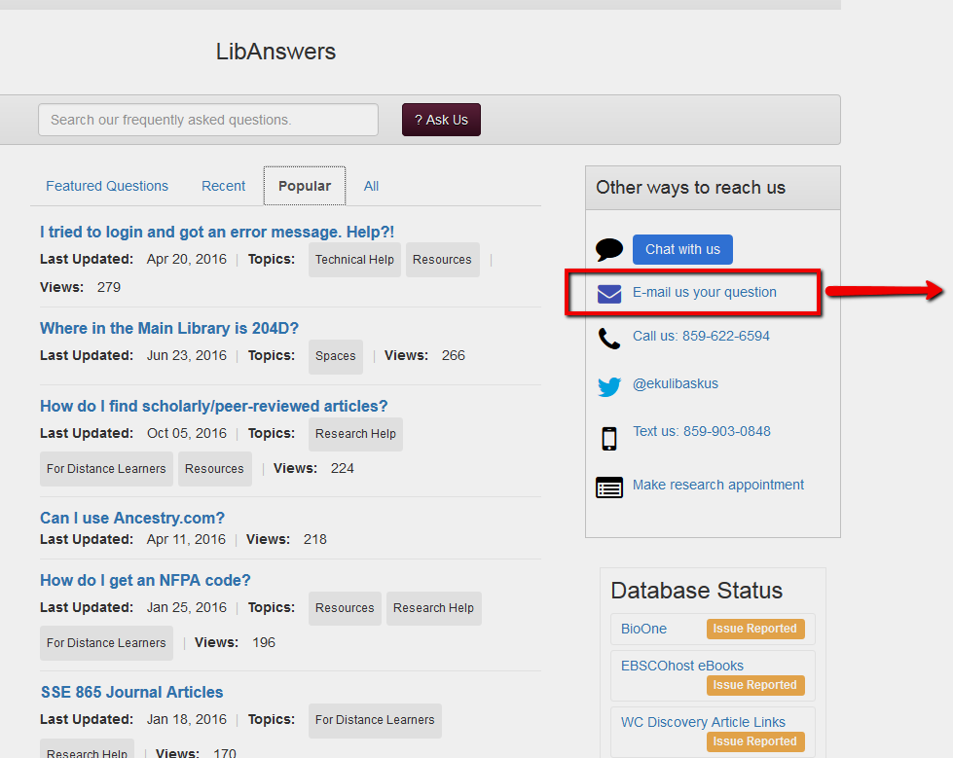
Tickets
How tickets come to eResources Staff...
Customizable contact form automatically creates ticket
Reference can transfer tickets to eResources
email automatically creates ticket
http://libanswers.eku.edu/
Notes:
Laura [45 sec]
“Ask Us” button everywhere leads to LibAnswers FAQs public facing landing page - given option to email a question or chat if can’t find FAQ that answers their question. Submission form was customized to make as simple as possible yet provide info we need to work the ticket.

Slide 5
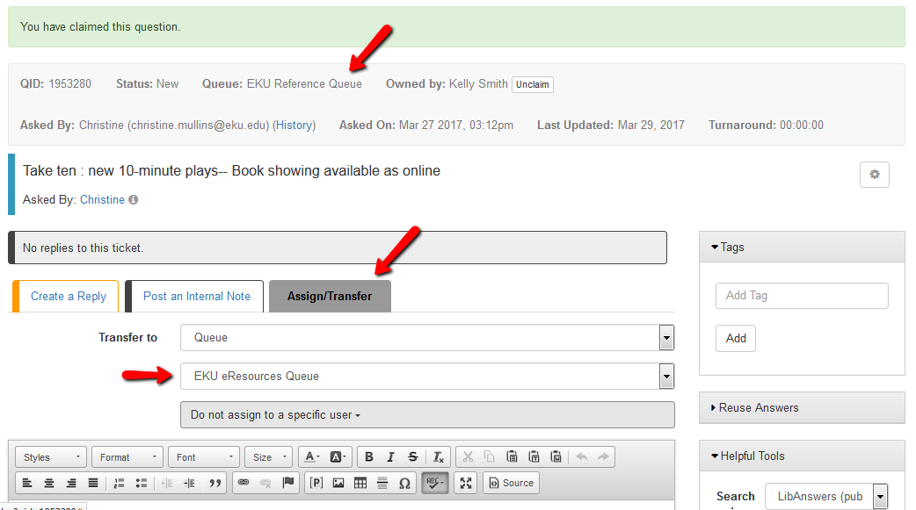
Tickets
How tickets come to eResources Staff...
Customizable contact form automatically creates ticket
Reference can transfer tickets to eResources
Email automatically creates ticket
Notes:
Laura [30 sec]
Reference and eResource queue - can transfer - access each other’s queue

Slide 6
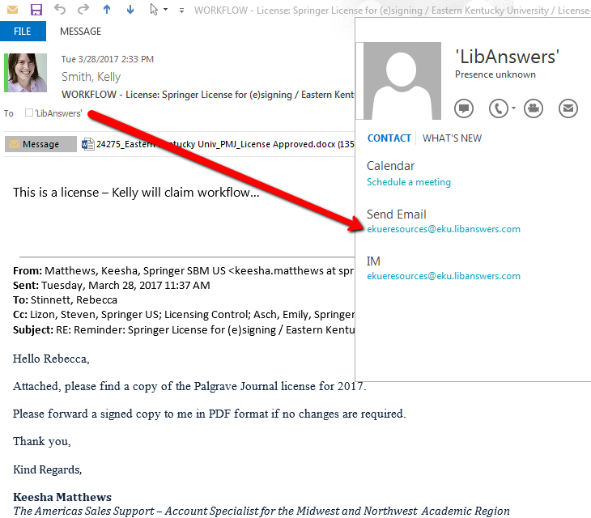
Tickets
How tickets come to eResources Staff...
Reference can transfer tickets to eResources
Contact form automatically creates ticket
Email automatically creates ticket
Notes:
Laura [30 sec]
You can create your own ticket by emailing the queue directly - Ref queue and eResources queue have separate email addresses. Can ask all library staff to send troubleshooting tickets to this email instead of individual staff members

Slide 7
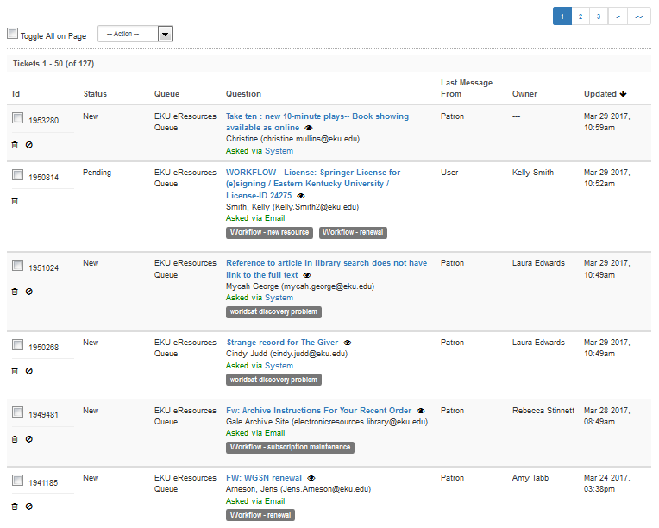
Tickets
Shared queue
Quick overview
Collaborative
History captured on ticket
Notes:
Laura [45 sec]
Quick overview of all open tickets and who is managing - can filter by owner
Tags let us isolate similar tickets / trends
Collaborative - Team members can see the status of tickets in progress
Tickets can be returned to reference staff if needed

Slide 8
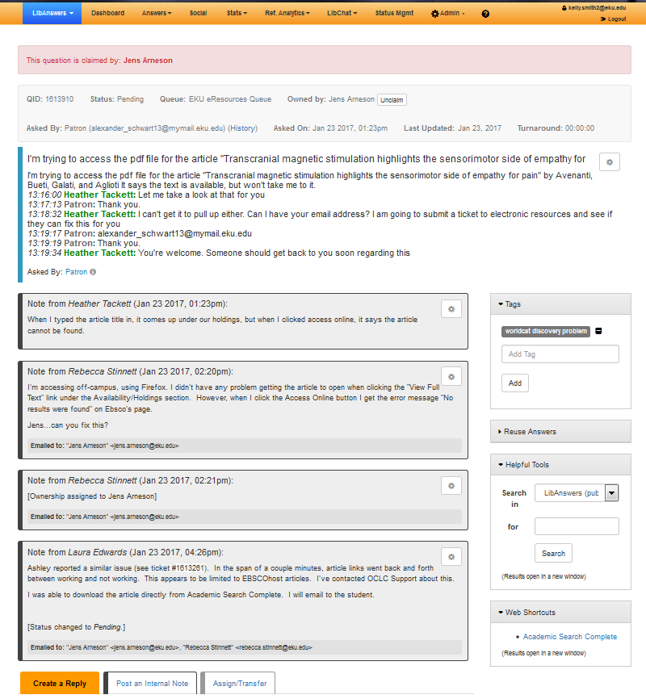
Tickets
Shared queue
History captured on ticket
Original chat transcript
Patron responses
Internal comments
Can reply directly to student from ticket
Notes:
Laura [60 sec]
Reduced confusion around responsibilities and increased transparency - email chains - not buried in one person’s email
Can keep long-term issues open, but still resolve for patron
Coding (tags) locally customizable, on the fly
Issues can be worked whether staff on vacation or not.
History of problems with a particular resource can be combined in one place.

Slide 9
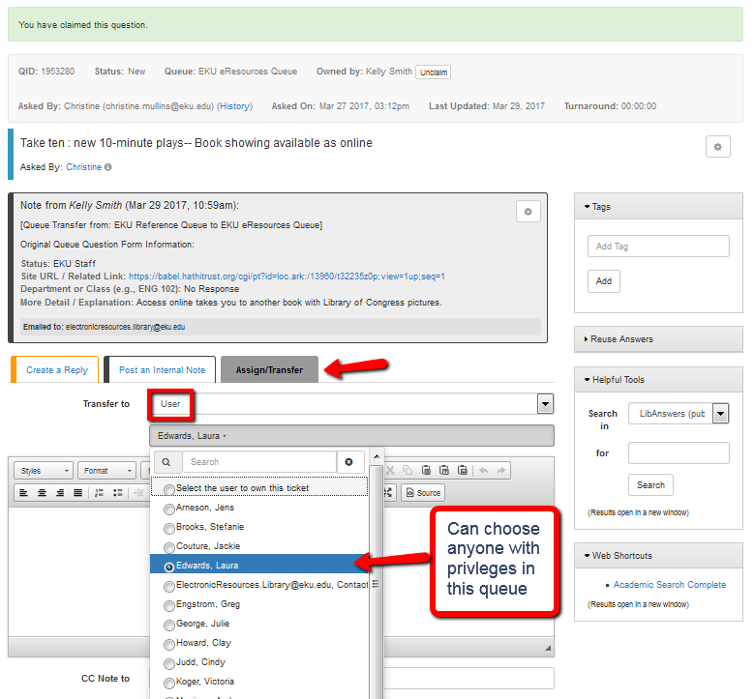
Workflows
Manage processes (renewals, licenses, new resources, cancellations, etc.)
Task claiming / assigning
Transfer between staff
De-clutter email / team communication tool
Macros for standard steps
Internal FAQ for staff
Notes:
Laura [30 sec]
Helpful tool for supervisors
Team leader can assign tasks to staff member and check back on resolution

Slide 10
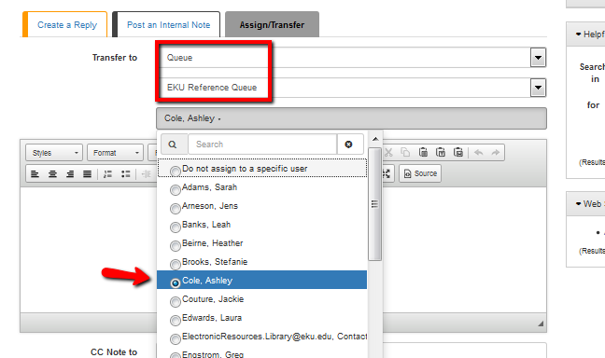
Workflows
Manage processes (renewals, licenses, new resources, cancellations, etc.)
Task claiming / assigning
Transfer between staff
De-clutter email / team communication tool
Macros for standard steps
Internal FAQ for staff
Notes:
Laura [30 sec]
Transfer back and forth between teams as needed (reference, ILL, acquisitions, eResources, etc.)
Only people with rights on the team queue to which you’re transferring the ticket will show up in dropdown menu

Slide 11
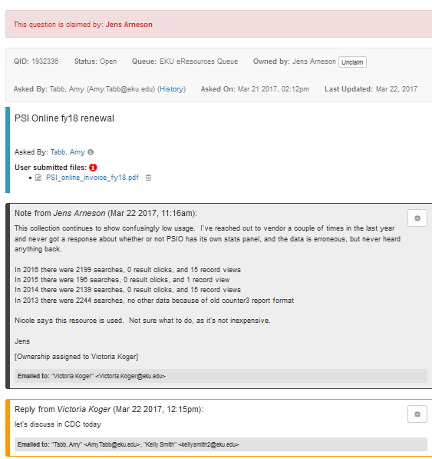
Workflows
Manage processes (renewals, licenses, new resources, cancellations, etc.)
Task claiming / assigning
Transfer between staff
De-clutter email / team communication tool
Macros for standard steps
Internal FAQ for staff
Notes:
Laura [30 sec]
Gets workflow out of email - reduce extensive email chains
Team members can tell where process is. Don’t have to email to ask question.

Slide 12
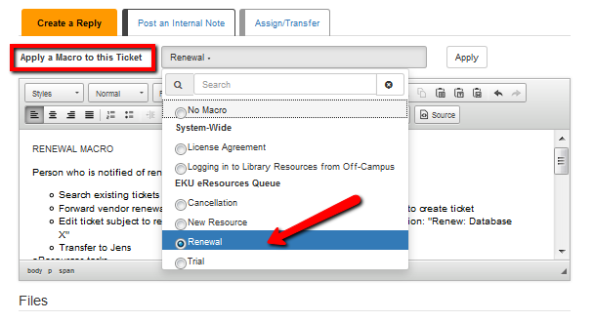
Workflows
Manage processes (renewals, licenses, new resources, cancellations, etc.)
Task claiming / assigning
Transfer between staff
De-clutter email / team communication tool
Macros for standard steps
Internal FAQ for staff
Notes:
Laura [15 sec]
Serves as a reminder to cover all bases - especially when workflow is transferred between multiple staffmembers

Slide 13
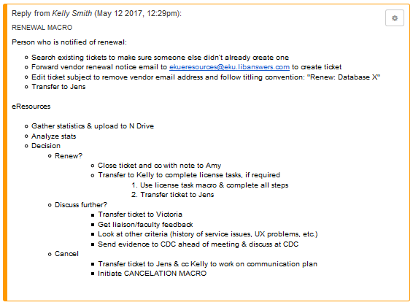
Workflows
Manage processes (renewals, licenses, new resources, cancellations, etc.)
Task claiming / assigning
Transfer between staff
De-clutter email / team communication tool
Macros for standard steps
Internal FAQ for staff
Notes:
Laura [30 sec]
Each step is outlined with task and person responsible
Macros for are inspired by TERMs, customized to our needs at EKU

Slide 14
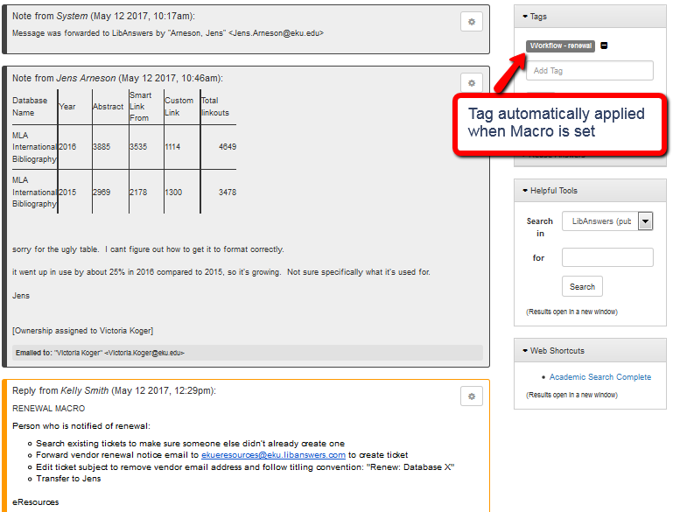
Workflows
Manage processes (renewals, licenses, new resources, cancellations, etc.)
Task claiming / assigning
Transfer between staff
De-clutter email / team communication tool
Macros for standard steps
Internal FAQ for staff
Notes:
Laura [15 sec]
Tags are automatically applied to save time and useful for statistics

Slide 15
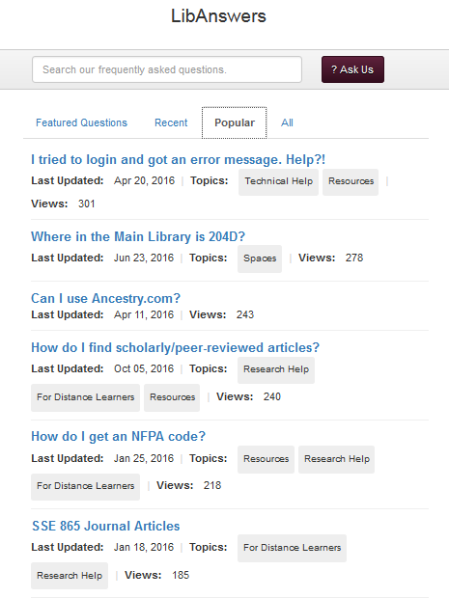
Workflows
Manage processes
Internal FAQ for staff
Only available when logged into the system - these FAQs don’t come up in public search
Public FAQ
Notes:
Kelly - Public FAQ - [15 sec]

Slide 16
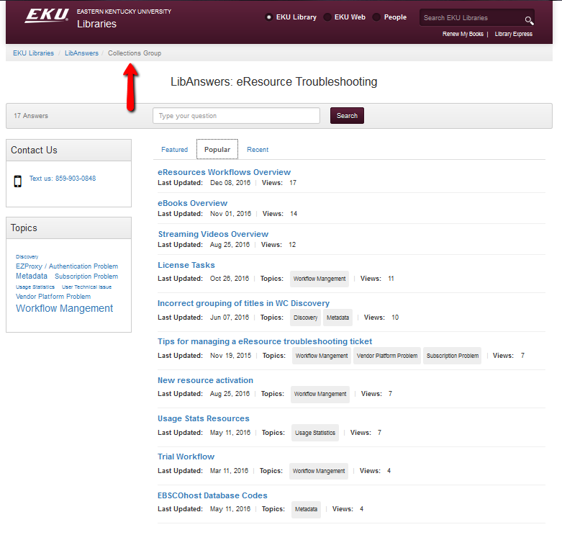
Workflows
Manage processes
Internal FAQ for staff
Only available when logged into the system - these FAQs don’t come up in public search
InternalFAQ
Notes:
Kelly [30 sec]
Used for training, communication
Backup when person with primary responsibility is out

Slide 17
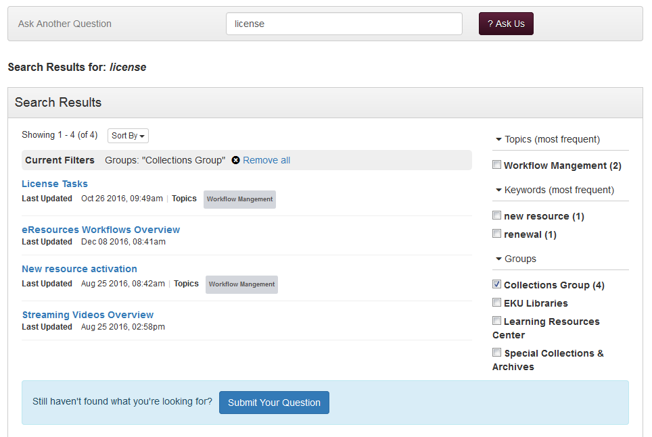
Workflows
Manage processes
Internal FAQ for staff
Only available when logged into the system - these FAQs don’t come up in public search
Notes:
Kelly [15 sec]

Slide 18
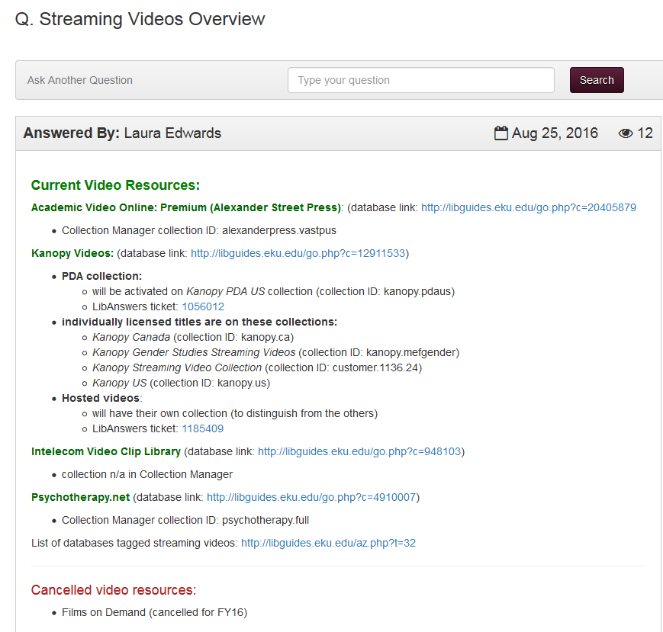
Workflows
Manage processes
Internal FAQ for staff
Only available when logged into the system - these FAQs don’t come up in public search
Notes:
Kelly [15 sec]

Slide 19
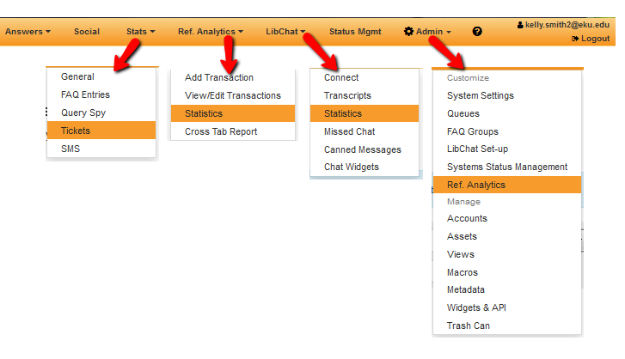
Analytics
Tickets Stats
Searchable
Quantitative
Provide overview of #s of tickets and team turnaround time (pat on back)
Analytics
Queryspy
Notes:
Kelly [60 sec]
LibAnswers has 3 different types of Analytics, which can be confusing.
Ticket Stats are canned metrics that come with LibAnswers
Analytics are based on locally determined datapoints
Queryspy offers a way to search patron questions to determine trends

Slide 20
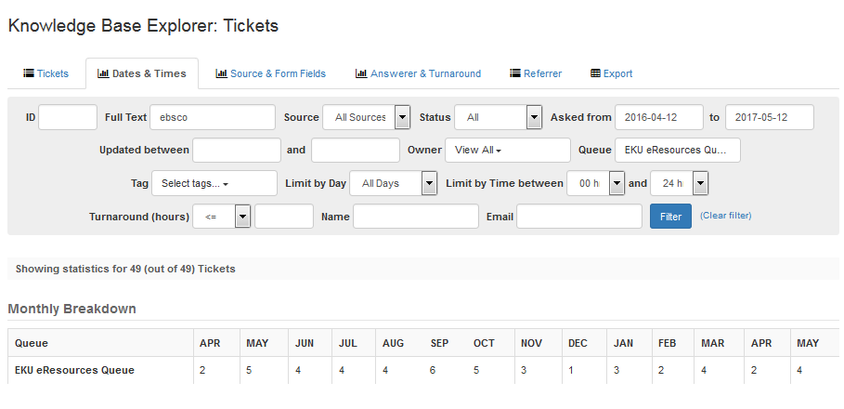
Analytics
Tickets Stats
Searchable
Quantitative
Provide overview of #s of tickets and team turnaround time (pat on back)
Analytics
Queryspy
Notes:
Kelly [15 sec]
Ticket Stats are filterable - in this case I was looking for all tickets with keyword “ebsco”

Slide 21
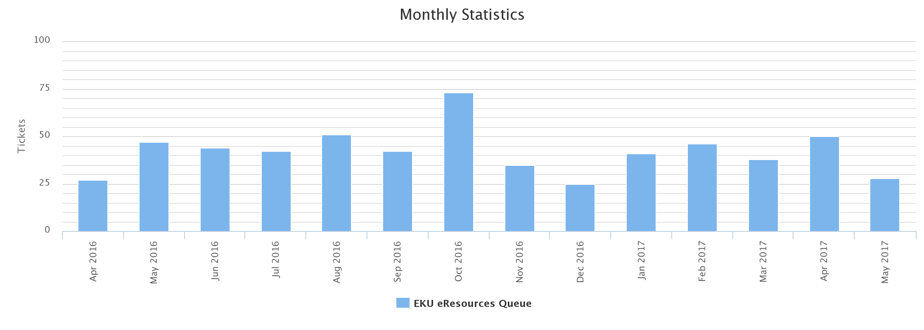
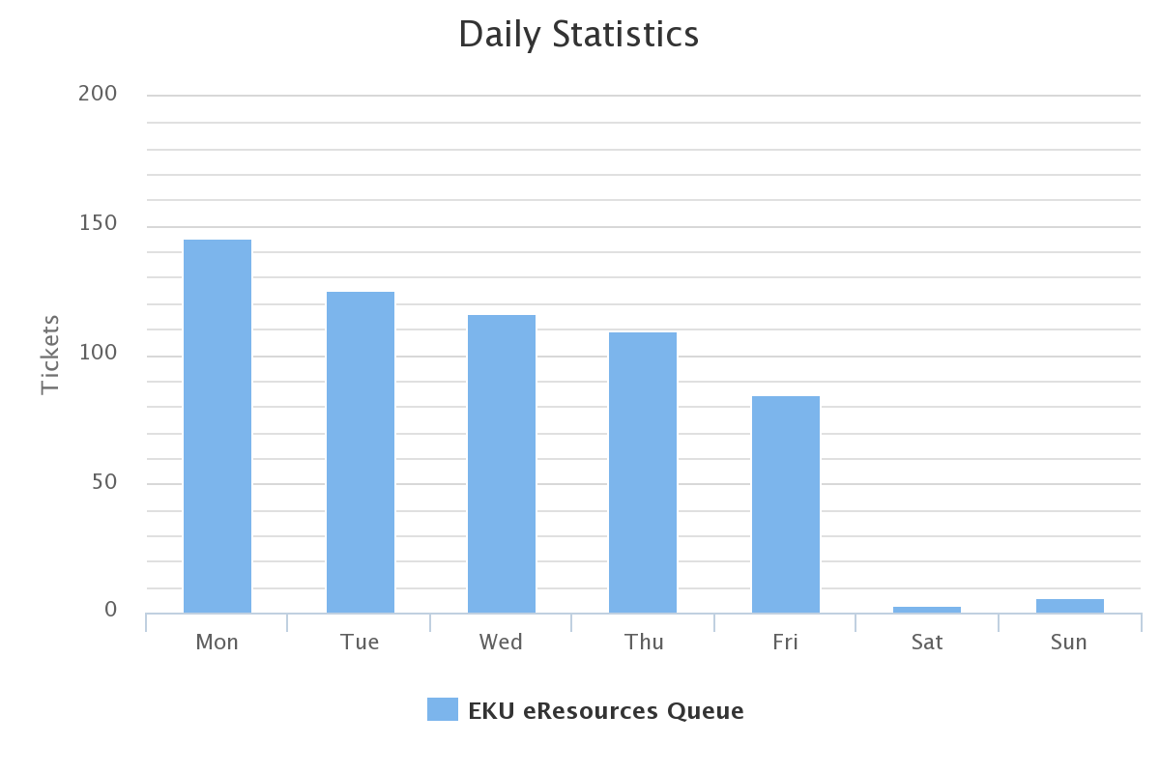
Analytics
Tickets Stats
Quantitative
Provide overview of #s of tickets and team turnaround time (pat on back)
Analytics
Queryspy
Notes:
Kelly [15 sec]
Overview of monthly/daily stats - helpful in staffing priorities

Slide 22
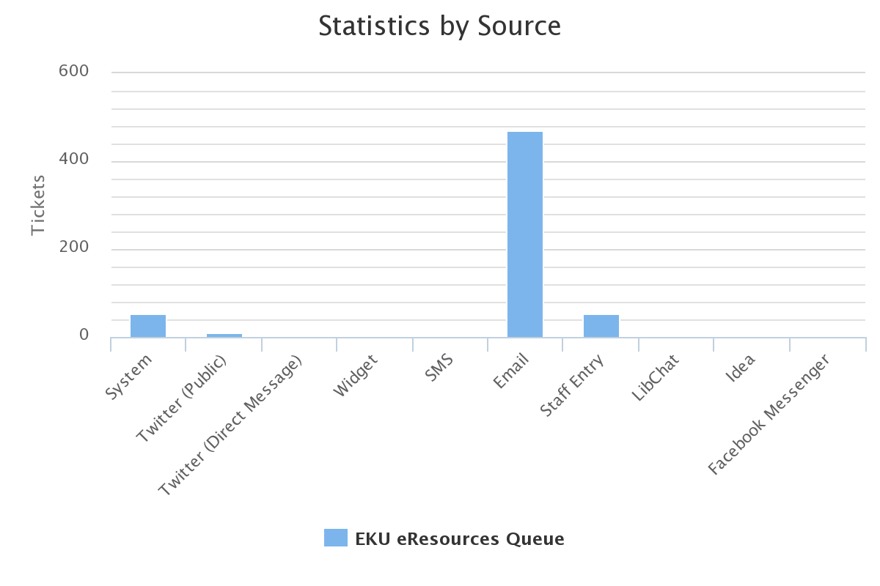
Analytics
Tickets Stats
Quantitative
Provide overview of #s of tickets and team turnaround time (pat on back)
Analytics
Queryspy
Notes:
Kelly [15 sec]
Source stats show how users are submitting questions

Slide 23
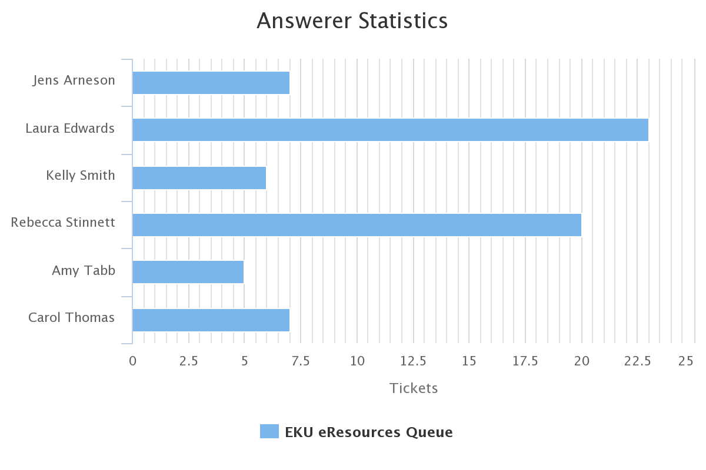
Analytics
Tickets Stats
Quantitative
Provide overview of #s of tickets and team turnaround time (pat on back)
Analytics
Queryspy
Notes:
Kelly [15 sec]
Team leaders can use for workload balancing

Slide 24
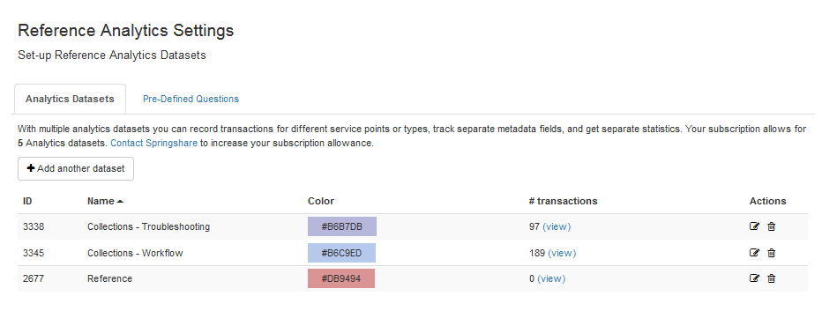
Analytics
Tickets Stats
Analytics
Granular
Customizable
Coding enables qualitative analysis
Exportable - pivots
Can use troubleshooting data to provide additional context for Collection Development decisions
Queryspy
Notes:
Kelly [15 sec]
Analytics on the other hand, are more granular and locally customizable. You can create multiple analytics sets to meet the needs of various teams.

Slide 25
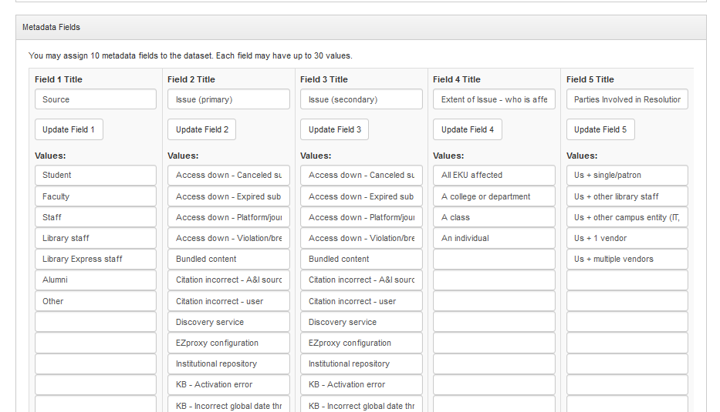
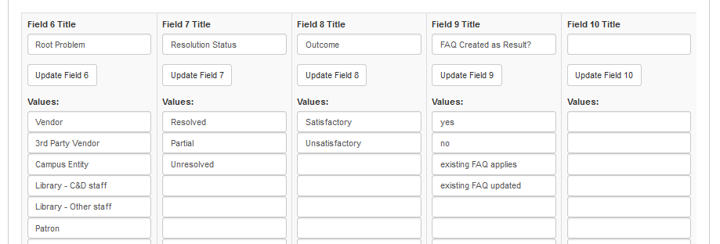
Analytics
Tickets Stats
Analytics
Granular
Customizable
Coding enables qualitative analysis
Exportable - pivots
Can use troubleshooting data to provide additional context for Collection Development decisions
Queryspy
Notes:
Kelly [45 sec]
Chicken or egg dilemma with Analytics Chicken or egg: have to know what you want to get out of Analytics before setting it up. But hard to know what you want until you’ve lived with the system a while. Also uncertainty about what the reports are capable of. Excel Pivot tables can help capture relationships between certain fields: ex; patron type and specific type of issue (we have to test this one)

Slide 26
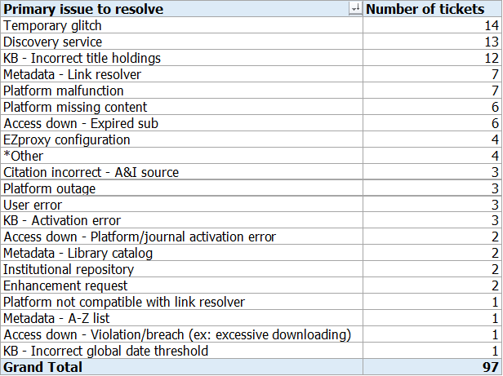
Analytics
Tickets Stats
Analytics
Granular
Customizable
Coding enables qualitative analysis
Exportable - pivots
Can use troubleshooting data to provide additional context for Collection Development decisions
Queryspy
Notes:
Kelly [15 sec]
this is an example of one of the datapoints we wanted to track = what was the ROOT PROBLEM of each ticket. When we have a few years of data, we’ll be able to identify trends and training priorities
The report comes out of analytics in a giant excel spreadsheet. I used a pivot table to grab the data in this screenshot

Slide 27
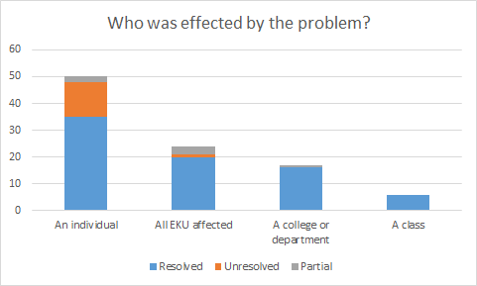
Analytics
Tickets Stats
Analytics
Granular
Customizable
Coding enables qualitative analysis
Exportable - pivots
Can use troubleshooting data to provide additional context for Collection Development decisions
Queryspy
Notes:
Kelly [15 sec]
….. And created pivot chart with this one.

Slide 28
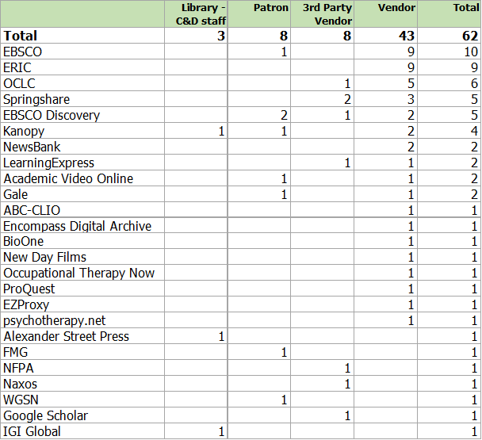
Analytics
Tickets Stats
Analytics
Granular
Customizable
Coding enables qualitative analysis
Exportable - pivots
Can use troubleshooting data to provide additional context for Collection Development decisions
Queryspy
Notes:
Kelly [30 seconds]
n- this is ROOT PROBLEM metric

Slide 29
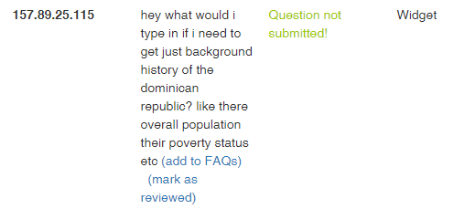
Analytics
Tickets Stats
Analytics
Queryspy
Observe how users are interacting with LibAnswers interface to proactively improve services
Notes:
Jens
can see how users are interacting with LibAnswers interface. Patrons have a tendency to treat the widget as a chat, which makes sense and points to a need to possibly redesign
Patrons are also entering citations into the search Also mention how you can track trends to decide which tickets to turn into a FAQ; and also how chat stats have dropped bc people are finding answers in the FAQ ~ks dropped 22% in one year
Result of process and also used to inform services
Phrase as a question patrons would ask: “What happened to the video from Films on Demand that I watched before for a class?”
Can bump up FAQs based on frequency of a question/time of year/difficult class assignment
Beginning of fall semester - add to “Featured FAQs” section: directional FAQs and FAQ about logging into library resources

Slide 30
Areas needing improvement
Firewall makes emails go into junk (had to whitelist to prevent outgoing messages from going into outlook junk folder)
Incoming messages from EKU users also sometimes go into Spam
Notes:
Jens
There can sometimes be a long delay in email communication. Server issues?

Slide 31
Areas needing improvement
Need Reminders - task due dates - calendar option would be good
Attachments purged after 3 months
Analytics from tickets don’t connect to Libinsight
Notes:
Jens
Team has resorted to adding tags with dates
Screenshots of issue in action; spreadsheets; etc. If it’s important to save, need to upload images into Springshare’s server. Make sure other files (spreadsheets, Word docs, etc.) are saved on your institution’s hard drive (ours is N: drive) and document filepath on the ticket Query spy also only keeps a rolling 6 months worth of data.

Slide 32
Notes:
Quick summation

Slide 33
Thank you

