Slide 1
Navigating WMS Analytics for the Right Data
Laura Edwards - Todd King - Kelly Smith
Eastern Kentucky University Libraries
OCLC Global Community + User Group Meeting 2017
http://encompass.eku.edu/fs_research/191

Slide 2
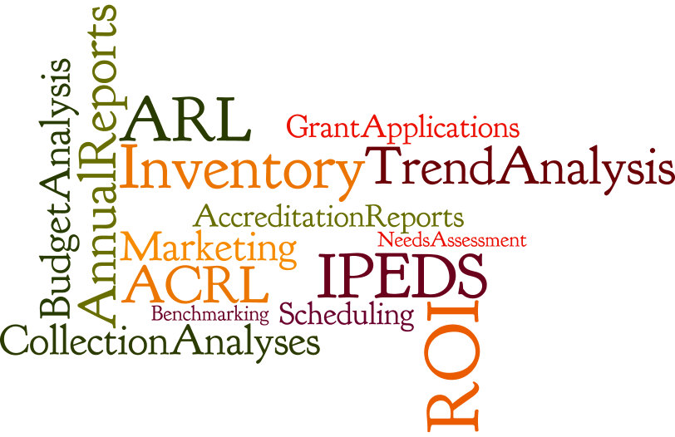
Keys to Success in WMS Analytics
Understand your question (The Why)
Why do you need it? (AKA who is your audience)
Articulate what combination of metrics you need to answer the question
Understand the data (The What)
Where is it coming from?
Who/what is inputting it?
Does it mean what you think it means?
encompass.eku.edu/fs_research/191
Notes:
KELLY
WMS analytics has a lot of power, but using it effectively requires an understanding of WHY you need the data and WHERE the best data to meet your need originates. Data is coming from worldcat master records, LHRs, acquisitions, circulation, license manager, collection manager, and the FTP inventory.
So you have to ask yourself up front:
Who is the audience? The Library Board? A Provost? A department? Your team?
Is this for a departmental accreditation? IPEDS reporting? For data cleanup?
Which data points do I need to fully address my problem?
Do the data points I’m using mean what I think they mean?
What exactly am I planning to do with the report? Can I rely on readymade reports or should I make my own query in analytics?
Understanding what you need, and knowing the data, will give you realistic expectation of what can and cannot be done. You may need to go elsewhere for some data, or do extra manipulation to get what you need

Slide 3
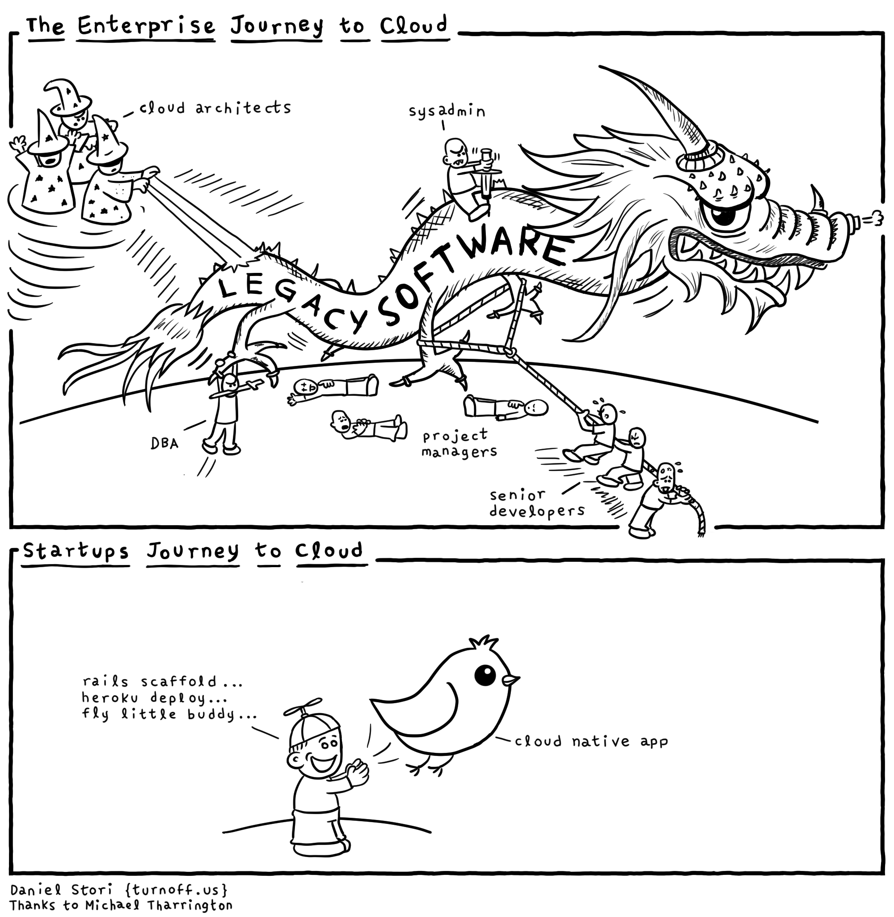
Notes:
LAURA: That was a nice way of putting it. But this pretty much captures how I really feel when working with the data.

Slide 4
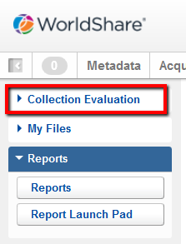
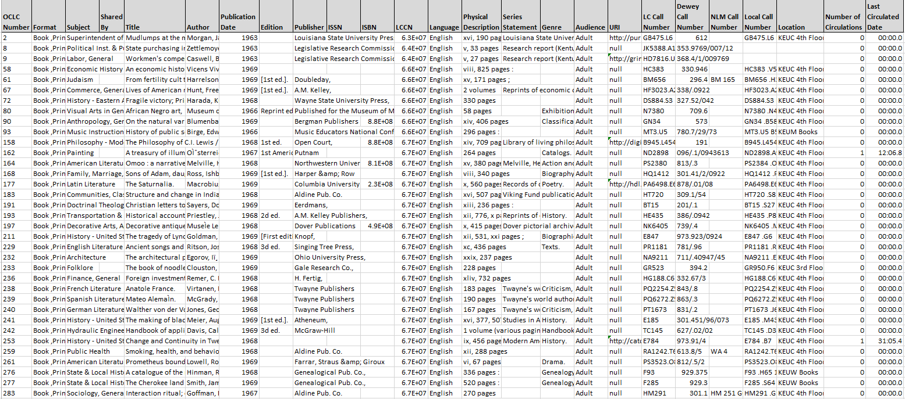
Collection Evaluation
Notes:
LAURA: I do not use this report as much as I do Inventory report. I don’t fully trust that it is an accurate “collection evaluation”
More fields from bib record - it is supposed to be focused on tools for evaluating your collection and comparing with other libraries
But helpful for running reports on locations - just remember that it won’t include multiple items attached to one LHR (i.e. periodicals)
Anyone with permissions can access via Analytics -- Collection Evaluation -- My Library tab
Don’t have choice over what fields to include, but can limit report by location, format, pub date, last circ date, # of times circulated, language
--ex:staff run report on GRR Display in order to periodically clean up temporary locations

Slide 5
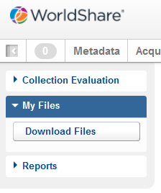
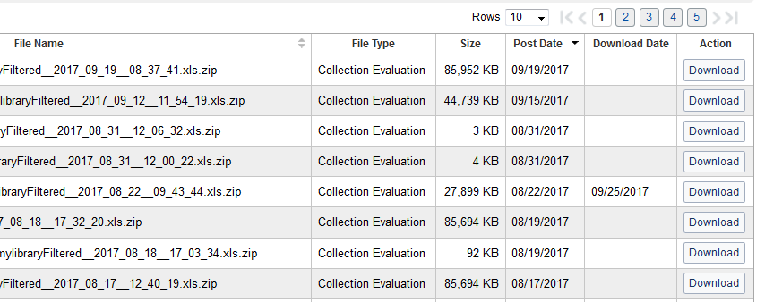
Collection Evaluation
Collection Evaluation reports count the number of titles
Titles activated via Collection Manager module are included in Collection Evaluation reports
*Caveat: Formats and Subjects are not entirely reliable
Notes:
LAURA:
Collection Manager titles Identifiable by:
“Format” field (“Book, eBook”; “eJournal”; etc.)*
Lack of shelving location in the “Location” field

Slide 6
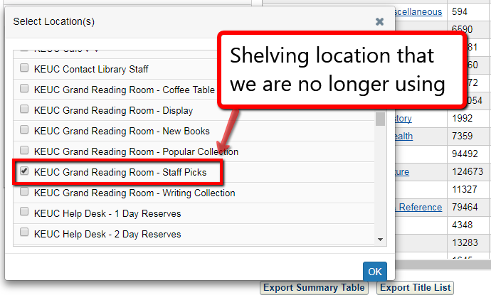
Collection Evaluation: what you can do
Review Shelving Locations in use
Collection Evaluation tool only displays shelving locations in use
Check here to see if the shelving location you need to remove is still in use
Notes:
LAURA: There are more shelving locations under Grand Reading Room, but they do not show up here, which means that they are not in use (whew - we can delete those unwanted locations now!)
**When reviewing locations, should always consult Inventory report as well

Slide 7
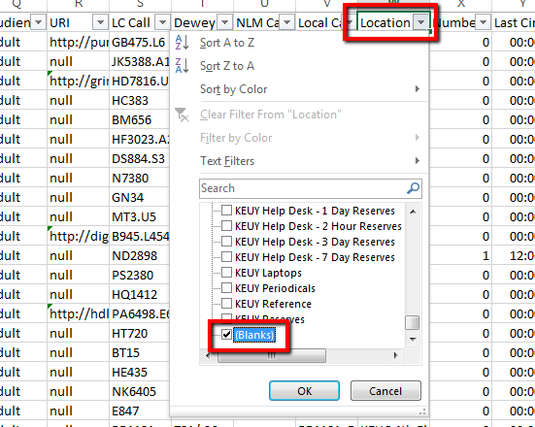
Collection Evaluation: what you can do
Review Titles with no Locations
Filter by Location = “(Blanks)”
Caveats:
Will include titles activated via Collection Manager module
Will include titles that are part of bound-with containers that have not yet been fixed
Notes:
LAURA: **When reviewing locations, should always consult Inventory report as well **
Be aware of your collections and any cleanup projects going on. For instance, we have a massive cleanup project for our bound-with volumes, so I keep that in mind when looking at this report since those titles are already being taken care of.
Also - sometimes print records are selected for titles that are in online collections activated via Collection Manager. This is a cleanup project idea: double checking these in Collection Manager and submitting online records for the override OCN (the “version of record” that Collection Manager will apply your holdings to). Remember that this has a public-side impact - patrons who may want online-only records (limiting to eBook, for example)

Slide 8
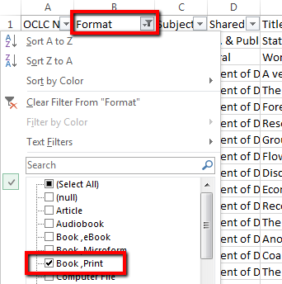
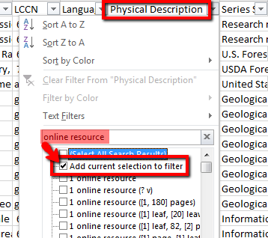
Collection Evaluation: what you can do
Review Print Books without a Location
Filter by Location = “(Blanks)”
Filter by Format = “Book, Print”
Filter by Physical Description = exclude anything with “online resource”
Will help exclude most online titles
Notes:
LAURA: **When reviewing locations, should always consult Inventory report as well **
Use if you want to catch print holdings that have Worldcat holdings applied, but no LHRs attached (these could potentially be caught during the inventory process, IF they are on the shelf and scanners catch it. Inventory process will not catch print holdings floating in Worldcat for items that are no longer on shelf)
eBook format only applied when an 856 40 field is present (if it’s 856 41 like a lot of our govdoc titles, then they will display as print books)
Be aware of your collections and any cleanup projects going on. For instance, we have a massive cleanup project for our bound-with volumes, so I keep that in mind when looking at this report since those titles are already being taken care of.
Also - sometimes print records are selected for titles that are in online collections activated via Collection Manager. This is a cleanup project idea: double checking these in Collection Manager and
submitting online records for the override OCN (the “version of record” that Collection Manager will apply your holdings to). Remember that this has a public-side impact - patrons who may want online-only records (limiting to eBook, for example)

Slide 9
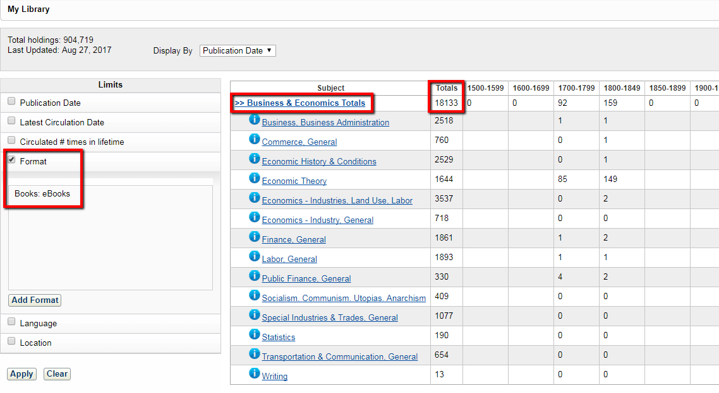
Collection Evaluation: what you can do
Accreditation reports*
Example: Number of eBooks in a subject area
Filter by Format = Books: eBooks
Drill down via subject
*Caveat: Formats and Subjects are not entirely reliable
Notes:
LAURA: We do not fully trust Collection Evaluation to do…”collection evaluation”
Subject assignment not 100% accurate - see Music materials example.
Format assignment not 100% accurate - see Collection Evaluation report, filter to titles with no location, then look at format listed. Lots of “Book, Print” listed for online GovDoc titles, eBooks, etc.

Slide 10
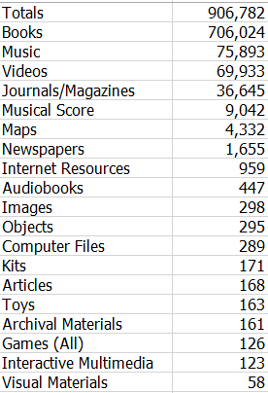
Collection Evaluation: what you can do
ADMIN POV
Quick and dirty on the fly holdings snapshots
Notes:
KELLY - Slide - With this, keep all former caveats in mind

Slide 11
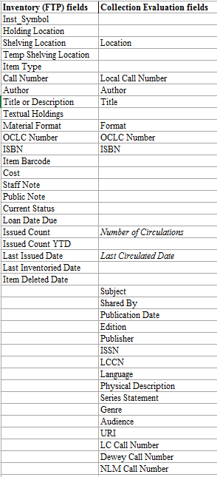
Inventory Report (FTP)
Collection Evaluation = everything with library holdings symbol applied
Title count (ACRL/IPEDS wants this)
Includes online materials
Periodical counted once
Inventory = everything with a barcode
Volume count
Includes each bound volume of a periodical
Notes:
LAURA:
Inventory = run every Sunday
Collection Evaluation says it will be ready in 2 hours. No - have to wait overnight, sometimes longer
Inventory - includes withdrawn items (for as long as you have set them to be retained: 1 week; 1 year; etc.)
Collection Evaluation - does not include withdrawn items
Weekly snapshot of the collection.
Sometimes just seeing all the data is helpful
If you have a lot of holdings, you may not be able to open this in excel.
Depending on how long you told WMS to retain withdrawn items, you will be able to see withdrawn items on this report. We don’t trust the count of “WITHDRAWN” items because of the indiscriminate way WMS treats deleted items, but be aware that it’s there. You may need to exclude it from cleanup reports. You may need to troubleshoot staff errors, etc.
Can use filters: filter by shelving location, current status, item type, etc.

Slide 12
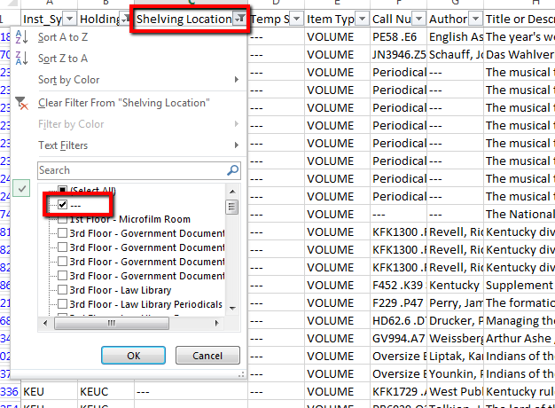
Inventory - what you can do
Review Shelving Locations
Review items missing a shelving location (filter by “Shelving Location” = ---)
Pull list of titles and their barcodes to bulk update the shelving location
Putting items on display
Moving items to a different location
Notes:
LAURA: Need barcodes in order to bulk update shelving locations (permanent or temporary). I.e. putting items on temporary display; changing permanent shelving locations
**When reviewing locations, should always consult Collection Evaluation report as well (remember - inventory report only includes items with barcodes)
Before creating cleanup reports - make sure you have excluded “WITHDRAWN” items so you’re not wasting time on records for materials that are no longer in the library

Slide 13
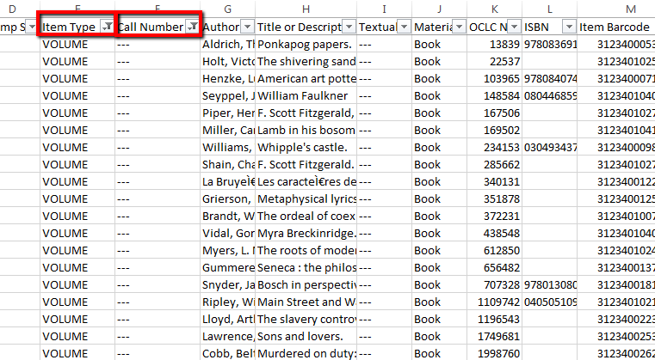
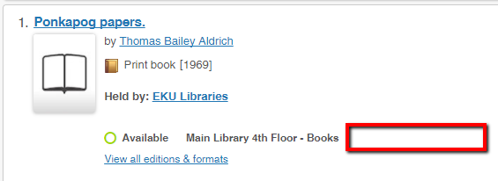
Inventory - what you can do
Clean up missing call numbers
Filter by “Item Type” = VOLUME
Then filter by “Call Number” = ---
Notes:
LAURA: Filter by item type volume, then by call number to see what records are missing call numbers

Slide 14
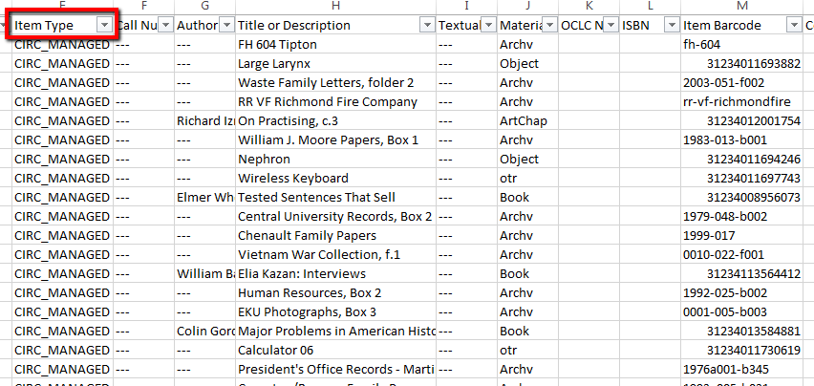
Inventory - what you can do
Clean up temporary items
Filter by Item Type = CIRC_MANAGED
*Caveat: Pay attention to item details - some temporary items are legitimate
Notes:
LAURA: Staff may forget to delete the original temporary item record when notified that an item needs an LHR
Some temporary items are legitimate - we have body parts on reserve for health sciences students; our archives staff use temporary records in order to track interest in manuscript collections

Slide 15
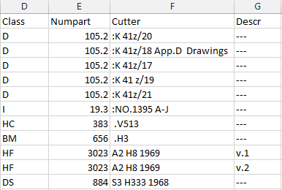
Inventory - what you can do
Perl script to sort Inventory - available on Community Center
tinyurl.com/wmsinventoryperl
Separates call number into parts for better sorting in Excel
Notes:
TODD: I may want to mention this as a tool for using the FTP inventory - I have a perl script that can sort the file in numerous ways, including by call number.
From a discussion on the Community Center: https://www.oclc.org/community/WMS/WMS_reports.topic.html/sorting_item_invento-jSCQ.en.html

Slide 16
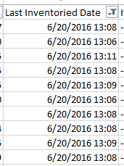
Inventory Workflow & Process at EKU
Scanners notify metadata associate of call number range scanned in previous week
Metadata Associate pulls inventory report weekly
Metadata Associate sorts and filters in succession, looks for:
titles scanned, but from another shelving location
titles scanned, but out of order
titles scanned, but with item status WITHDRAWN or ON_LOAN
titles not scanned
Report is smaller and smaller based on progression of checks
Eventually narrowed to call number range inventoried as of a certain time period
Problems noted, cleaned up and/or referred to other staff
Notes:
LAURA: Inventory report only reports the timestamp when an item was scanned in “inventory” mode (set on check-in mode in Circulation module). Does not “tell” you whether scanned items are in another location, misshelved, or not scanned. You still have to review the report.
Inventory process will not catch holdings floating in Worldcat for print items that have no LHRs and are no longer on shelf. Inventory will potentially catch titles that have no holdings/LHRs applied if they are on the shelf and scanners catch it (we remind them to go slow and pay attention to the screen for each book they are scanning)

Slide 17
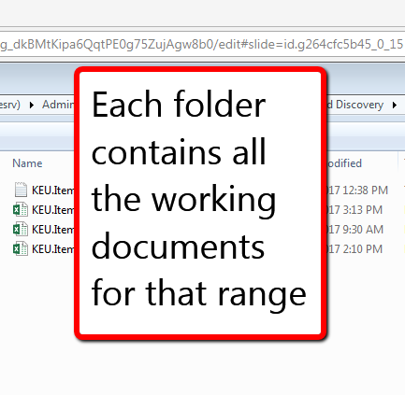
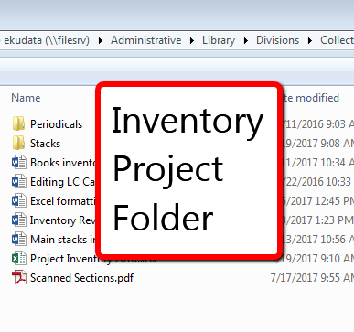
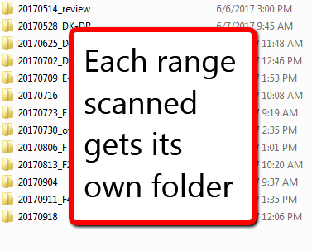
Inventory Workflow & Process at EKU
Notes:
LAURA: For more detailed information about the workflow, contact Laura

Slide 18
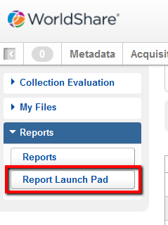
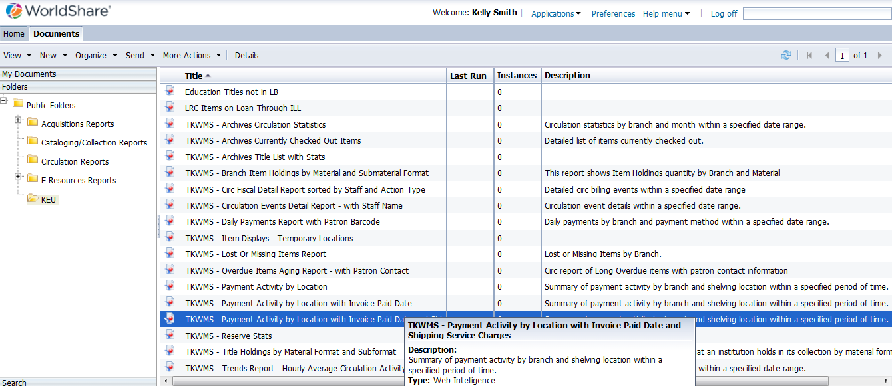
Report Designer
Notes:
TODD

Slide 19
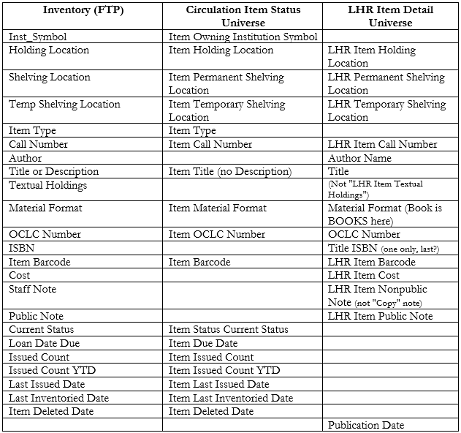
Inventory (FTP) vs. Report Designer
To get Inventory-like report, had to create a multi-universe report using “Circulation Item Status” and “LHR Item Detail”
Matching fields are listed here
Note: where there are blanks there are no matching fields
For multi-universe report: had to get certain pieces from certain universes E.g. "Notes" from LHR
Notes:
TODD: Publication date, often desired for reports, is only in the LHR Item Detail universe (it’s not even in the Inventory)
It’s possible to write reports that will pull items based on inventory timestamp. However, the report will only pull the fields that you specify.
If you limit the report to items that have an inventory timestamp, you may leave out missing/lost titles that don’t have an inventory timestamp.
If you limit the report to a shelving location, it will leave out items that may have been scanned during the inventory process, but are from a different shelving location (because sometimes they get misshelved or we overlook a title when updating locations).
If you limit the report to a specific call number range, it will leave out items that may have been shelved out of order (and staff overlooked it while scanning).
This is why I like to work with the inventory report - because it has all the data
(TODD: but with a couple exceptions that may/may not be needed, depending on the task at hand: weeding vs inventory)

Slide 20
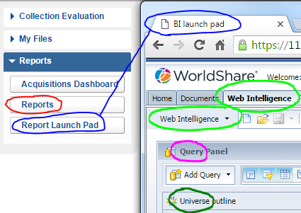
Report Designer - Training Session Topics
Terminology first
Notes:
TODD: It’s confusing when communicating where you’re at especially when the words “Report Designer” is nowhere to be seen

Slide 21
Report Designer - Names of the things
Notes:
TODD:

Slide 22
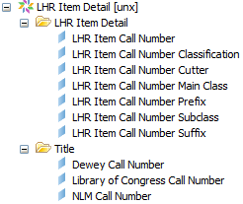
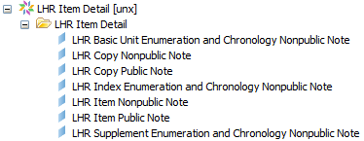
Report Designer: what you can do
Don’t forget the “Item Inventories” reports on FTP – it has a lot of shelf material + stats! (but no publication info)
Title Shelf List
Use new “LHR Item Detail” Universe
It has great Call # data
Publication info
Notes!
But no “Measures” or status or stats
Notes:
TODD: Here’s a closer look at the LHR universe mentioned in the previous slide

Slide 23
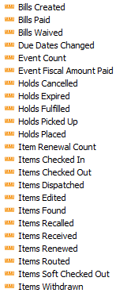
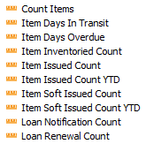
Report Designer: what you can do
Numbers/Counts/Stats
(w/ or w/out Titles)
“What’s happened over time?”
“Circulation Events”
Universe
Title List
(w/ or w/out Stats)
“What’s the status at this time?”
“Circulation Item Status” Universe
Neither of these Universes have “Author” or “Publisher” fields
Notes:
TODD: Before setting out, ask what kind of report the user needs - and what fields must be present

Slide 24
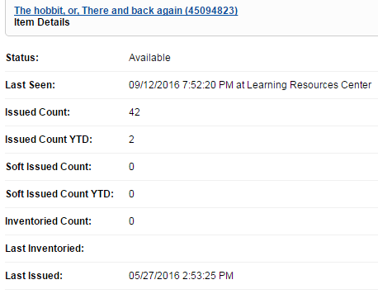
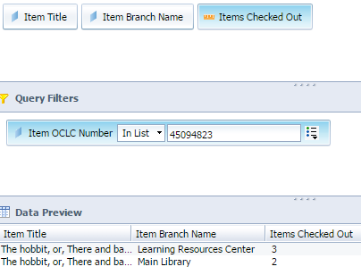
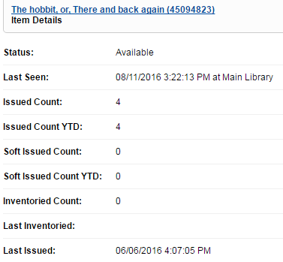
Report Designer: what you can do
More accurate checkout data than Circ module
Checkouts
vs.
Issued Count
(not the same)
Notes:
TODD: Left: "Issued Count" - as seen in WMS Circulation - Stats
Right: "Checkouts" - as seen in Analytics
These are not equal because they're not the same thing

Slide 25
Report Designer: what you can do
More accurate checkout data than Circ module
Issued Count (Circ)
Checkouts
+ Renewals
+ Any previous stats from implementation
= Issued Count
Checkouts (Report Designer)
Checkouts
= Checkouts only
Notes:
TODD: Documentation says Issued Count = number of checkouts is incorrect!

Slide 26
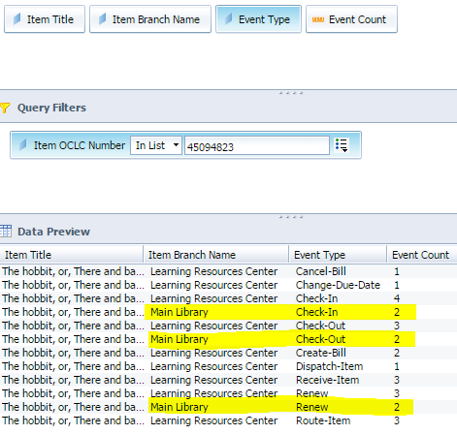
Report Designer: what you can do
More accurate checkout data than Circ module
Notes:
TODD: This is just to illustrate checkout + renew = issued count (for the "main" copy ... for the "lrc" copy, it is those stats + previous checkouts from old system)

Slide 27
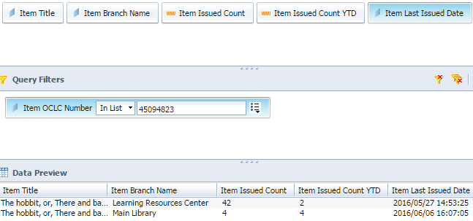
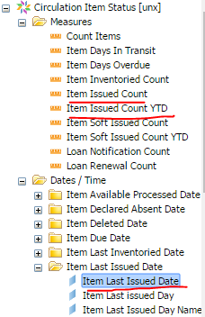
Report Designer: what you can do
More accurate checkout data than Circ module
Notes:
TODD: In Report Designer: for "Issued Count," you can get those numbers from Circ in the Circulation Item Status universe and they match up!
YTD = The number of times an item has been checked out since 1 January of the current calendar year
FYI: "Soft Issued Count" is when an item is Checked-In in Circulation as a "Non Loan Return"
On right-bottom: these numbers come from the Circulation Item Status universe (checkouts come from Circulation Item Events universe)

Slide 28
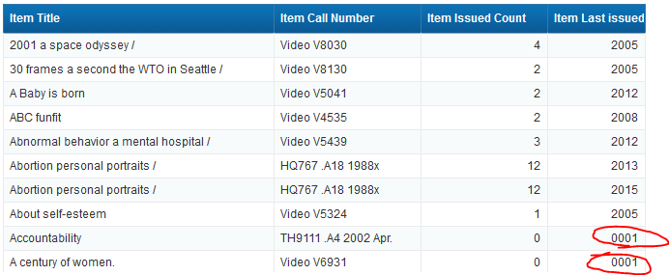
Report Designer: what you can do
Weird Year?
If Last Issued Year is “0001” item, then the item hasn’t circulated in date range
Notes:
TODD:

Slide 29
Report Designer: what you can do
Identify non inventoried items
Use “Circulation Item Status” universe
Use “Item Last Inventoried Date” in Query Filter and make equal to: 1/1/0001 00:00:00 AM in criteria (shows different in report)
Make it “Not Equal to” to eliminate items not inventoried
Notes:
TODD: How to deal with dates, not just “Inventoried” date - when keeping/removing items based on a date that is sorta null

Slide 30
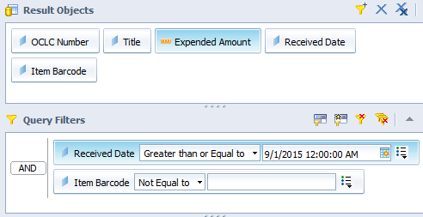
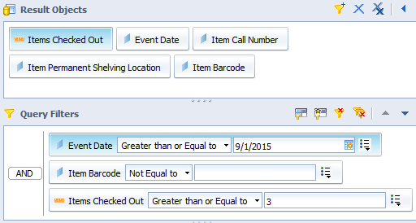
Report Designer:
what you can do
Circ Stats + Purchase
Acquisitions
universe
query
Items purchased within past 2 years that have circulated 3 or more times
Must be a “cross-universe” report with Acquisitions + Circulation Events universes
These queries match on Item Barcode
Circulation Events
universe
query
Notes:
TODD: not uncommon type of report to be requested

Slide 31
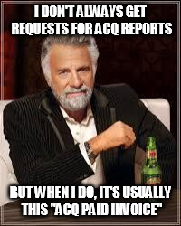
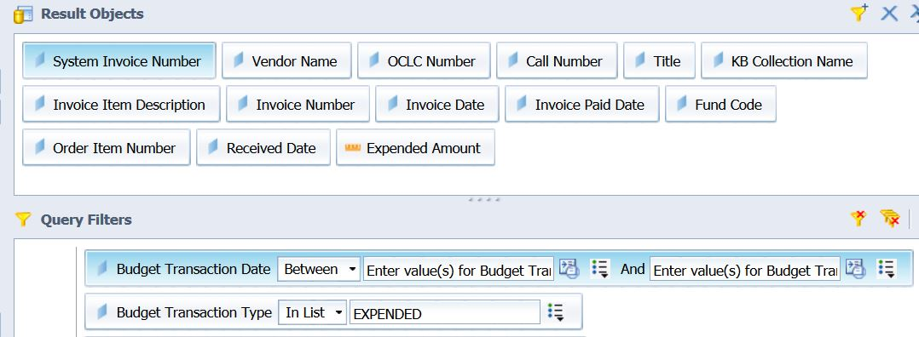
Report Designer - what you can do
Acquisitions Reports
Notes:
TODD: Don’t get these a lot, but it’s usually “Acq Paid Invoices” which prompts for a date range for the transactions (often for fiscal period)

Slide 32
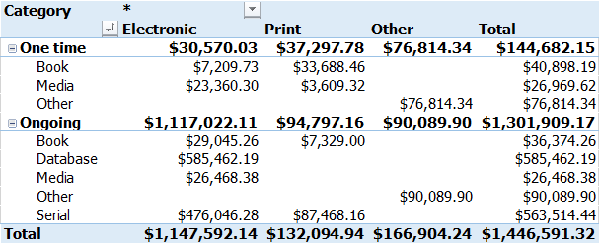
Report Designer - what you can do
Acquisitions Reports
For ACRL / IPEDS Reporting
Notes:
KELLY - how I translate to ACRL requirements

Slide 33
Miscellaneous Problems

Slide 34
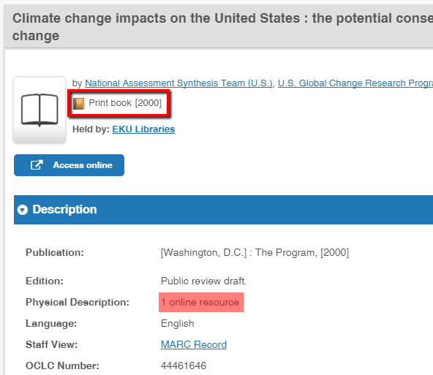
Collection Evaluation: Format field not entirely accurate
Ex: “Book, Print” format may be applied to online records because of how OCLC determines eBook status...
Notes:
LAURA: eBook icon only applied when an 856 40 field is present (if it’s 856 41 like a lot of our govdoc titles, then they will display as print books); if thesis/dissertation, it will display as print book, even if field 856 40
Still trying to understand how OCLC translates the myriad codes in catalog records. See for example: http://www.oclc.org/support/help/SearchingWorldCatIndexes/#06_Format_Document_Type_Codes/Format_Document_type_codes.htm%3FTocPath%3D_____5

Slide 35
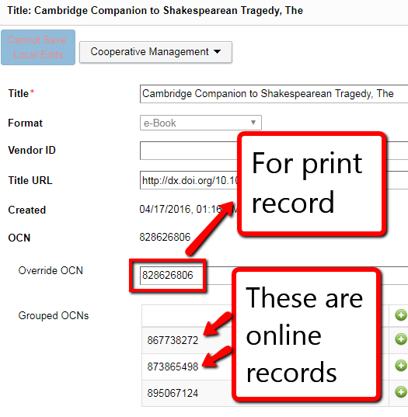
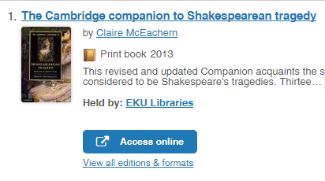
Collection Evaluation: Format field not entirely accurate
...or because Collection Manager is using a print record instead of online
Notes:
LAURA: Sometimes print records are selected for titles that are in online collections activated via Collection Manager. This can be either because the vendor is providing title info for print, or Collection Manager is matching on a print record rather than online
This is a cleanup project idea: double checking these in Collection Manager and submitting online records for the override OCN (the “version of record” that Collection Manager will apply your holdings to).
Remember that this has a public-side impact - patrons who may want online-only records (limiting to eBook, for example)

Slide 36
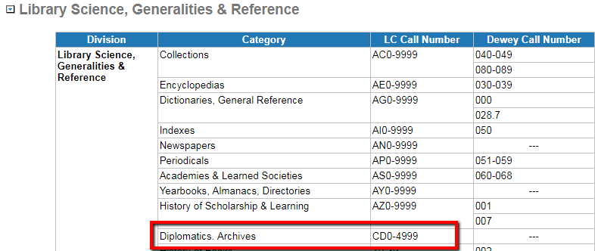
Collection Evaluation: Data problems
Subject assignment only as good as data entered into call number fields
Music CDs categorized as:
“Diplomatics. Archives,” “Diseases of Organs, Glands, Systems,” etc.
???
Notes:
LAURA: Subjects are coming from OCLC’s Subject Conspectus. This assigns subjects based on the call number fields (the conspectus lays out each call number range and its corresponding subject area). If call number fields are not used correctly, then subjects may be inaccurate. This may be from libraries editing records for local use and not realizing the impact in Worldcat if they load records there.
Domestic Engineering is from Dewey 644 call number range.
Diplomatics. Archives is from LCC CD call number range.
Diseases of organs, glands, systems, is from Dewey Decimal 616 call number range.
It also appears to look at the local call number field if it doesn’t recognize what is in the 050 or 082 fields. If you notice weird subjects on the Collection Evaluation report, you can try fixing the call numbers (if you are able) to see if that does anything.
OCLC Conspectus: http://www.oclc.org/support/help/collection_evaluation/Default.htm#OCLC Conspectus/OCLC_Conspectus.htm%3FTocPath%3D_____8

Slide 37
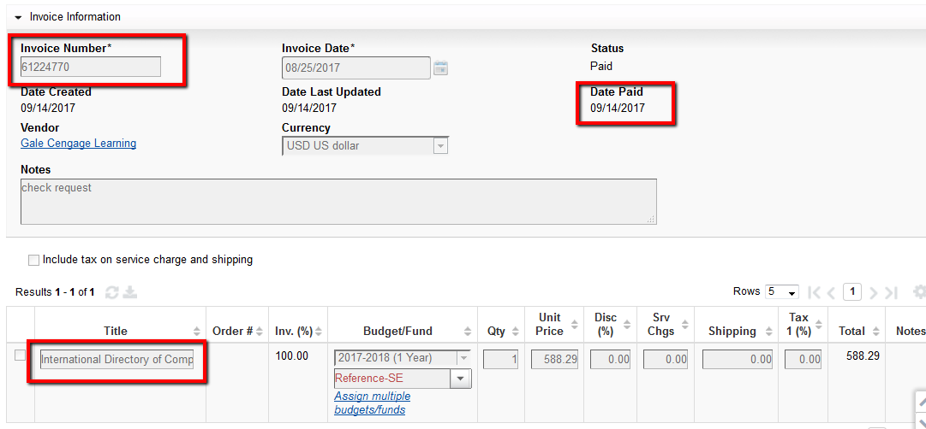
Report Designer: Invoice Paid Report problem
ADMIN POV
Notes:
KELLY Makes verification against Banner really difficult.

Slide 38
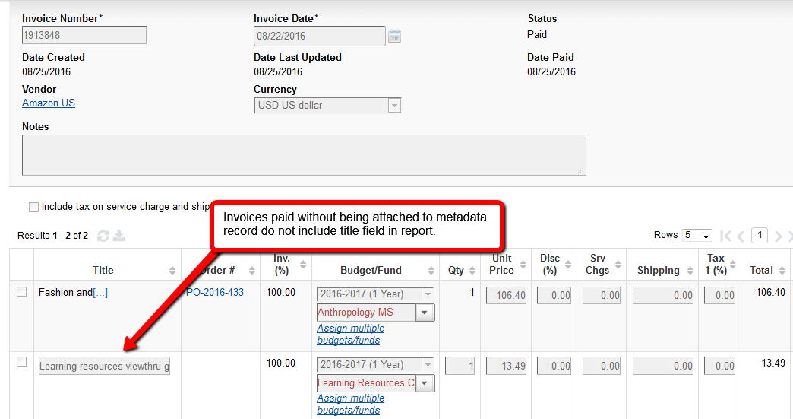
Invoice Paid Report problem
ADMIN POV
Notes:
KELLY. Discovered source of problem. Invoice not attached to metadata record because Gale treats each volume in the series like a standalone eBook and sends records for each volume (instead of relying on series-level record), and these records are added months after Amy receives the invoice for them.

Slide 39
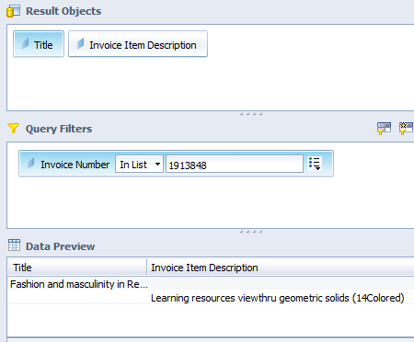
Invoice Paid Report problem
Can get title names that aren’t connected to a metadata item (where we manually put in “title”)
Needed to add “Invoice Item Description” from Acquisitions universe
However, the report is still missing fields such as shelving location, format, etc.
Notes:
TODD:

Slide 40
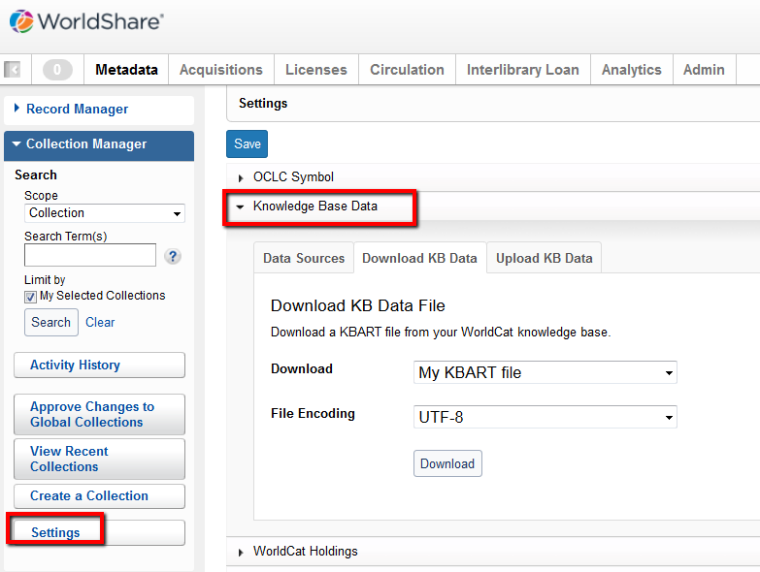
Report Designer: Collection Manager data not included
Only option right now is to download one massive file
Need ability to export with limits by:
Collection(s)
Format (eBooks, eJournals, etc.)
DDA Triggered vs. not triggered
Provider(s)
Fields needed:
Title
ISBN
Publisher
Collection Name/ID
Activation status of title
Notes:
LAURA:“My KBART file” is massive - 534 MB last I checked
Report needed for JSTOR Book Acquisition pilot with SAALCK - for consortial DDA pool. Needed report of all of our activated eBooks (not including any in our JSTOR DDA collection because those technically are not purchased yet).
Todd could not do this in Reports (at the time - not sure if Reports has improved since April 2017)
--report appeared to be pulling ALL eBooks, regardless of activation status
Laura ended up exporting KBART files for each of our eBook collections and combining into one file

Slide 41
Inventory: WITHDRAWN item status is misleading
Applied anytime a barcode is deleted
But what if it was an accident? Wrong record, cataloger fumble, accidentally hit wrong button
Our solution: Staff submit withdrawal stats to google form
Enhancement request: let staff manually set item status to withdrawn
Notes:
LAURA: Lots of mistakes as a new WMS library; also before ability to move LHRs to different record. Cataloging staff didn’t know about ability to “change worldcat record” in Acquisitions

Slide 42
WMS Analytics: The eBook problem
OCLC documentation does not appear to follow current guidelines
From “Searching Worldcat Indexes - Format/Document Type values and codes for Worldshare and Worldcat Discovery” website
From the PCC’s “Provider-Neutral E-Resource MARC Record Guide” document (dated Aug 30, 2017)
Notes:
LAURA: Most eBook records I have looked at are using “o” in 008/23.
http://www.oclc.org/support/help/SearchingWorldCatIndexes/#06_Format_Document_Type_Codes/Format_Document_type_codes.htm%3FTocPath%3D_____5
https://www.loc.gov/aba/pcc/scs/documents/PCC-PN-guidelines.html

Slide 43
WMS Analytics: The eBook problem
It all hinges on the 856 field...
OCLC Support stated:
...But not always?
???
Notes:
LAURA: How does system identify eBooks? OCLC support told me eBook facet is displayed in WC Discovery based on 856 40/4_ field. This seems to also impact how the format is determined for records in Collection Evaluation and in other reports.
OCLC has a lot of print records that were modified for electronic, which accounts for some of the issues Worldcat has in properly identifying eBooks.
Not sure why thesis/dissertation records show as “book, print” on collection evaluation report, even if 856 40 field is present - actually waiting to hear from Support about this

Slide 44
WMS Analytics: The eBook problem
Titles activated via Collection Manager module are included in Collection Evaluation reports
Identifiable by:
“Format” field (“Book, eBook”; “eJournal”; etc.)*
Lack of shelving location in the “Location” field
Notes:
KELLY: This can also be seen in Collection Manager reports.
Collection Evaluation is pulling the 1st URL listed on the master record in Worldcat - whether or not that’s the localized link that we use (which is coming via Collection Manager NOT Record Manager)

Slide 45
Questions?
Understand your question (The Why)
Why do you need it? (AKA who is your audience)
Articulate what combination of metrics you need to answer the question
Understand the data (The What)
Where is it coming from?
Who/what is inputting it?
Does it mean what you think it means?
Slides available at http://encompass.eku.edu/fs_research/191
Laura Edwards laura.edwards@eku.edu
Todd King todd.king@eku.edu
Kelly Smith kelly.smith2@eku.edu

