Slide 1
Inventory in Digby
Laura Edwards
Eastern Kentucky University
WMS Midwest User Group Meeting 2018

Slide 2
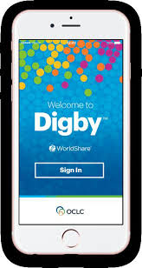
What is Digby?
Mobile app
Supports basic circulation tasks:
Pull lists
Reshelving (track browse counts)
Basic inventory
OCLC’s Digby app FAQ
Notes:
Mobile app - can use on compatible devices like your smartphone, tablet. I think it works on Apple and Android devices. Can use your own device - OCLC controls access to the Digby app in a couple of ways. First you have to submit a request for them to activate Digby for you, then when you download the app, you will be prompted to login with your typical library login. That way, someone can’t just download the Digby app and mess with your library’s holdings for some reason.
The Digby app has a very streamlined interface versus the WMS modules. Doesn’t include the full functionality of WMS Circulation module, which means it runs quickly and seamlessly
We use it for our inventory - we don’t use the other modes at this time.

Slide 3
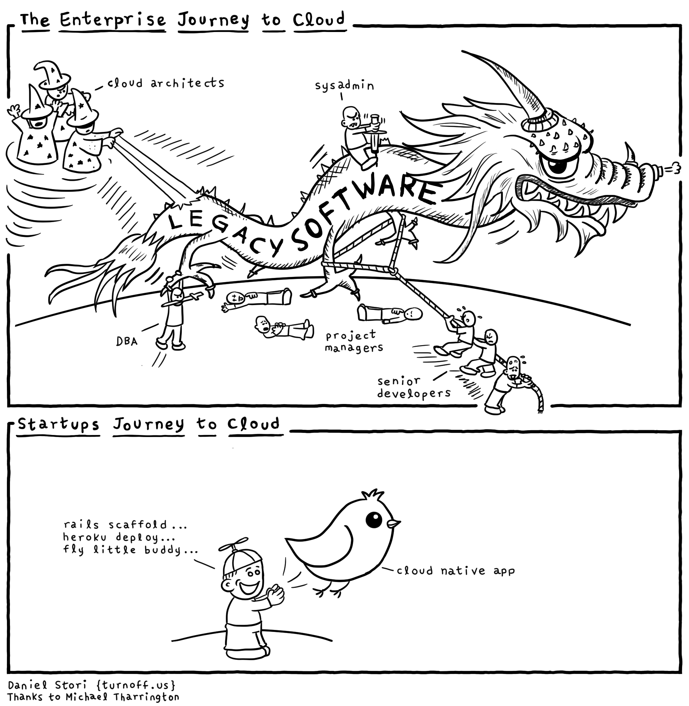
WMS Circulation module
Digby app

Slide 4
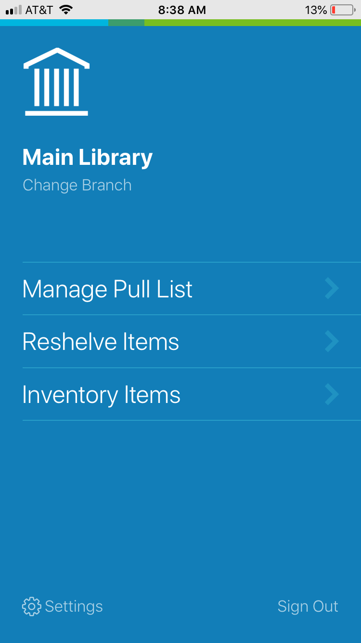
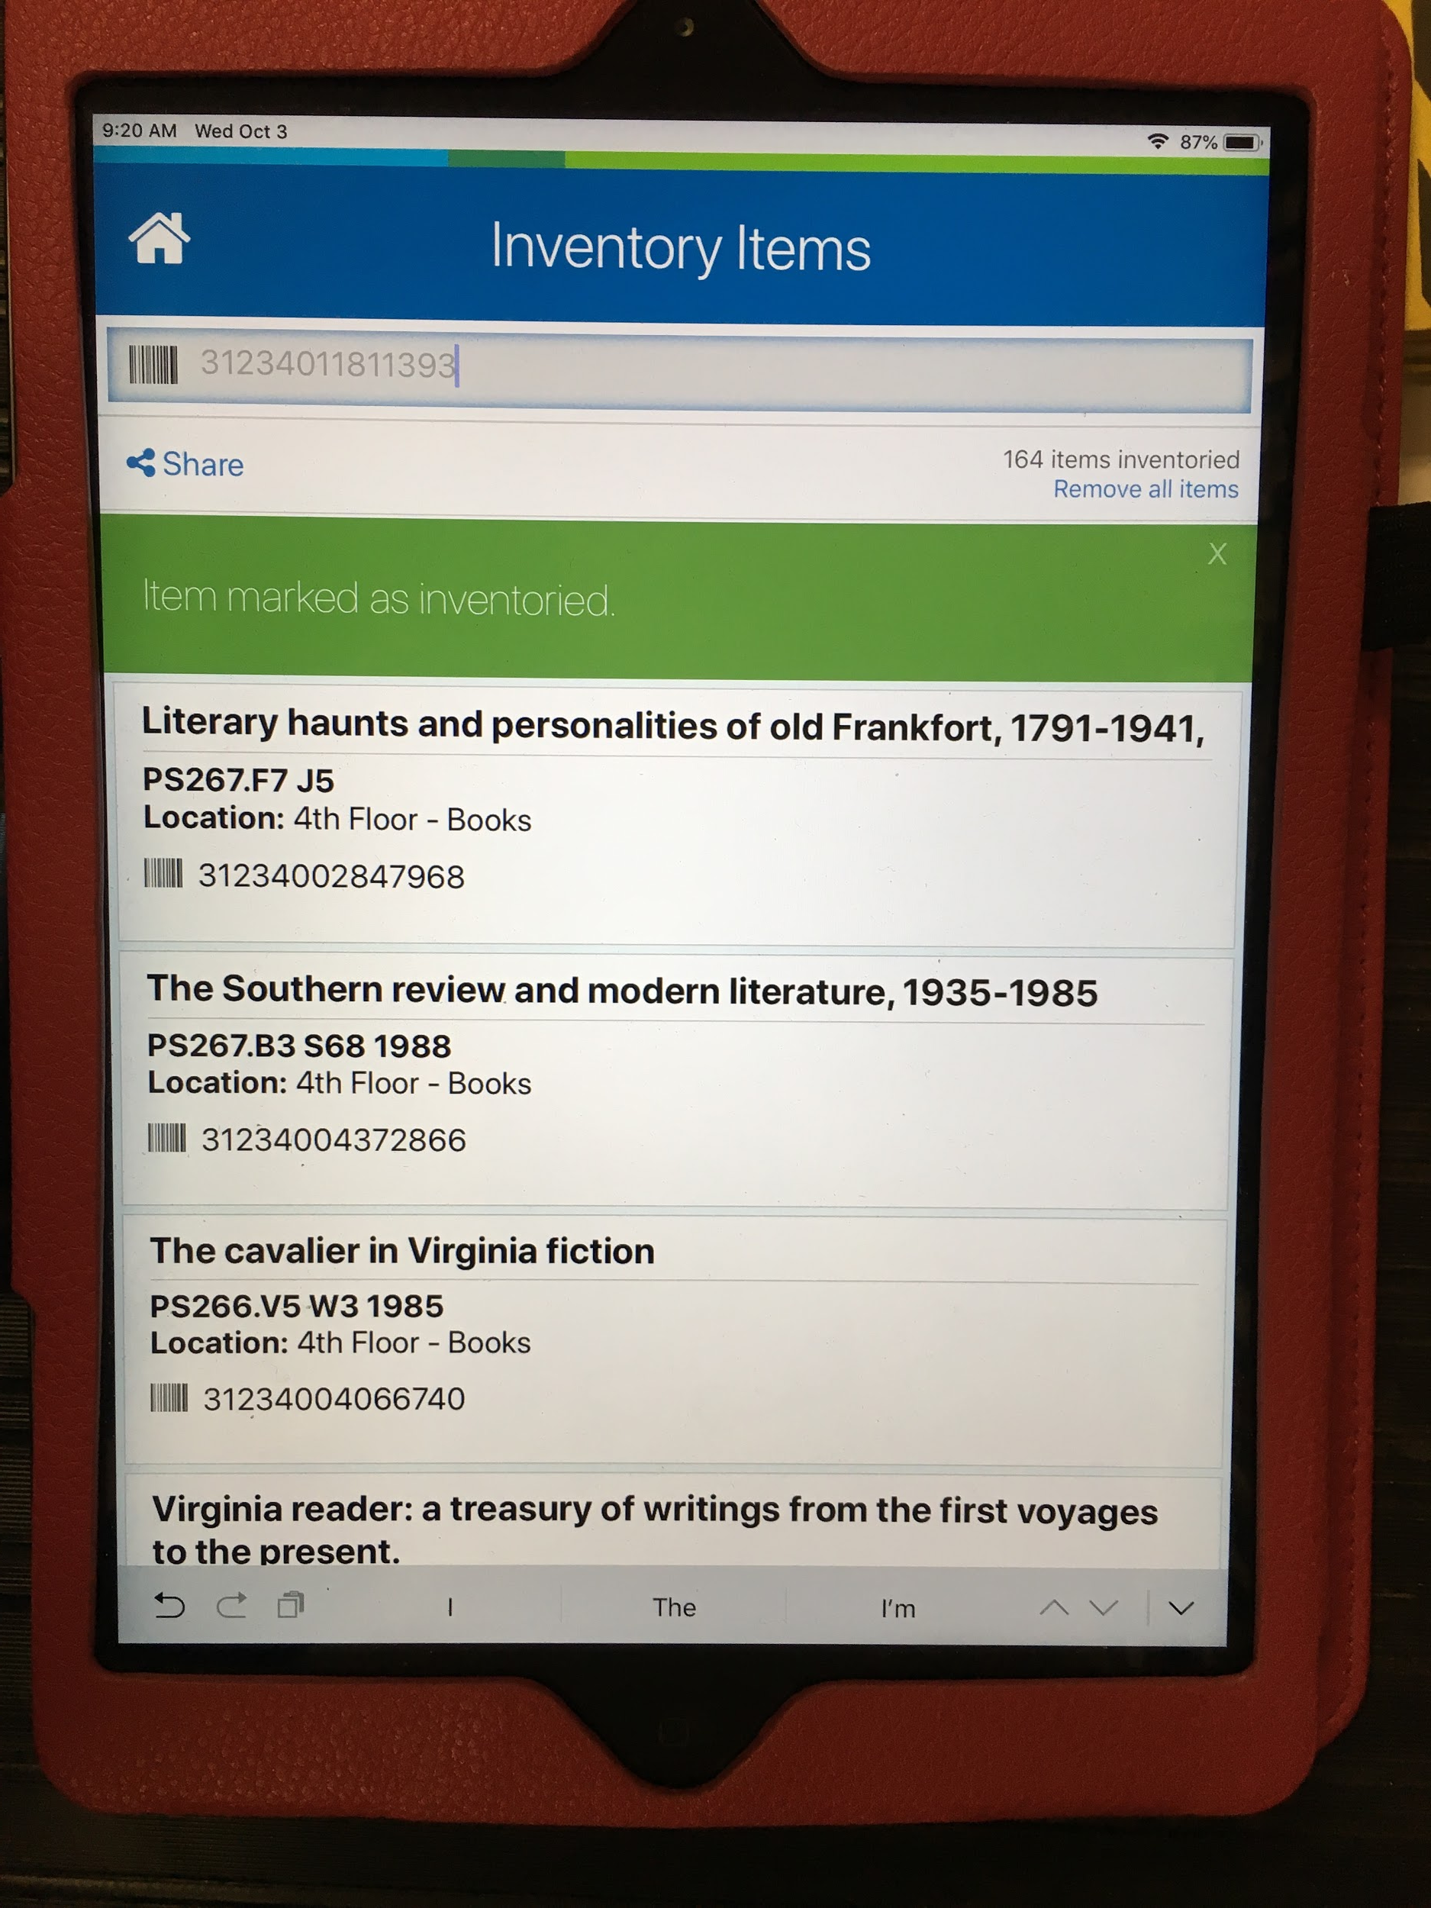
Digby: Inventory Items mode
Notes:
Here’s what the inventory mode looks like in Digby
Maintains a running list of what you’ve inventoried - the list is very easy to scan at a glance. All the basic info related to the item is there for you if needed - title, call number, shelving location, barcode. Just enough info. You won’t be able to access circ stats, or go in to add a staff note. But that’s just fine - that’s the nice thing about Digby - it’s very task-focused.
Remembers what you last inventoried (unless you clear it out via that “Remove all items” link - you will need to once you’ve scanned 1000 titles. Otherwise, it starts slowing down).
Can share a report of your inventory activity via that “Share” link. Later on, I’ll talk a little more about the inventory reports

Slide 5
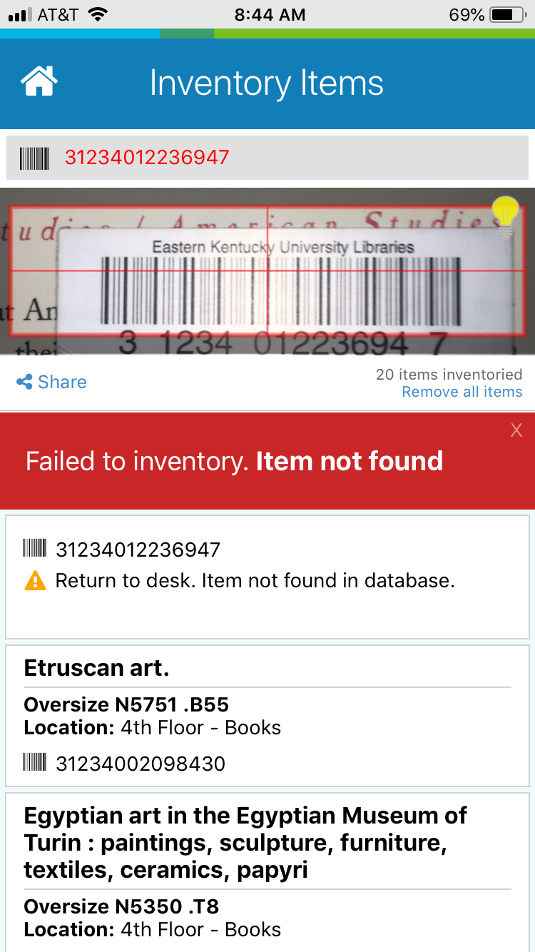
Digby:
Scanning Barcodes
Camera
Scanner
Notes:
Can rely on your device’s camera OR pair with a scanner. If you’re planning to do inventory, you should really look into using a scanner. Fiddling with your device camera to get it to focus on the barcode will get annoying if you have rows and rows of books to scan.
One of the nice things about the Digby app is the thoughtfulness of the design. If you’re relying on your device camera, they’ve given you the opportunity to turn on your device’s built-in flash. Just tap that flashlight icon in the picture box and it will turn on the flash. Helpful if you’re in a dark part of the stacks.

Slide 6
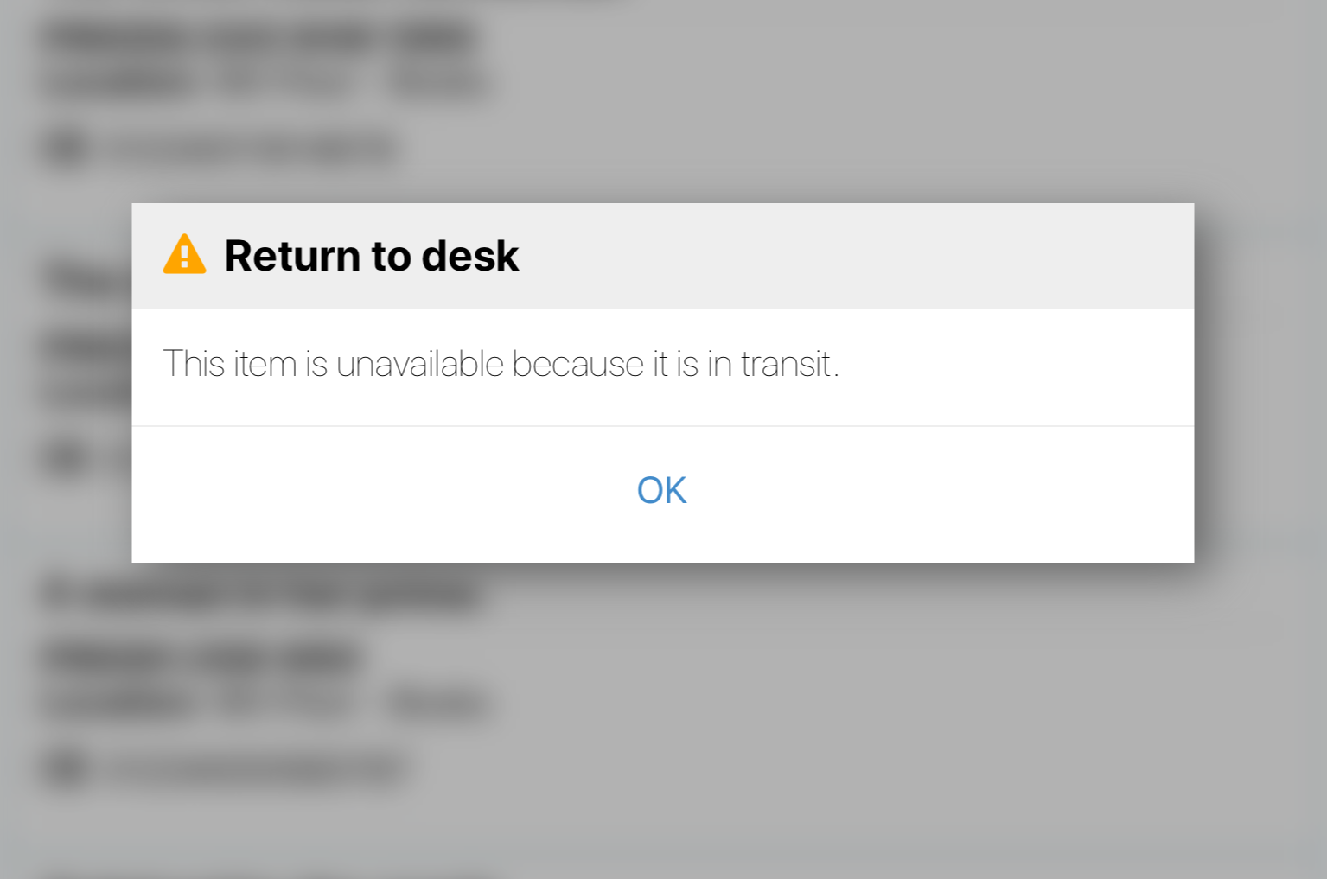
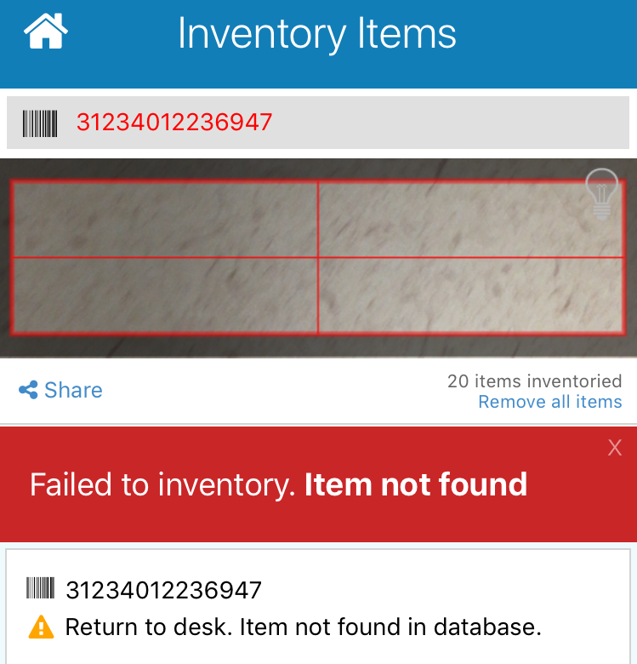
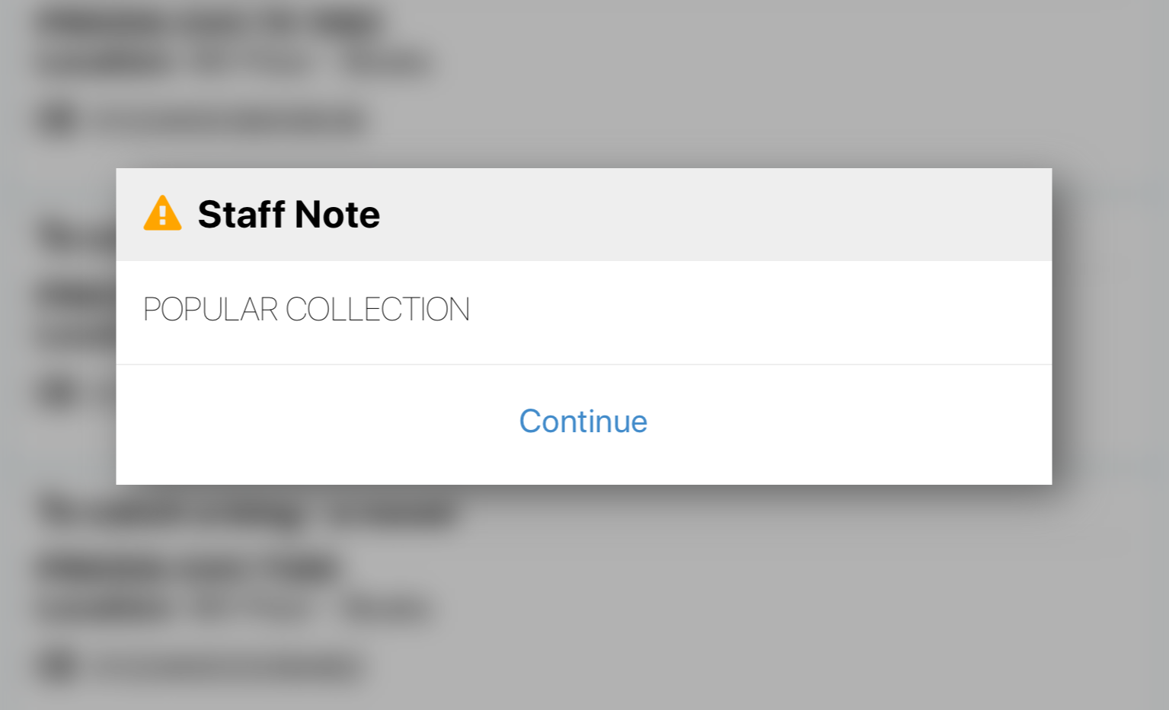
Digby:
Issues with Items while scanning
Notes:
Digby will alert you to any problems while scanning.
Some examples
Item not found -- barcode was not in the system.
Item status of “In Transit” - needs to be checked in to clear that status
Staff note -- if the staff note is coded to alert circulation workers, it will show up during inventory too (i.e. you might code something to notify staff to check multi-part items to make sure everything was returned together, or a staff member wanted something sent to them for cleanup, etc.)
side note: to code staff notes to generate a popup note for circulation, put an exclamation point in front of the note

Slide 7
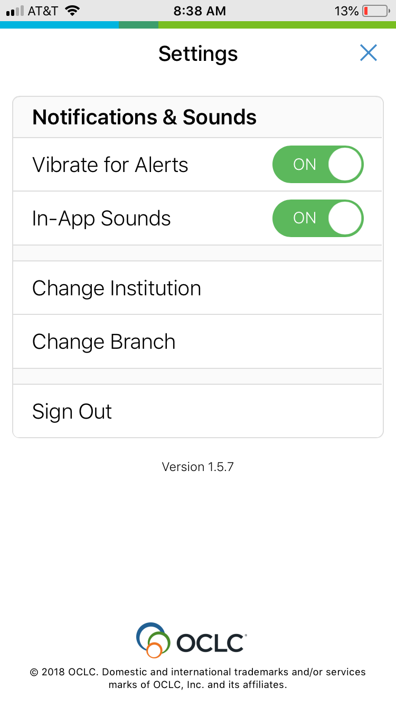
Digby:
Notifications & Sounds
Notes:
This is the most helpful thing about Digby - it has an option to notify you by sound or vibration anytime an issue crops up. I strongly recommend that you turn this on. It is very helpful when you are in scanning mode, so you can scan without worrying about keeping a close eye on the screen.

Slide 8
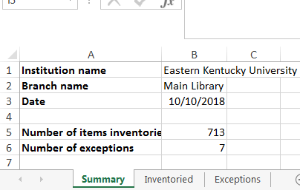
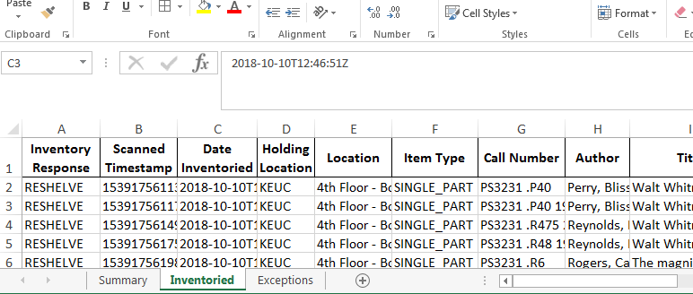
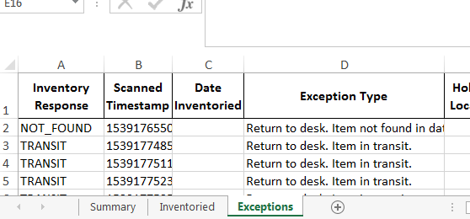
Digby:
Inventory Reports*
“Summary” tab
“Inventoried” tab
“Exceptions” tab
*not the same as the FTP Circulation Item Inventory Reports
Notes:
Digby generates inventory reports based on your activity for the day. You can send to yourself, and anybody else you need to, via email.
Report has 3 tabs:
Summary with number of titles inventoried, and number of issues encountered
Inventoried tab - list of items inventoried
Exceptions tab - list of barcodes and their problems (usually either “item not found” or items with IN TRANSIT statuses)
These are the barcodes that you will have been alerted to while scanning. The report will also document the problem barcodes on this spreadsheet for you
Important to remember that Digby Inventory Reports are only reports of what you scanned. They are not a comprehensive report of everything that should have been scanned in that particular range that you were inventorying. If an item should have been on the shelf, but was not (missing, long lost, etc.), Digby will not notify you of those titles. You will have to refer to the FTP Circulation Item Inventory Report for a more in-depth review of the collection.

Slide 9
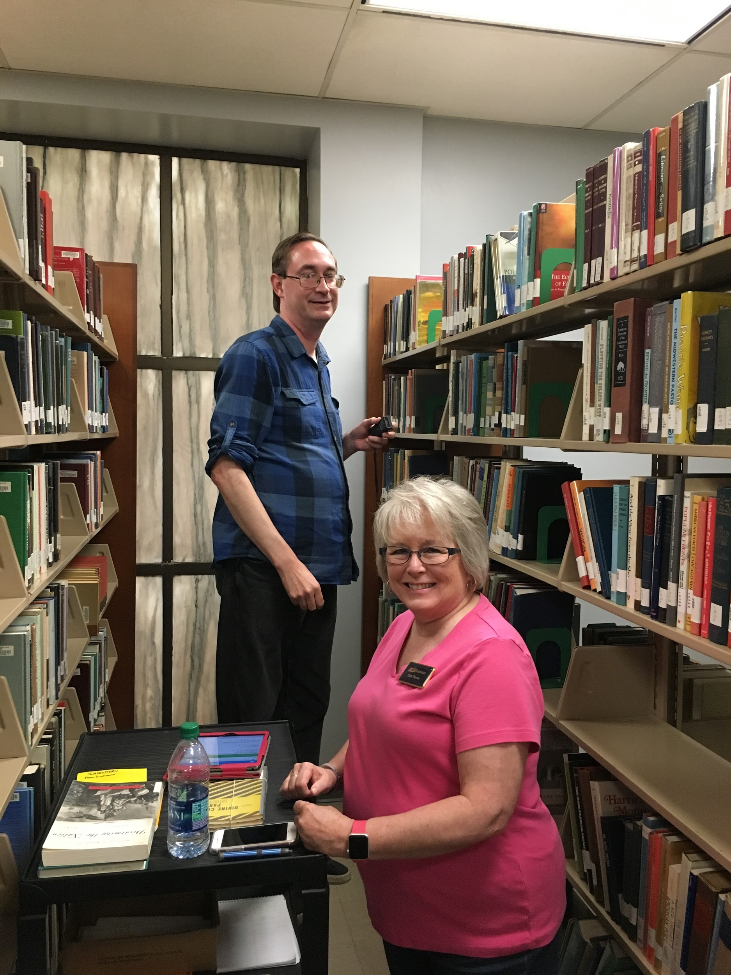
Inventory Workflow & Process at EKU: Scanning
Staff perform quick shelf-read of range they plan to scan.
Spread books out on each shelf for easy scanning
Start scanning
Problem titles are pulled and taken to subject liaison for review
→ Do they need to work in pairs?
Notes:
Here’s our cataloging staff members Carol and Kyle in action.
Shelf-read: we use Library of Congress classification at EKU. Shelving staff have shelf-read ahead of the inventory, but we have noticed that sometimes our student workers overlook the letter part of the call number -- put PRs in the PS range. So Carol or Kyle just look at the letters of the top row -- making sure the letters match the range they are in. The inventory report review will catch items scanned out of order, but this is just a quick way for them head that problem off at the pass.
Make room on each shelf: one of them will go ahead and space out the books on each shelf to make it easy to pull books out for scanning
Problem titles: items not found are pulled and taken to the subject liaison for review. Sometimes we don’t want to add the title to the collection (and if no one has asked for, do we really need it?). After review, subject liaison will take to cataloging staff to either add back to collection or donate/recycle.
Working in pairs - this is a legacy from when we were using WMS Circulation module on a laptop for inventory. Using the laptop was a more clunky process than the Digby app, and really did require two people. 1 to scan, and 1 to keep a very close eye on the laptop screen to make sure items were getting scanned, as well as to monitor any error messages that might pop up since the system didn’t give you a sound alert. They’ve continued to work in pairs out of habit, and because 1 person can still go ahead and perform the manual tasks ahead of the person scanning since they don’t need to keep an eye on the Digby app. Carol will go up on her own to do more scanning.

Slide 10
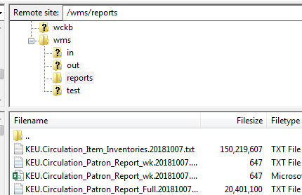
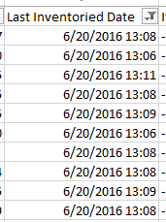
Inventory Workflow & Process at EKU: Report Review
Scanners notify metadata associate of call number range scanned in previous week
Metadata Associate pulls FTP Circulation Item Inventory report weekly
Metadata Associate sorts and filters in succession, looks for:
titles scanned, but from another shelving location
titles scanned, but out of order
titles scanned, but with item status WITHDRAWN or ON_LOAN
titles not scanned
Report is smaller and smaller based on progression of checks
Eventually narrowed to call number range inventoried as of a certain time period
Problems noted, cleaned up and/or referred to other staff
Notes:
Inventory report only reports the timestamp when an item was scanned in “inventory” mode (via Inventory Items on Digby or via the check-in mode in Circulation module). Does not “tell” you whether scanned items are in another location, misshelved, or not scanned. You still have to review the report.
Inventory process will not catch holdings floating in Worldcat for print items that have no LHRs and are no longer on shelf (need to look at Collection Evaluation reports to catch these). The Inventory scanning process will potentially catch titles that have no holdings/LHRs applied if they are on the shelf and scanners catch it (we remind them to go slow and pay attention to the screen for each book they are scanning)

Slide 11
Inventory Workflow & Process at EKU: Record Cleanup
Notes:
This is a typical report sent along to cataloging staff for cleanup.
Different tabs for types of problems:
For Review - there were some things about the records that caught the metadata associate’s attention, like incorrect call numbers
Unscanned - items that should have been scanned during the inventory, but weren’t. Most of these are just withdrawn.
Withdrawn - items that had a withdrawn status but were put back on the shelf for some reason

Slide 12
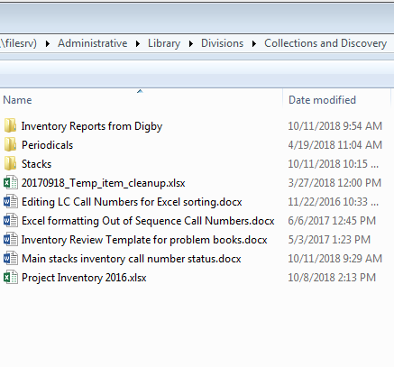
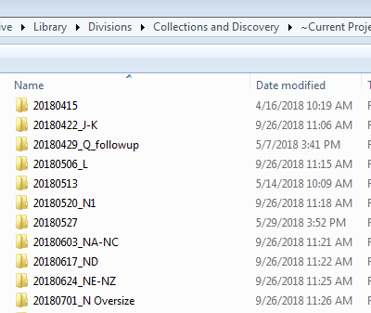
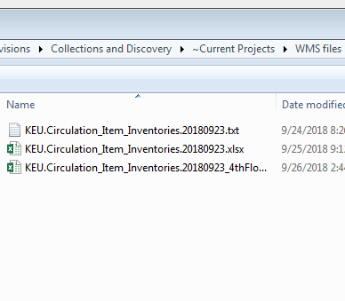
Inventory Workflow & Process at EKU:
Report Review - File Management
Each folder contains all the working documents for that range.
Each range scanned gets its own folder.
Inventory Project Folder in Metadata Team’s folder
Notes:
This is how we manage the files for our inventory review process.
Folders are named according to the range scanned.
Files are named according to the range scanned.

Slide 13
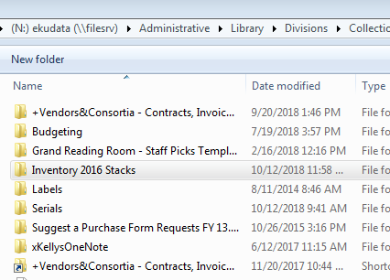
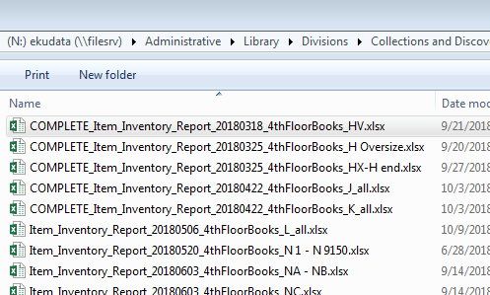
Inventory Workflow & Process at EKU:
Record Cleanup - File Management
Inventory Project Folder in Cataloging Staff’s folder
Files sorted by range scanned
Notes:
When it’s time to pass along titles for clean up, the Metadata Associate copies the problem titles onto a different spreadsheet and saves it to a different folder for the cataloging staff to access. That way, we maintain the integrity of our files as we work through our review process from start to finish and don’t have to worry about someone accidentally overwriting the work of another staff member.
Files are renamed to include “COMPLETE” when cleanup is complete - helps to quickly scan progress of record cleanup

Slide 14
Digby and Inventory: Some Tips
Workflow ease:
Just get a scanner
Keep your device charged
If using a work device, create an account with a generic work email
Collections Review:
Digby will not tell you what’s missing from the shelf
For a comprehensive review, consult:
FTP Circulation Item Inventories report (export via FTP)
Collection Evaluation report (via WMS Analytics tab)
Notes:
To send Digby inventory reports, your device needs to have an email address to send FROM. If you’re using a work device, you will need to create a dummy persona. We associated our existing eResources email with an Apple account on our work iPad

Slide 15
Questions?
Laura Edwards laura.edwards@eku.edu
*For more information about the different reports and data available in WMS,
see “Navigating WMS Analytics for the Right Data”
http://encompass.eku.edu/fs_research/191

