Slide 1

SWK 225 Human Behavior in the Social Environment 1
Module 4: Applying your Eclectic Knowledge: Pregnancy, Birth, Infancy and Toddlerhood
Slides developed by Erin Stevenson, PhD, MSW, Assistant Professor at Eastern Kentucky University’s Social Work Program. Adapted from text: Tyler, S. (2020). Human behavior and the social environment I. University of Arkansas Libraries. OER Textbook https://uark.pressbooks.pub/hbse1/ Creative Commons Attribution-NonCommercial-ShareAlike 4.0 International License

Slide 2

Prenatal Development
A typical pregnancy lasts 9 months - from conception to birth – and is broken up into trimesters for understanding development
First Trimester
Organs and systems begin to develop and become more complex. Heart rate, gender, and some motor abilities can be distinguished
Crucial development occurs during first trimester – Prenatal care is critical
Second Trimester
Development continues and body parts become more distinguishable.
Movement more controlled, wake and sleep cycle established
Third Trimester
Organs complete development and are functional.

Slide 3

Heredity
Genes located on your chromosomes are the specific sequence that makes up your inherited traits from parent genes
Normal human cells have 46 chromosomes (23 from each parent)
Genotype is the sum of all inherited genes
Phenotype is the set of genes that actually are expressed and impact things like hair and eye color
Genetic disorders are typically inherited
  Example: Tourette’s Syndrome, Cystic Fibrosis, Tay Sachs Disease
Chromosomal abnormalities occur when too many chromosomes are inherited (46+)
  Example: Trisomy 13, 18 or 21 (Down syndrome), Turner Syndrome, Klinefelter Syndrome
The Human Genome Project began in 1990 and continues to sequence genomes and identify genetic blueprints and variations

Slide 4
Alcohol and Drug use during pregnancy
Alcohol use may cause neural or cognitive development issues in the fetus
  Fetal Alcohol Syndrome is a range of developmental delays, physical features and behavioral issues that occur due to alcohol consumption during pregnancy
Tobacco use exposes the fetus to dangerous chemicals like nicotine, carbon monoxide and tar which reduces oxygen availability to the fetus
  Outcomes may include low birth weight, ectopic pregnancy, placenta previa, preterm or stillbirth, fetal growth restrictions, Sudden Infant Death Syndrome (SIDS), birth defects, learning disabilities and early puberty in girls
Prescription Drugs should be taken with caution of a doctor including ibuprofen
Illicit Drug use causes a range of problems which are complicated by the fact that most women who abuse substances will abuse more than one
  Babies can be born addicted to substances like opioids or heroin and have to go through withdrawal after birth, called Neonatal Abstinence Syndrome

Slide 5

Other maternal health Concerns
Birth defects and developmental delays can be caused by a pregnant woman’s exposure to:
  Chemical pollutants in water, soil and air (ex: lead, pesticides, bisphenol A, radiation, mercury)
  Toxoplasmosis parasite exposure from animal feces
  Sexually transmitted diseases like gonorrhea, syphilis, chlamydia and HIV/AIDS can be transmitted to the fetus by an infected mother
  German measles or rubella contracted during pregnancy can cause birth defects
Teenage mothers and women over 35 are considered at high-risk of health issues due to age and developmental stages of the mother
Maternal nutrition, physical health (cancer, diabetes, obesity, hypertension) and mental health all affect the development of the fetus.
  Access to prenatal care is essential to having a healthy mother and baby
  Having good health care is linked to employment, health insurance, income, and even culture

Slide 6
Maternal Control over childbirth
Many women give birth at home with doulas or certified midwives
Other support options include:
Birthing classes – educate and prepare women for what to expect during childbirth
C-sections – cesarean birth, most common surgical procedure in US, scheduled or unplanned
Episiotomy – in the past cutting of vaginal folds to assist with natural birth was common practice, most women choose to forgo the procedure now
Breastfeeding - gives mothers more control over the infant’s diet; may be healthier for the infant and mother and provides some immune protection for the vulnerable infant; recommended for first six months of life or longer though this can be challenging for women returning to work
Family Medical Leave Act (1993) required employers to protect jobs and provide unpaid leave at a minimum for women to give birth
Affordable Care Act of 2010 (ACA) made 22 preventive and other services accessible including:
  pregnancy screenings for illnesses and genetic issues
  support for breastfeeding education and post-natal
  well-women visits before, during, and after pregnancy
  Screenings and support for issues like mental illness, including maternal mental illnesses and postpartum depression, and domestic violence

Slide 7
Birth weight
Approximately 1 in 12 babies born in the U.S. are categorized as low birth weight
Ethnic minority groups tend to have higher rates than the national average
Preterm infants, born 3 weeks before full term, typically have low birth weight
Low birth weight: Baby that weighs <5 ½ pounds at birth
Very low birth weight: <3 pounds at birth
Extremely low birth weight: <2 pounds at birth
Concerns with low birth weight include:
More likely to have health problems as a newborn, especially respiratory and heart problems
20x more likely to die in infancy
More susceptible to infectious diseases, delays in growth and cognitive development

Slide 8

Postpartum Maternal Care
Attachment refers to the emotional bond between parent and child
It is a critical factor in brain development and influences social and emotional growth
Lack of attachment can lead to physical decline or emotional difficulties in the child’s development
Poor emotional health of the mother can negatively impact the ability to bond and develop a strong healthy attachment with their infant
“Baby Blues” or depression postpartum = persistent sleep issues, moodiness, sad feelings that don’t go away
Common among women in the first 10 days postpartum
Continued issues occur in about 1 of 8 women and can affect bonding with the newborn
Risk factors: teenage mother, family history of depression, stress, substance abuse
Postpartum anxiety can also occur with heightened alertness and stress
Continued postpartum care for the mother will assure she can seek assistance from a health care provider or counselor for mental health support

Slide 9
Maslow’s Hierarchy of Needs
Humans have multiple needs – Each level, from bottom up, must be achieved before an individual can focus attention on the needs of higher levels
Social Determinants of Health are tied to resource access and our ability to meet basic needs
Poverty may negatively impact pregnancy and birth, as well as child development
Self-Actualization Needs:
Self-Acceptance, Morals, Values, Problem solving
Challenges with finding food, shelter, safe locations, clothing, and transportation can lead to poor health and well-being
Esteem Needs:
Self-respect, Competence, Approval, Respect of Others
Belongingness and Love Needs:
Affection, Acceptance, Intimacy
Safety Needs: Security, Shelter, Stability
Physiological Needs: Food, Drink, Shelter

Slide 10

Infant and Toddler Cognitive Development
Language development is universal
Newborns immediately communicate needs via sounds, which become more complex as the child ages
First words generally occur between 10 and 15 months, though children often understand through gestures and sounds more than they can speak
Are able to speak full sentences by 3 years
Piaget’s Cognitive Development Theory – Sensorimotor Stage: focused on developing schema for the world around them, assimilation and accommodation of new information
Critical milestone is object permanence or idea that an object or person still exists even when it is out of sight

Slide 11

Infant and Toddler Physical Development
Physical Development occurs rapidly in the first few years of life
Monitoring milestones typical for development at specific ages may help alert us to delays and need for intervention at well-child checkups
The brain shows some of the most dramatic growth in this time period thus sleep and nutrition are essential
Sleep patterns
  A newborn typically sleeps approximately 16.5 sporadic hours per 24-hour period
  Infants sleep about 15 hours while a 6-month old will sleep about 14 hours
  By age two the average is 10 hours per 24-hour period
Gross Motor Skills require use of large muscles and develop from the initial reflexive actions like suckling or rooting to neck strength for holding up the head, rolling over, and balance for sitting and standing
Fine Motor Skills use small, controlled movements using smaller muscle groups (fingers, toes, eyes) for vision, grasping, eating

Slide 12

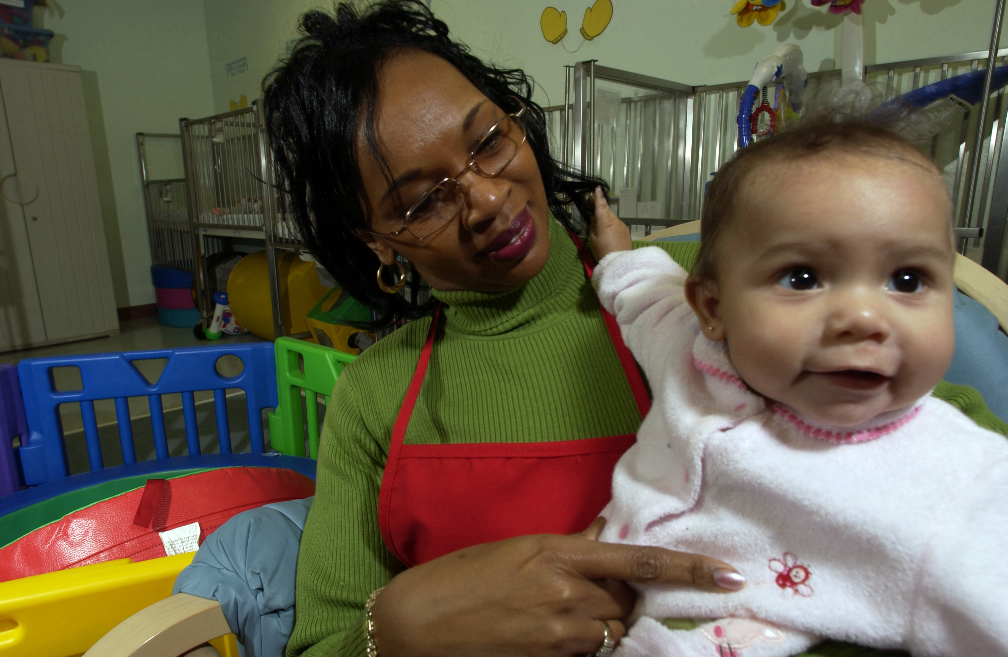
Infant and toddler social development
Social development is focused on the immediate family and caregivers
Bandura’s Social Learning Theory – observation and imitation of language develops our speech and communication abilities, as well as engagement with the environment
Erikson’s Stage of Psychosocial Development – Trust vs. Mistrust
  Developing ability to trust adult caregivers
  Emotional attachment is being formed
  Depends on level of needs being met
  Neglect very damaging at this phase with lifelong consequences
Starting Autonomy vs. Shame at end of toddler phase to focus on independence

Slide 13

Key Takeaways
Many things impact fetal and infant development
  Heredity, drug/alcohol use, maternal health and well-being, access to healthcare
  Birth outcomes like low-birth weight and physical health are also affected by maternal health
  Access to prenatal care is imperative as well as postnatal and well-child checkups
  Mother’s maintain some control over birth through planning and support
Cognitive and physical development is rapid during the first 3 years of life
Maslow’s Hierarchy of Needs is a helpful tool to understand the social environment and its effect on development
Access to care and resources can impact outcomes including policies supporting women and infants

