Slide 1
Chapter 16: Reporting Research
Scientific Inquiry in Social Work

Slide 2
Chapter Overview
The previous chapters in this textbook described how to create a research question and answer it using the methods of social science.
Social work research is aimed at gaining knowledge for action on behalf of target populations.
Research that sits idle on your computer is not of use to anyone.
This chapter will help you understand how to share your work as the final step in your research process.
What to share and why we share
Disseminating your findings
The uniqueness of the social work perspective on science

Slide 3
Reporting research
The good, the bad, and the ugly…You must tell it all…the whole story.
Why did you conduct this research?
How did you conduct it?
For whom was the research conducted?
What conclusions can be reasonably drawn from this research?
Knowing what you know now, what would you do differently?
How could this research be improved?

Slide 4
Who is your audience?
What are important social work audiences? Stakeholders? Funding agencies?
How might social workers use different media to disseminate their findings, depending on the audience?
Professional vs. non-professional
Who is your audience?
Where is your audience?
How do you reach your audience? Be specific

Slide 5
Professional Presentations
Common forms of sharing your research findings include:
1. Formal talk: presentation lasting about 15-20 minutes using slides and other visual aids
2. Roundtable presentation: goal is to stimulate conversation, shorter presentation time and often with other professionals at the table
3. Poster presentation: tells the story of your project in images; great place to start for young researchers, students
Big social work conferences:
CSWE/APM
BPD
SSWR
AEA
Also look at college supported conferences that feature undergraduate and graduate research - Pedagogican

Slide 6
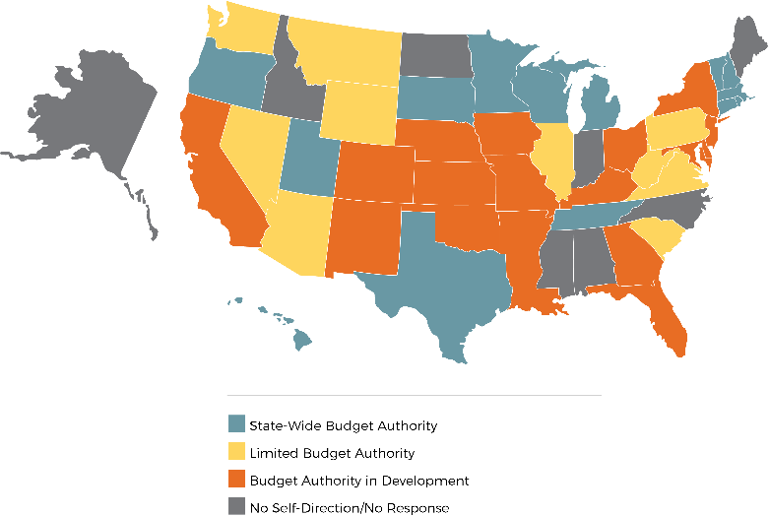
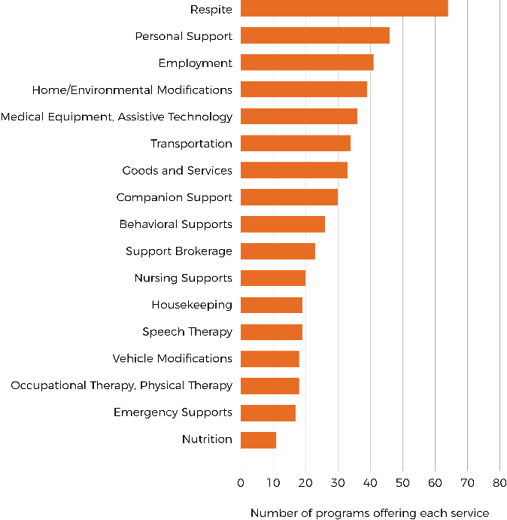
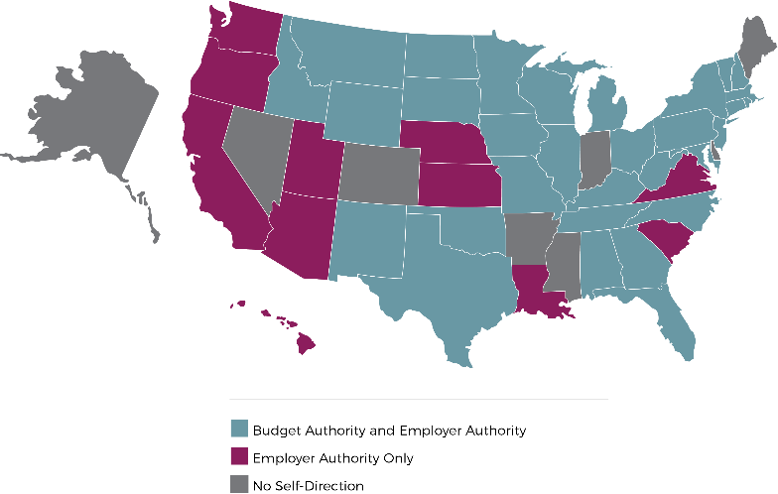
State of the States in Self-Direction for Individuals with Intellectual and Developmental Disabilities (2015)
State of the States in Self-Direction for Individuals with Intellectual and Developmental Disabilities (2015)
Dr. Matthew DeCarlo, Radford University School of Social Work
Co-authors Jennifer Hall-Lande, PhD | Matthew Bogenschutz, PhD | Amy Hewitt, PhD
Background and Methods
Self-Direction in 2009
Key Figures
Self-direction is an approach to service delivery within long term services and supports that aims to provide greater control for individuals with disabilities and their closest supporters. The purpose of this study was to understand how self-direction has been implemented for individuals with IDD.
Researchers conducted a document review of the CMS Medicaid waiver database and state DD department websites for information about programs. To corroborate these findings, questionnaires and administrator interviews were completed for 35 of the 42 states with self-direction. A second wave of interviews was completed with administrators in 7 of 9 states without self-direction. Interviews were conducted with program directors, waiver managers and other administrators via phone and analyzed using thematic analysis.
42
States with state-wide self-direction
State-wide programs
Offered budget and employer authority
Allow self-direction of at least 5 services
102
75%
60%
Types of Services Offered
Interview Themes
RQ | Themes | Subthemes
Strengths | Opportunities for Self-Determination | Flexibility, individualization, decision-making, responsibility
 | Improved Support Relationships | Controlling who comes in the home, consistency of support relationships
Challenges | Restructuring Case Manager Relationships | Oversight of participant spending, documentation, recruitment
 | Public Stewardship | Rulemaking and enforcement, public perception of fraud
Future Directions | Increasing Program Size | Administrator as change agents, selective incentives
 | Using New Technology | Electronic billing and records, Supports Intensity Scale, budget algorithms
Self-Direction in 2015
Printing Supported by the RU Office of Undergraduate Research & Scholarship

Slide 7
Informal outlets
News media
https://www.vox.com/the-big-idea/2017/7/17/15973478/bosses-dictators-workplace-rights-free-markets-unions
TV news
https://www.youtube.com/watch?v=mH3GWlj6IYA&t=13s
Book reviews
https://jacobinmag.com/2017/06/private-government-interview-elizabeth-anderson
Podcasts
https://www.libertarianism.org/media/free-thoughts/do-employers-rules-our-lives
YouTube debates
https://www.youtube.com/watch?v=EyYjKeW_qyk

