Slide 1
Living Separate Lives:
How to Nurture a Work-life Balance
Amanda Bullington
Catalog & Serials Librarian
University of South Carolina Law Library

Slide 2
Introduction
Who am I?
What is my story?
Why did I need to learn to balance my work life and my home life?
Notes:
My name is Amanda Bullington. I live in Columbia, South Carolina and I am the Catalog and Serials Librarian for the University of South Carolina Law Library. And I also have a chronic illness. In fact, my chronic illness decided to seriously flare up over the past two weeks – which kind of made me restructure this presentation through the lens of my chronic illness. But first…let’s go back in time…to March of 2020…I was attending another conference in Knoxville, Tennessee when the news of the covid-19 pandemic was escalating. When I returned to South Carolina, I would be thrown immediately into learning how to “work from home” as a cataloger. Which, at first, meant dragging my desktop computer and boxes of new books from my office to my house. Also during March of 2020, i began experiencing chronic pain – a shooting, stabbing pain that would prevent me from comfortably existing in the world at all, much less working. As the pandemic moved along, I also moved along…seeing different doctors and getting different medical tests. Throughout all of this chaos I saw an increasing need to separate my lives – my work life from my personal life. When you’re working from home, it can be hard to “turn off” at the end of the work day, especially for me living in a small duplex. It was difficult to make the switch from “work mode” to “home mode” when both of those “modes” happen in the same place – my living room couch. How can I relax and watch a movie in the same place where I work on electronic resources all day? Even when I was no longer working from home and was back in the office full-time, i still needed to keep that work-life balance that i had been cultivating in order to properly manage my day-to-day symptoms and pain. Eventually, i would get a real diagnosis – which in itself was huge for my mental health, it gave me a real sense of validation. I would also go on to have two major surgeries during this time – one in November 2021 and another in June 2022. My chronic illness dictates a lot of what I do in my life – both of my “lives” actually, my work life and my personal life. Trusting my body, giving myself grace, and using various self-care techniques help me to be healthier in my work life and my personal life.

Slide 3
What exactly is self-care?
“Self-care is a self-guided active practice required to prevent short-term and long-term complications.”
Farshi et al. BMC Psychiatry (2020)
Notes:
The term “self-care” is thrown around a lot these days. I’ve noticed that it can be applied to a wide range of different things from indulging in chocolate and bubble baths to practicing yoga. For myself, I define “self-care” somewhere along the lines of this quote from Nooshin Farshi – self-care, to me, means things that we can do as individuals to improve our quality of life and manage our physical and mental health. Also, for me, self-care means activities that I can perform in order to control (or at least navigate) the symptoms of my chronic illness and allow me to fully enjoy my life. Working towards a work-life balance is really a form of self-care – keeping the balance in both these areas means that your entire life as a whole will be healthy.
– Farshi, Nooshin, Hasnpour, Shirin, Mirghafourvand, Mojgan, Esmaeilpour, Khalil. Effect of self-care counselling on depression and anxiety in women with endometriosis: a randomized controlled trial. BMC Psychiatry (2020) 20:391

Slide 4
Work-life Balance and Mindfulness
“...flexible working designs increasingly blur the work–home boundaries, making it difficult for employees to switch off from work.”
“Mindfulness-based interventions (MBI), which cultivate mindfulness practice to enhance state mindfulness, have been shown to help workers detach, to cognitively and emotionally separate life domains, and to thus improve work–life balance.”
Althammer, Sarah E. et al. Journal of Occupational and Organizational Psychology (2021)
Notes:
In an article for the Journal of Occupational and Organizational Psychology, Sarah Althammer writes about how mindfulness can be used to increase feelings of work-life balance. Working from home during the pandemic certainly blurred the lines between home and work, making it difficult to switch off the “work mind” at the end of the day. Some of us are still working from home, either full time or on a flexible basis. It can be difficult to not think about work when you get home, even if you are physically going into the workplace. It is easy to worry about things happening at work when you really should be decompressing from the day and relaxing. Mindfulness techniques can help us to detach from work and keep our work life and our home life separate.
Sarah Elena Althammer, Dorota Reis, Sophie van der Beek, Laura Beck, and Alexandra Michel. A mindfulness intervention promoting work–life balance: How segmentation preference affects changes in detachment, well-being, and work–life balance. Journal of Occupational and Organizational Psychology (2021), 94, 282–308

Slide 5
Technique - Mindfulness
Be present
Try to avoid thinking about the big meeting coming up or the annual review you just had
Notice your work-related thoughts THEN detach from them
Let them float across your mind like clouds
Bring yourself back to the present moment
Over and over and over…
Notes:
Mindfulness can be used as an effective strategy for detaching from work.
Being present is the first step – when the workday is over, you can focus on the present after work and avoid thinking about past or future-related work issues. Focus on cooking dinner or finally allowing your cat to sleep on your lap and leave work in its place
The second step is noticing but not dwelling on your work-related thoughts and feelings.. A visualization that I have liked to use in the past to describe this process is to imagine any anxious thoughts as clouds. Then picture those clouds floating past your mind’s eye. You have acknowledged their presence but you have realized that you don’t need to focus on them or dwell on them.
Don’t get frustrated when you find your mind drifting or getting carried away by your thoughts – you will have to bring yourself back to the present moment over and over again. There isn’t a way to do mindfulness “wrong.” I used to get so frustrated when my thoughts would run away with me but it is a process that never ends. As I mentioned before, focus on the after-work activities that you are doing – when you start to worry about an item you need to claim with the vendor, just focus your attention back to petting your cat and how soft his fur feels.
These techniques are also useful in many other situations. I personally use them when I feel anxious. I will try to focus on something tangible, like my feet on the floor or my breath.
Sarah Elena Althammer, Dorota Reis, Sophie van der Beek, Laura Beck, and Alexandra Michel. A mindfulness intervention promoting work–life balance: How segmentation preference affects changes in detachment, well-being, and work–life balance. Journal of Occupational and Organizational Psychology (2021), 94, 282–308

Slide 6
Technique - Bodily Mindfulness
Being mindful of my body and how it feels on a day-to-day basis
Learning to LISTEN to my body
Do I have any pain?
Learning to ACCEPT what my body tells me
Do I need to take it easy today?
Learning to practice self-compassion and self-acceptance
Notes:
Bodily mindfulness is similar but slightly different. It is important for myself, and i think it would be helpful for everyone to take the time every day to really tune in and listen to how they are feeling.
It starts with just being mindful of my body and how it feels on a day-to-day basis. I consider my mental health part of this body mindfulness.
To do this i have to really listen to what my body is telling me – for example, to ask myself if i have any pain today
After that, I need to just truly accept what my body is telling me – for example, should i take it easy today? Maybe i should avoid walking the distance from my parking lot at work and just park at a meter closeby
All of this is really the act of learning to practice self-compassion and self-acceptance :
Melissa A. Shepherd wrote in an article for Best Practices in Mental Health, “Self-compassion practice consists of positive thoughts, attitudes, and behaviors, such as being kind rather than self-judging, exercising tolerance and humanity rather than seeking isolation during times of personal challenge and suffering, and using mindful awareness of one’s own thoughts and feelings while caring for the needs of others (Shepherd, 2020).” I think that this is personally my greatest challenge. It’s hard for me to treat myself as i would another person – it’s easy to be very hard on myself. Jon Kabat-Zinn writes in his classic book “Wherever You Go, There You Are” about the need to “practice feeling deserving enough” to accept yourself and give yourself the grace that you would give to another. Practicing self-compassion and self-acceptance means that i won’t beat myself up if i need to call in sick to work or leave work early for a doctor’s appointment. It’s better for my body not to suffer through the day – and it’s better for my colleagues as well.
– Shepherd, Melissa A., Newell, Jason M., Stress and Health in Social Workers: Implications for Self-Care Practice. Best Practices in Mental Health, Vol. 16, No. 1, Spring 2020
– Jon Kabat-Zinn. Wherever you go, there you are. 2005

Slide 7
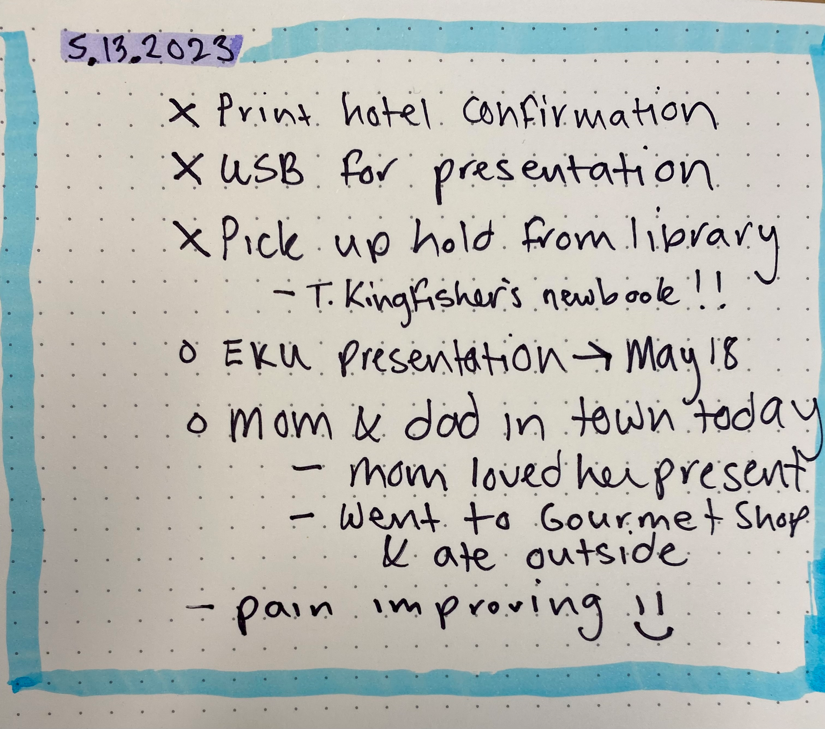
Bullet Journaling
Notes:
Time management is also important for separating work life from home life. I find Bullet journaling to be an easy method for this – you can even get creative with it, if you want. I like bullet journaling in particular because it can be part to-do list, part diary, and part schedule. In my case, I also use it as a symptom tracker. Sometimes I will also take a page to just create a “dump list” and list every single thing that I have on my plate – that way, i can easily strategize what i need to get done first.
The slide shows my entry from this past saturday – please ignore my handwriting hahah. if it were a work day, you could write down your work schedule, lunch break, and any important things happening.
Ryder Carroll. The Bullet Journal Method.

Slide 8
Work-life Balance in the Library
“Cost of living is ridiculous”
“Salary does not reflect cost of living”
“I will never be able to own a home or have children because of finances”
“I have a nagging feeling that I should get a second job.”
Notes:
I am quite obviously not alone in the need for developing some sort of balance between my work life and my personal life. In their article for the Journal of Library Administration, Tamara Townsend and Kimberley Bugg asked 329 urban academic librarians about their perceptions of their current work-life balance. These librarians responded that they felt stretched thin between their workload and their responsibilities at home. Home responsibilities included things like child-care and elder-care as well as making time for personal hobbies. Another factor is institutional culture, including the lack of flexible work schedules in regards to child-care. In addition to these things, a common theme in regards to the success of a work-life balance is something far trickier – as we see in this slide, concerns about finances and societal issues at large are a massive inhibitor to successfully balancing work and life.
Which leads me to my final point…
Townsend, Tamara, Bugg, Kimberley. Perceptions of Work–Life Balance for Urban Academic Librarians: An Exploratory Study. JOURNAL OF LIBRARY ADMINISTRATION
2020, VOL. 60, NO. 5, 493–511

Slide 9
Final Thoughts
“I’m all for learning stress management techniques to aid us throughout day-to-day chaos…My point is that we should take a step back to analyze the root issues. Stress is rarely a matter of a broken brain or a poor ‘lifestyle choice’ but often a symptom of the structural issues facing society.”
― Rina Raphael, The Gospel of Wellness: Gyms, Gurus, Goop, and the False Promise of Self-Care
Notes:
I would like to close with this quote from Rina Raphael.
“I’m all for learning stress management techniques to aid us throughout day-to-day chaos…My point is that we should take a step back to analyze the root issues. Stress is rarely a matter of a broken brain or a poor ‘lifestyle choice’ but often a symptom of the structural issues facing society.”
Self-care cannot fix societal problems and I understand that I am extremely lucky to have paid sick leave and supportive supervisors. Unfortunately, not everyone shares this situation. Without paid leave, a true work-life balance may be out of reach for some people. But things like mindfulness and bullet journaling are small things that can help in daily life until, hopefully, one day everyone will have the opportunity to have paid leave. I would like to mention to anyone else who may be suffering with chronic illness – don’t be afraid to ask for accomodations at work (for me, something as small as a step-stool to rest my feet on under my desk made a world of difference) – also, don’t hesitate to ask your doctor about FMLA documentation (that also made a world of difference for me).

Slide 10
Questions
Do you have any questions for me?

