Slide 1
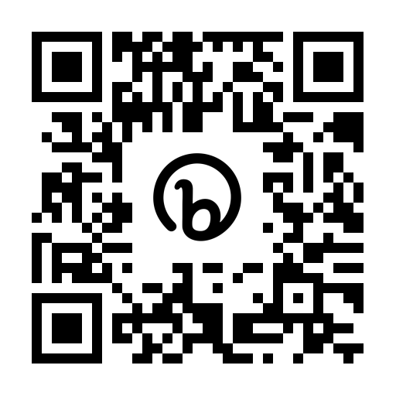
From “What if?” to “That Was EZ!” –
Leveraging "auth eq" in EZproxy to take
SAML authentication to scale
Ilona Burdette & Enid Wohlstein,
Kentucky Virtual Library
https://KYVL.org/KYVLovgtsl

Slide 2
What we’ll talk about –
Our old authentication method
The new authentication method, in addition to existing process
How we configured EZ Proxy to handle “single sign on” or SSO

Slide 3
Our “Old” Method
for Authentication

Slide 4
KYVL assigned ID and password
360 unique login combinations
Assigned to 360 k12 school districts, private schools, public libraries, universities and colleges both public and private, agencies, and hospitals
Another login to remember
Syntax difficult for younger students [example: trigg#k12:random#23]

Slide 5
Login process before SAML

Slide 6
Challenges in creating a new system
2 person staff
No development staff
No funding for coding/web design
Where would we host a solution?

Slide 7
The Question:
Could We Use EZ Proxy?

Slide 8
EZ Proxy benefits for KYVL
Already have a license for a locally hosted instance [since 1999]
Existing logins were handled by EZ Proxy [the 360]
EZ Proxy server hosted by Commonwealth Office of Technology
EZ Proxy listserv global community

Slide 9
SAML Authentication at Scale

Slide 10
After a year, success looks like:
almost 100 authentication servers
450,000 students
Key collaborators
Notes:
We’ll share today how KYVL has leveraged EZproxy's capacity to configure multiple authentication servers
to scale SAML authentication for Kentucky school districts and other member institutions.
To date, we’ve configured over 80 authentication servers that make it possible for 450,000 Kentucky students to log into KYVL resources using their school email address.
With no access to Google or Azure AD admin consoles, KYVL remained stuck on “what if?” until the right collaborators helped put us on the road to “That was EZ.”
We gratefully acknowledge the IT teams that brought us along as they captured screen shots and documented procedures, and we’re delighted to pass along both step-by-step procedures for EZproxy admins and step-by-step tutorials for the IT staffs we partner with. We hope these tools will enable those who may wish to to try this at home.

Slide 11
How did we get here?
Changes to KYVL login form and its javascript
EZ Proxy metadata and tutorials to share with IT partners
Configure EZ Proxy once partner metadata has been received
Notes:
We will break down our process into three parts --
•The KYVL login form and its javascript
•Your EZproxy metadata and tutorials to share with IT partners
•And how to configure EZproxy once partner metadata is received.
We’ll cover a lot of ground quickly, but never fear – all these resources and more can be found at KYVL.org/ezproxy.
Upcoming slides will include more targeted links, but everything we’ll share is easily accessible from dropdown menus or simply by scrolling at the main link.

Slide 12
Demo of our SAML login process through our existing KYVL login form
Notes:
Let’s begin with a demo our SAML login process through the KYVL login form.
•The user has clicked on a proxied link for Britannica School, taking them to KYVL’s EZproxy login page.
•The user enters their school email address, and the javascript presents a button directing them to log in using their school email.
•This sends them to a Google login screen where they again enter their email address.
•About a dozen of our districts redirect users to a Microsoft login.
•Upon entering their password, they are authenticated to the original Britannica link.
Most of our districts authenticate using Google only or Microsoft only, but this example demonstrates seamless transfer from Google to Azure AD.

Slide 13
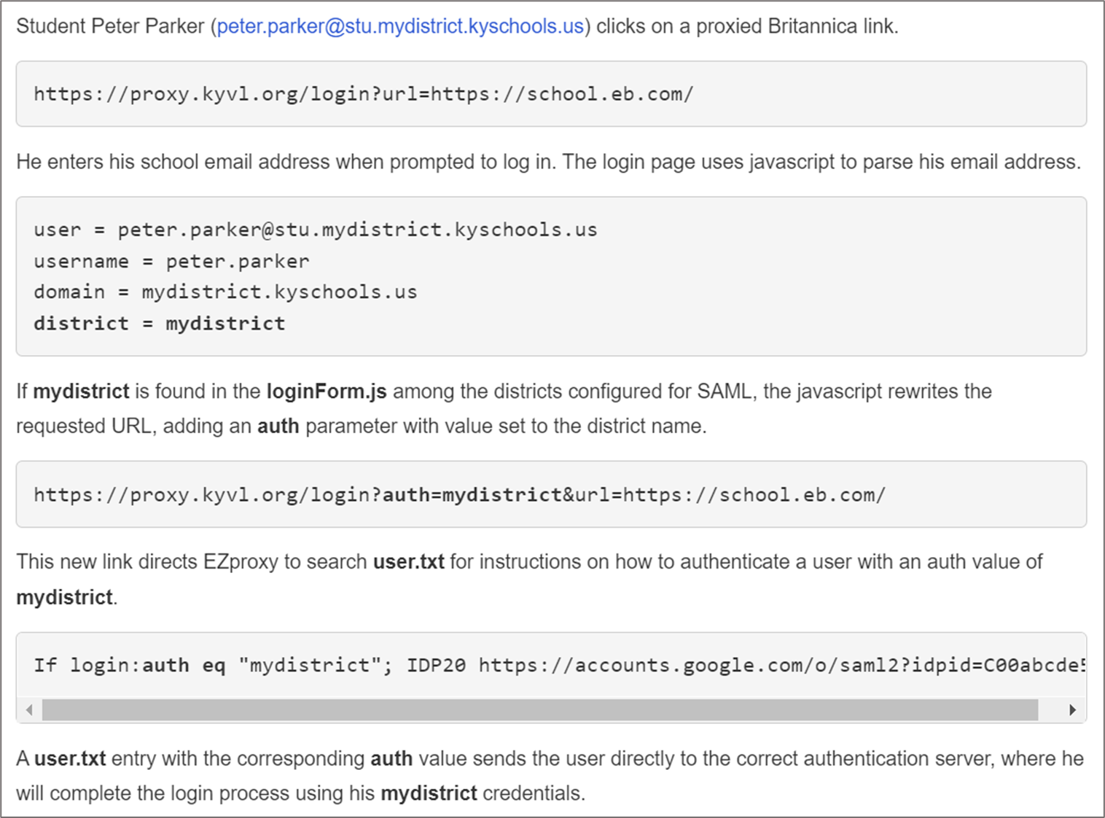
Our instructions & documentation are here:
KYVL.org/ezproxy
Notes:
The javascript on the KYVL login page parses the user’s email address to see if their email domain is configured for SAML authentication with KYVL.
If so,
it assigns an auth value based on the user's email address that directs the user to the correct authentication server without user intervention. This is key to avoid the delays that can arise with multiple authentication servers as described in Ezproxy support docs.
The auth value will be used again when configuring user.txt.

Slide 14
Changes to make:
• login.htm
• loginForm.js
• model html and javascript are linked here:
kyvl.org/ezproxy/resources
Notes:
The RESOURCES section of KYVL’s Ezproxy page includes links to html and JS that you can use as models.

Slide 15
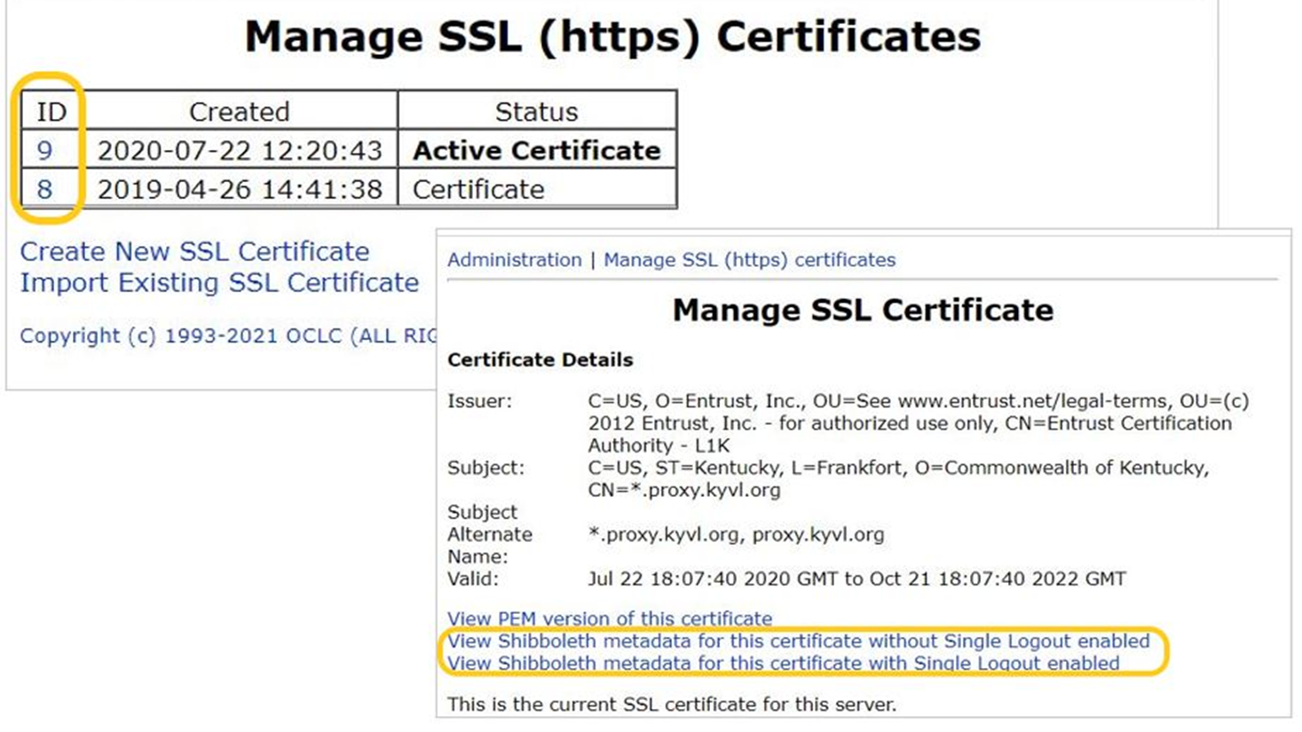
Metadata to share:
Documentation is here:
kyvl.org/ezproxy/metadata
Notes:
Next up – your metadata and other resources to share with your IT partners.
EZproxy metadata can be found in EZproxy Adminstration > Manage SSL Certificates. If needed, create or import your SSL certificate here.
To find the metadata values you will need, click the number of the certificate you will use for your SAML connections.
On the next screen, select one of the View Shibboleth metadata for this certificate options.

Slide 16
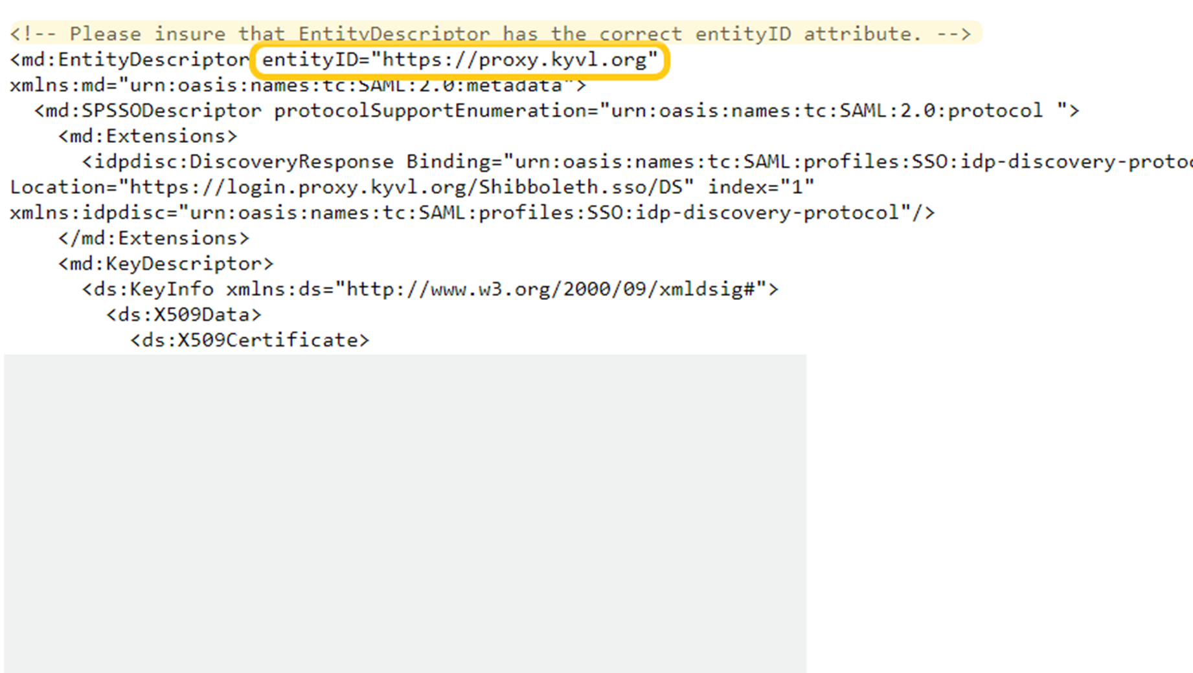
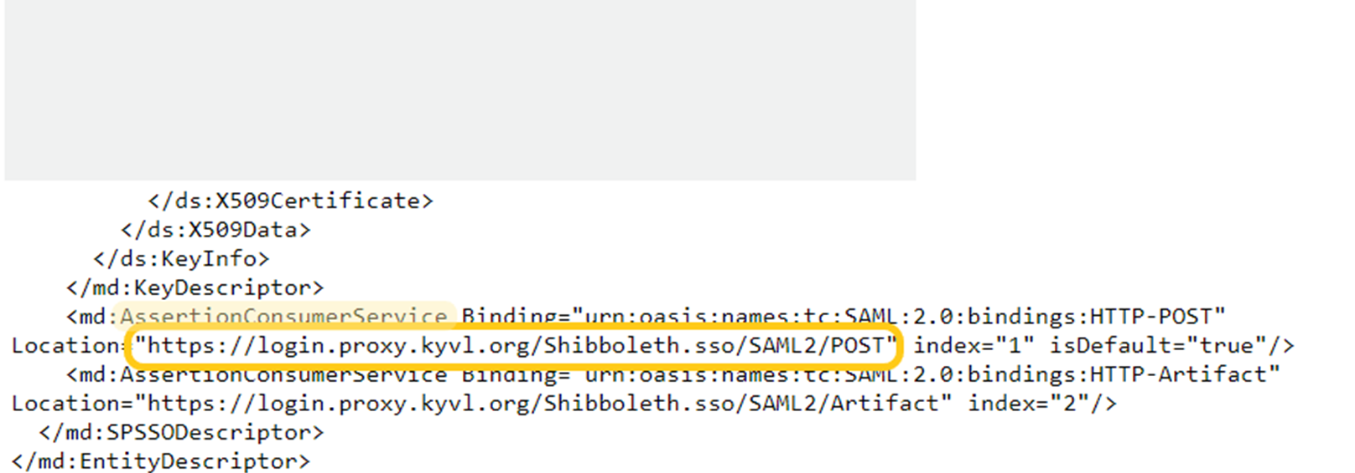
Metadata to Share: entityID and Assertion ConsumerService (POST) Location
Notes:
While viewing your certificate, make note of two metadata values – the EntityDescriptor entityID and the AssertionConsumerService (POST) Location.
The first is found near the top of the file, the second near the bottom.
These values will be needed by your IT partners when configuring Azure AD or Google for SAML Login.

Slide 17
Entity IDs:
Service Provider (SP) EZproxy
Identity Provider (IdP) Google or Azure AD
Notes:
Metadata for both service providers and identity providers contains entityIDs. For current purposes, EZproxy is the service provider and Google and Azure AD are IdPs.

Slide 18
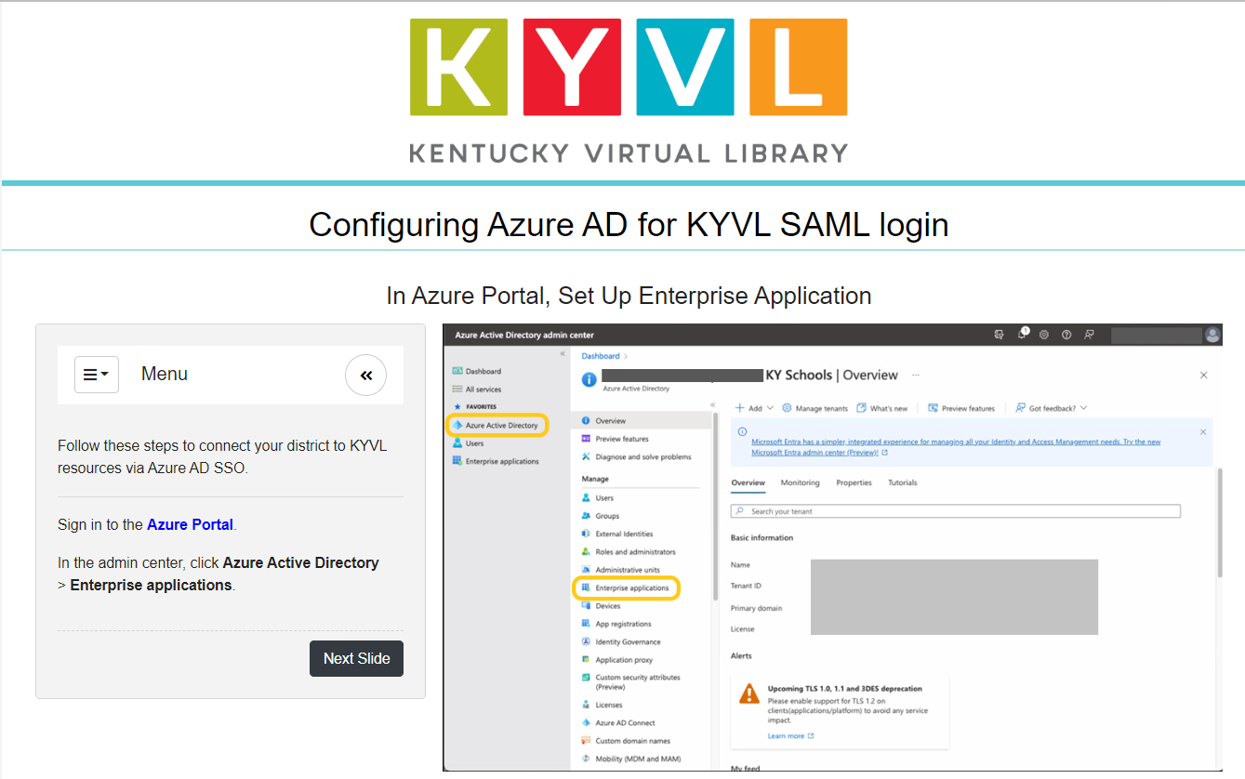
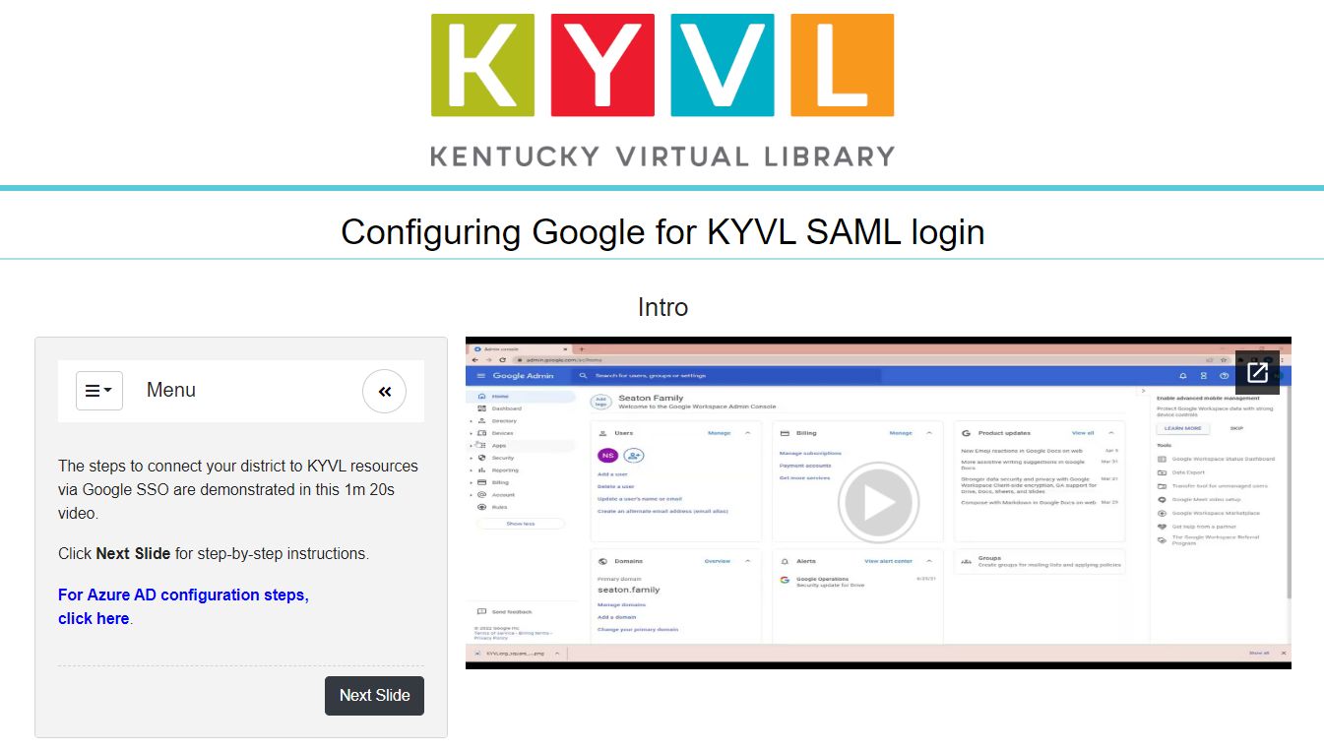
https://kyvl.org/ezproxy/tutorials
Notes:
Step-by-step tutorials for both Google and Azure AD configuration are available in the resources section.
Be sure to substitute your EZproxy metadata values for the KYVL values in the tutorials when sharing with your IT partners.

Slide 19
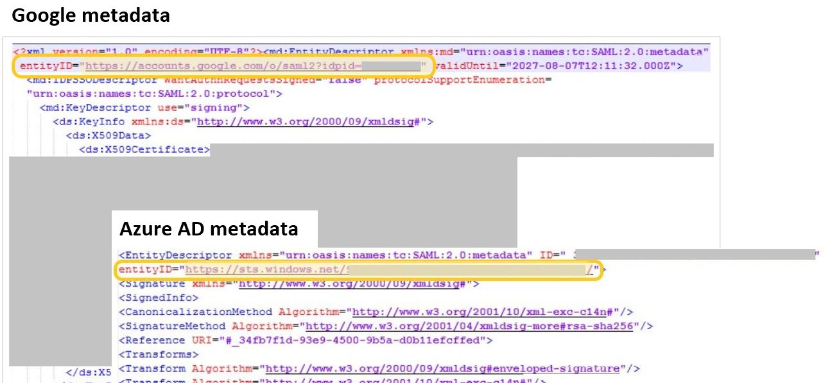
kyvl.org/ezproxy/idp
Notes:
Metadata for both service providers and identity providers contains entityIDs. For current purposes, EZproxy is the service provider and Google and Azure AD are IdPs.

Slide 20
kyvl.org/ezproxy/config
Upload metadata.xml file
Edit user.txt
Edit config.txt
Edit loginForm.js
RESTART EZproxy
Notes:
Finally, let’s take a look at the edits made under the hood in EZproxy each time a new SAML connection is made.
Once the identity provider’s metadata is received and logged, it's time to configure a new SAML connection in EZproxy. The process is simple and can be completed in about five minutes. And there is no limit to the number of authentication servers you can add. KYVL currently has over 80 configured!
To configure a new authentication server, you’ll simply:
Upload the identity provider’s metadata file to the server.
And make minor cut-and-paste edits to user.txt, config.txt and the login form JS.
And - no surprise – Restart EZproxy.
If that sounds easy, it is! If a local IT partner provides the proper metadata and has made the necessary configurations on their admin side, we can have a new server configured, up and running in under five minutes.
Just a note:
KYVL uses Notepad++ to edit all the files listed on this slide. A Download link can be found in the resource section.

Slide 21
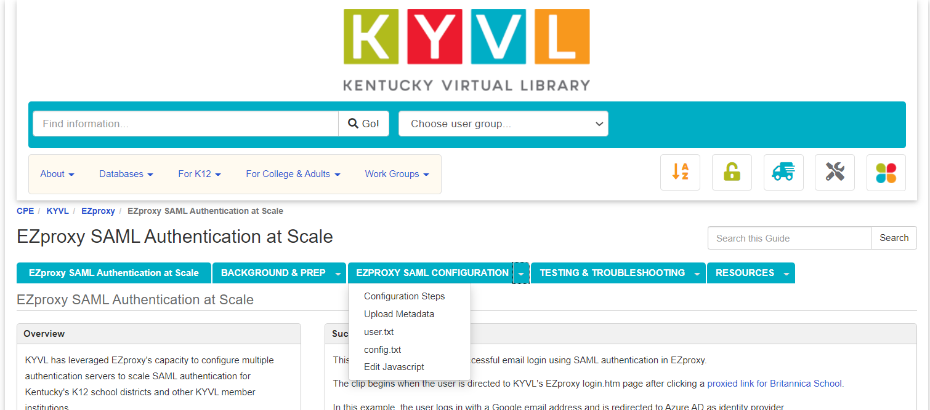
kyvl.org/ezproxy/config pt 2
Notes:
When uploading metadata, KYVL renames each metadata file auth.xml to match the auth value assigned by the javascript on the login page, generally the district name from a user's email.
KYVL created a folder called includeShib in the main EZproxy directory as the destination folder for metadata .xml files.
The combined path and file name for each metadata file, e.g., /includeShib/mydistrict.xml, will be used in a ShibbolethMetadata directive in config.txt.

Slide 22
kyvl.org/ezproxy/xml
Rename metadata file to auth.xml to match auth value (district name).
Upload to includeShib folder
Path for config.txt: /includeShib/mydistrict.xml
Notes:
When uploading metadata, KYVL renames each metadata file auth.xml to match the auth value assigned by the javascript on the login page, generally the district name from a user's email.
KYVL created a folder called includeShib in the main EZproxy directory as the destination folder for metadata .xml files.
The combined path and file name for each metadata file, e.g., /includeShib/mydistrict.xml, will be used in a ShibbolethMetadata directive in config.txt.

Slide 23
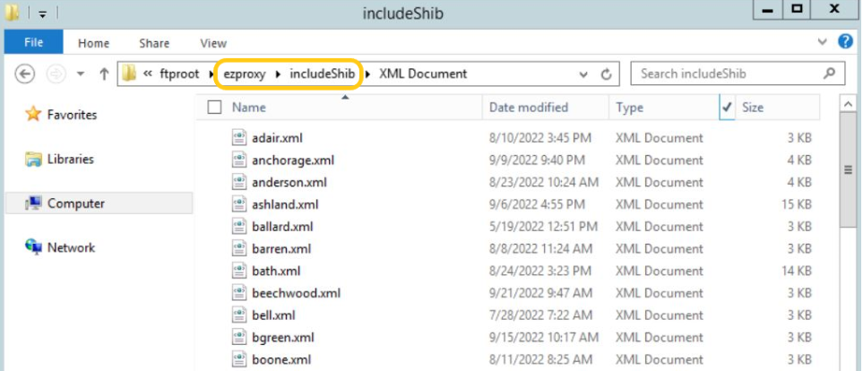
Ezproxy includeShib

Slide 24
kyvl.org/ezproxy/user-txt
::Shibboleth
If login:auth eq “myauthname”;
IDP20 https://accounts.google.com/o/saml2?idpid=C04123AB
/Shibboleth
Notes:
Shibboleth in user.txt is configured between these bookends.
Add the conditional If login auth eq statement for your new identity provider, where AUTH matches value assigned by the login page javascript.
Here’s where you include the entityID you received in the identity provider’s metadata file.
Google and Azure AD entity IDs have different formats. You can view both on the guide.

Slide 25
kyvl.org/ezproxy/config-txt
ShibbolethMetadata \
-EntityID=https://proxy.kyvl.org \
-File=includeShib/filename.xml \
-SignResponse=false -SignAssertion=true -EncryptAssertion=false \
Notes:
Each KYVL Shibboleth directive has this format.
Note the entityID from our EZproxy metadata and the path to the filename in the includeShib folder. The remaining information uses the defaults from OCLC’s EZproxy documentation.
For each new identity provider, we simply cut and paste, editing only the filename.
EZproxy restart is required for edits to config.txt to take effect, but this can be postponed briefly while we edit login.js.

Slide 26
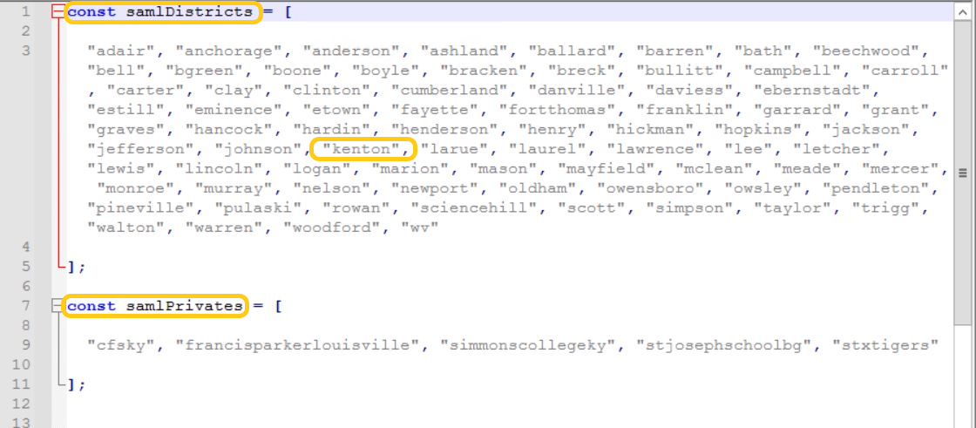
kyvl.org/ezproxy/js
Notes:
One last edit.
The newly configured district needs to be added to the list of configured districts in loginForm.js (or in KYVL's case, loginFormAllSaml.js).
Public school districts and other IdPs are handled differently by the javascript, so KYVL's javascript maintains separate alphabetized lists.
Use caution when editing! The code is unforgiving. A misplaced comma or quotation mark can break the whole thing.
Save changes and RESTART EZproxy!

Slide 27
Things to know:
Get help anytime via KYVL@ky.gov or
Email ilona.burdette@ky.gov or enid.wohlstein@ky.gov
Resource page KYVL.org/ezproxy
Slidedeck https://KYVL.org/KYVLovgtsl

