Slide 1
Bridging
Collection Development
and Cataloging
Cross-Departmental Collaboration at the Centre College Library
Crystal Ellis
Assistant Director and Head of User and Access Services
Beth Morgan
Cataloging and Special Collections Librarian/Archivist

Slide 2
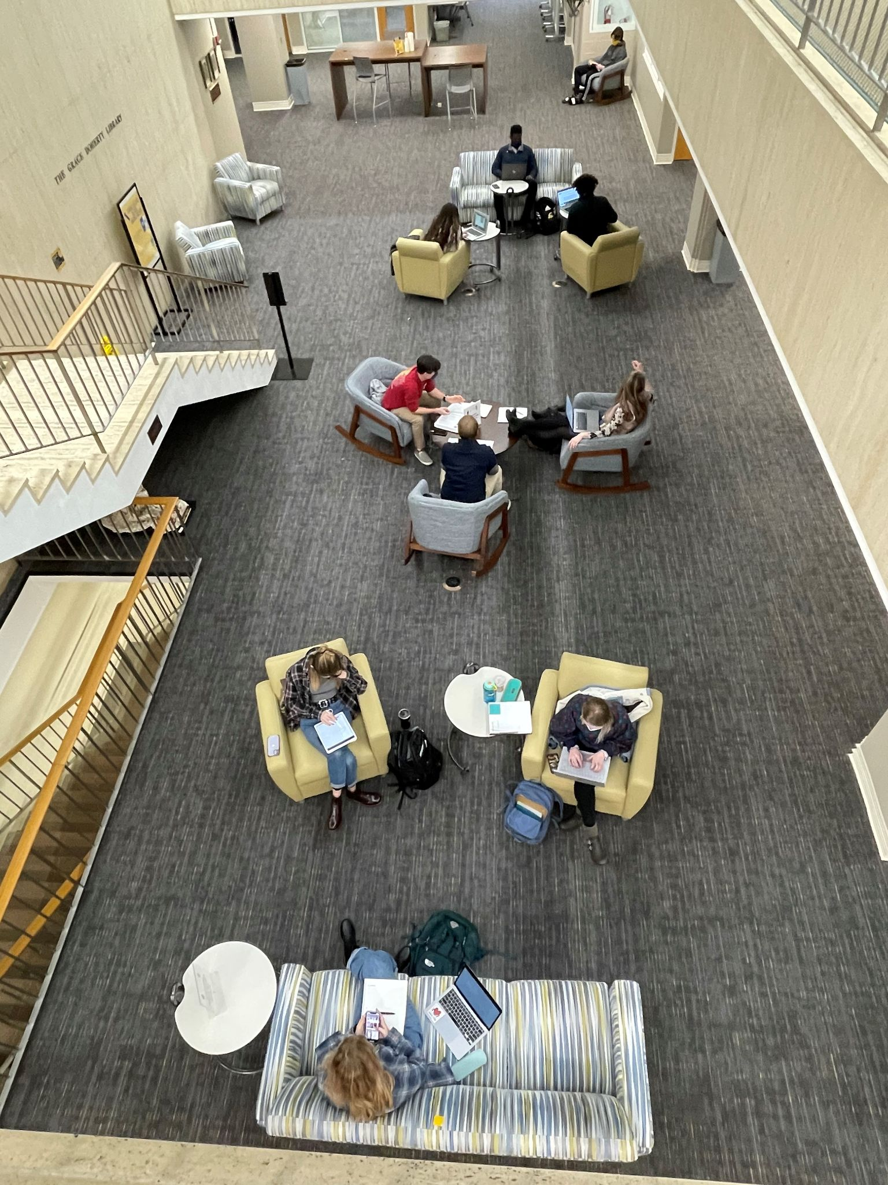
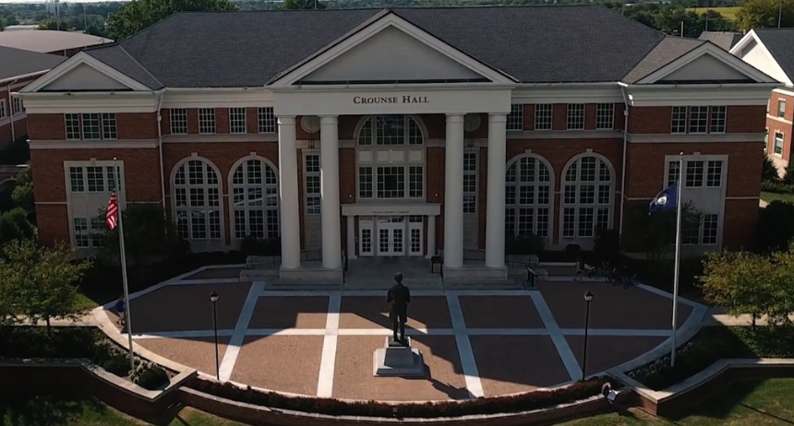
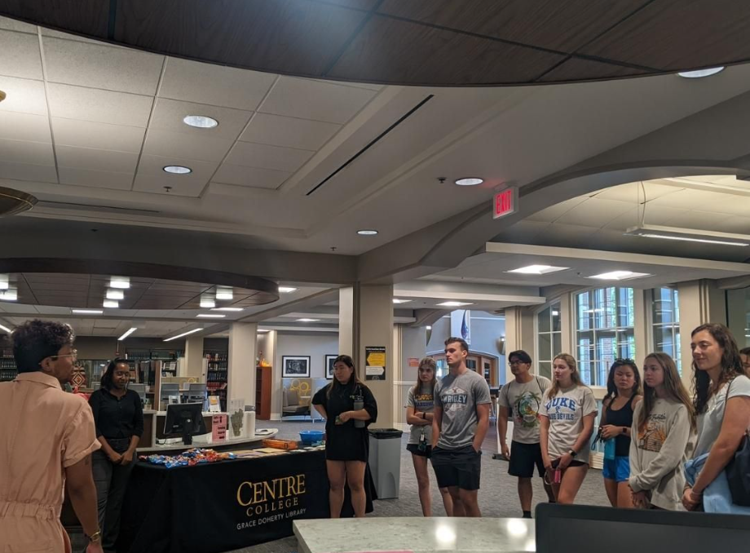
Centre College
Private liberal arts College located in Danville, Ky.
Highly residential
Approx. 1,400 students and 150 full-time faculty
13 library staff
Most librarians perform dual roles
Notes:
CRYSTAL: 13 staff - all wear multiple hats - just 1 cataloger. In my old role I was reference/instruction and collection development. Migrated to new ILS, liaisons started ordering print books, really liked this aspect so I started ordering all the print books for the library. Choice cards did work well and were moving to online, book it was developed with help of IT for faculty suggestions. Really liked this part of the job, brought it with me when I moved back to the realm of circ.
BETH: I was hired in 2013 as the Cataloging Librarian/Systems Administrator. In 2016, I absorbed the role of Special Collections Librarian/Archivist, at which time we hired a full-time systems librarian to pick up the systems admin tasks I had previous handled, in addition to other library systems tasks such as website maintenance that had been spread across other library employees. Also in 2016, we migrated from Innovative’s Millennium to OCLC’s WMS. This was a good opportunity for us to look at our workflows and streamline processes and procedures and how we landed on our current collaborative processes.

Slide 3
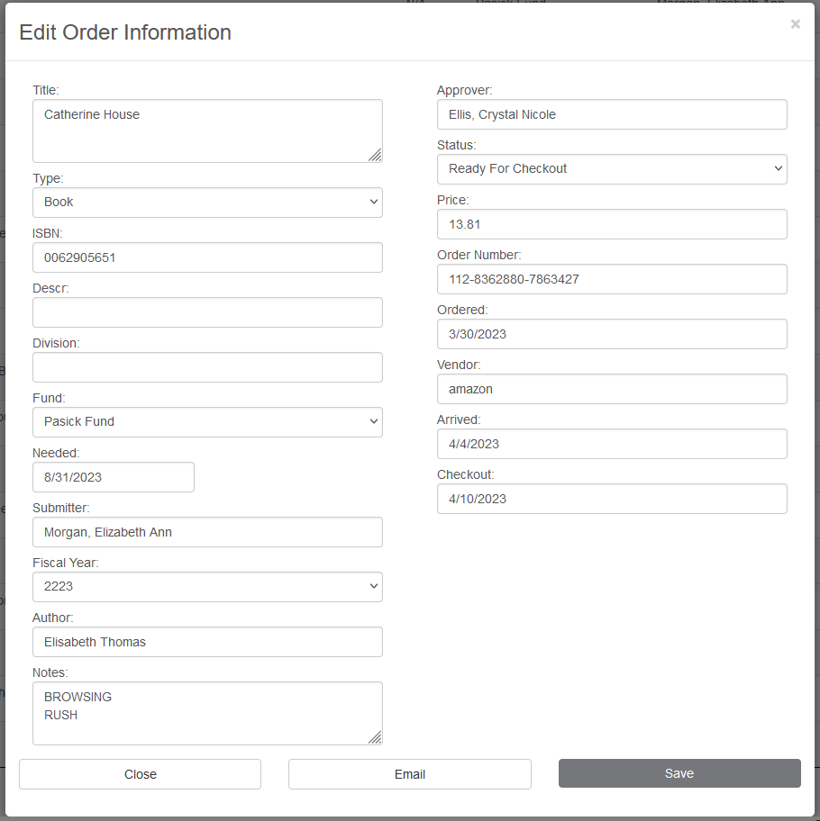
Book-It
Book Ordering System
Developed in-house by IT to meet the collaborative needs of the Collection Development Librarian and the Cataloging Librarian
Added bonus: Coll. Dev. Librarian is notified when request has been submitted. Faculty are notified by the system when an item has been ordered and when it is ready for checkout.
Notes:
CRYSTAL
https://centrenet.centre.edu/ICS/Academic/Library/Book_It.jnz
Title: Catherine House
Book-It is an in-house book ordering and tracking system that was developed, at our request, by our IT department and used by Centre faculty and librarians. Faculty and library staff submit book orders in Book It, and then they can track the progress of a book by checking the Status. They receive a system-generated email notifying them that their book is ready once the item has been marked “Ready for Checkout.” Two library staff use Book It to track the book as it moves through the workflow: 1) Crystal uses Book It to order items (Ordered), and then she monitors it to see if anything hasn’t been delivered, if anything hasn’t been cataloged, etc.; 2) the Technical Services Assistant uses Book It to indicate when books are delivered (Arrived) and when they are shelf-ready (Ready for Checkout), and she uses the Fund information to determine gift plate assignments and Notes fields to determine any other special processing instructions; and 3) Beth uses the Notes field to determine any special cataloging instructions (eg. replacement copies).
The Cataloger relies on the information entered into Book It by the Coll Dev Libr to accurately catalog and process each book that comes through. Likewise, the Coll Dev Libr relies on the Cataloger to accurately set the Status of each book in order to accurately account for where a book is any given time throughout the workflow. If someone comes in looking for a book they have ordered, the Coll Dev Libr should be able to reference Book It and determine that the book is either waiting to be cataloged (Status = Arrived), hasn’t arrived yet (Status = Ordered), or is on the shelf (Status = Ready for Checkout). If the Cataloger does not accurately set the status, havoc ensues. Haha, just kidding–but it does create confusion in that if the book isn’t in plain sight on the shelf or in the cataloging queue, then we have to check the catalog, cross-reference the new books shelf with the regular stacks, etc. BUT this tool generally keeps us all on track and on the same page in regards to what is happening with a book at any given time until it goes into regular circulation.
We made a conscious decision to NOT allow the faculty to be notified when a book has “Arrived.” Historically, we had a lot of faculty coming in really frequently to look for books they had ordered–and even take them without them being shelf-ready–which is why we made this decision to only notify them when their book is Ordered and Ready for Checkout. Since implementing Book It, we have seen a drastic decrease in faculty inquiries as to the whereabouts of their books. Also, our shelving system works in tandem with Book It notifications to keep us all on track regarding the physical whereabouts of a book once it is Ready for Checkout. We shelve new books that had been cataloged the previous week on Monday mornings,, and the faculty receive their “Ready for Checkout email” on Tuesday mornings, so usually no one comes looking for their book until they have received that email, and we know it’ll be either on the New Books shelf (if within the week) or in the regular stacks (if older).

Slide 4
Cross-training for
Collection Development Librarian (Orders)
Cataloging micro-training
Why: To enable the Collection Development Librarian to select bibliographic records in WMS for the creation of order records
Invoicing, receiving, and cataloging cannot be done without this first initial step
Correct record selection at the get-go helps eliminate confusion later in the workflow and saves time by cutting out the need for the Cataloger to do this for the Collection Development Librarian
How: Explanation of main points of access (title & ISBN) as well as other helpful bibliographic identifiers (publisher, edition statement)
We use DLC records, or records created by other national agencies, so the Coll. Dev. Libr. was also shown how to identify those records
When there is no DLC record, we go with the record with the most holdings (in most cases), so the Coll. Dev. Libr. was also shown how to check for number of holdings
When no record can be found, the Coll Dev Librarian contacts the Cataloger to create a new OCLC record for the material
Notes:
BETH

Slide 5
WMS Workflow - Orders
Collection Development Librarian receives email that a book request has been placed
Search for ISBN in WMS Acquisitions module
Select correct item record to add to order
Enter fund, shelving location, price, and any special notes that the cataloguer needs to be aware of into WMS
Enter price, order number, vendor, and ordered date into Book It.
Notes:
Crystal

Slide 6
WMS Workflow - Cataloging
Receive & catalog items
May change bibliographic record at this point if necessary
Assign call number
Check Shelving Location
Flag for processing as necessary
Check Notes for any special instructions
Flag for processing as necessary (eg. Rush)
Scan barcode
At this point, the LHR (i.e. item record) has been created
Edit LHR as necessary and/or add LBD
Add staff notes or public notes to LHR
Public note: Donated to the Grace Doherty Library by…
Staff note: Replacement
Add LBD to bib record
Faculty/staff/alumni publication
Notes:
BETH
Bolded steps are set up or determined by Collection Development Librarian. (Cataloger has some discretion, but generally always double-checks with the Coll Dev Libr.) You can see that several steps conducted much later in the workflow, such as physical processing, are determined by the Coll Dev Libr as early in the process as ordering, showing how inter-dependent our individual workflows are.

Slide 7
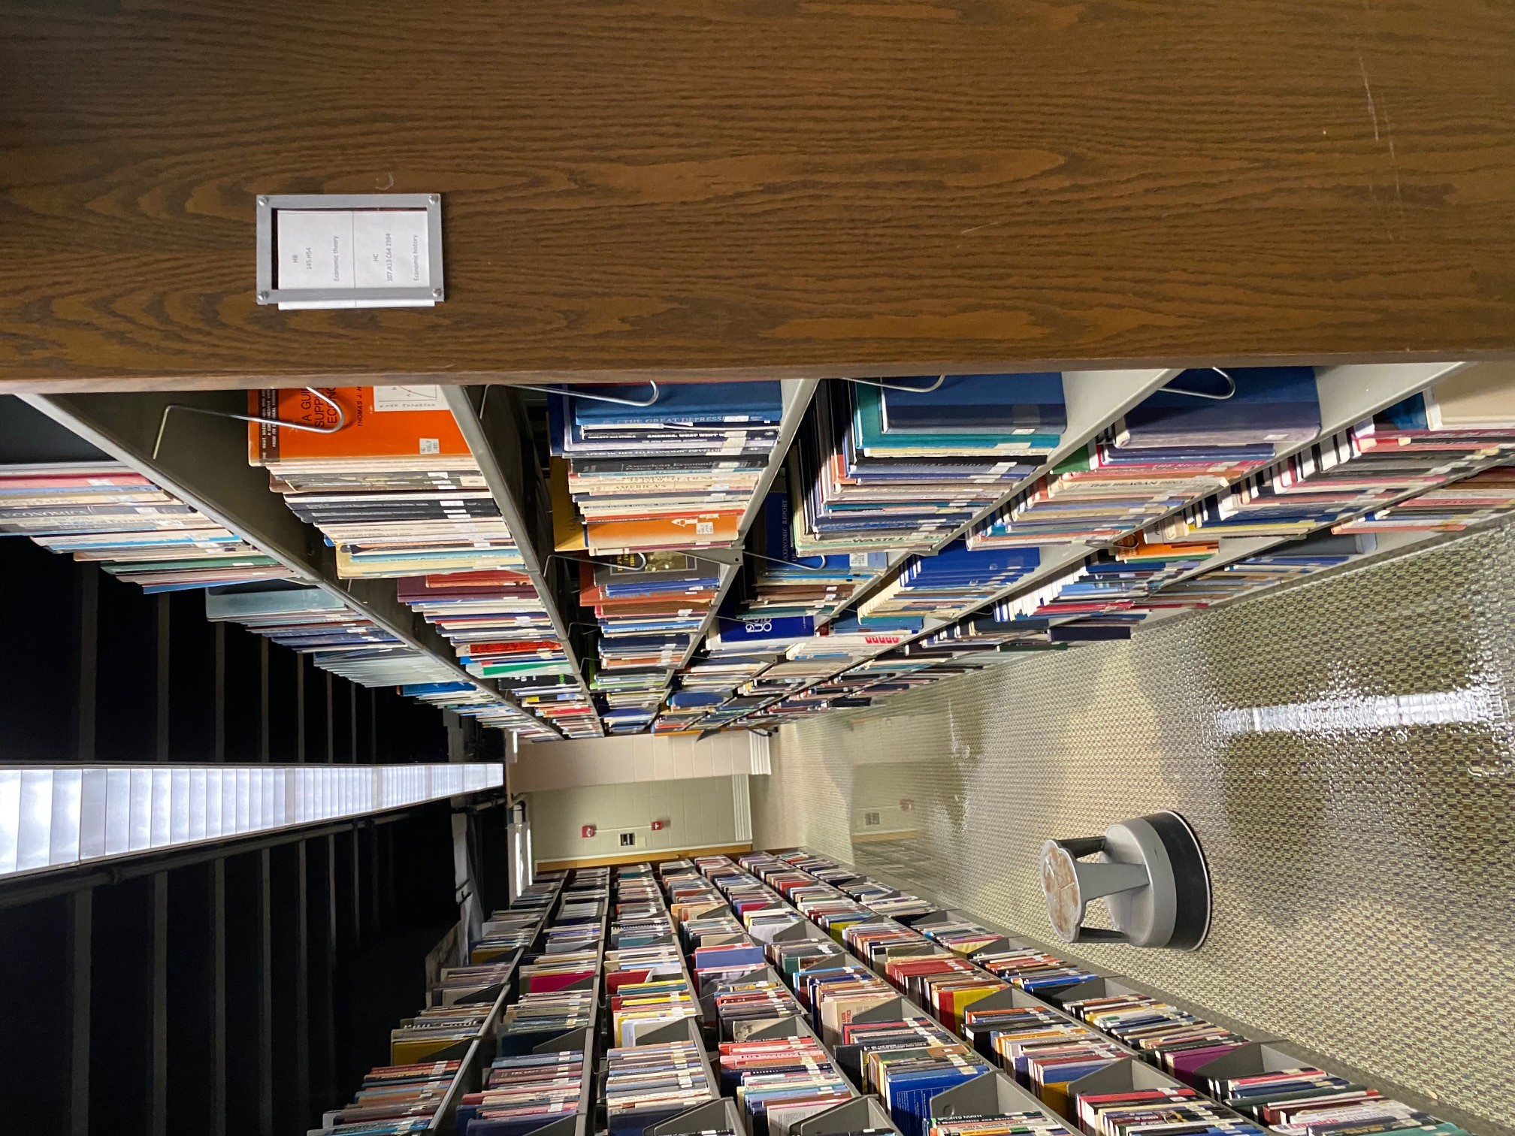
Special Projects
Weeding
2 major renovations
Spring/summer of 2020
Affected call numbers A-E
Summer of 2022
Affected call numbers A-PN
1 burst pipe in December 2022
December 2022
Affected call numbers F-PN
Inventory - started inventory in 2018
Had not been done in 20+ years
Finding books that had been withdrawn, incorrect barcodes, missing, not checked in, etc.
Notes:
Crystal The Systems Librarian, Cataloger, and Coll Dev Librarian work together to run reports for the criteria for weeding (circulation dates, number of checkouts, date of publication, seminal, or previously replaced). Using the Staff notes in the item record is important for this purpose. All work together to establish the terminology for the notes and where best to put the information for ease of reporting purposes.

Slide 8
Cross-training for
Collection Development Librarian (Weeding Projects)
Database maintenance micro-training: LHRs
Why: To enable the Collection Development Librarian to perform simple tasks normally performed by a cataloger
Change shelving locations
Delete items
How: Review the steps to perform these tasks, write out the steps for later reference, and assist the Coll. Dev. Libr. with the tasks until she is proficient
Notes:
BETH

Slide 9
Cross-training for Systems Administrator
Micro-training: MARC Records and LHRs
Why: To enable the Systems Admin to be able to independently run reports that utilize bibliographic data in order to assist the Collection Development Librarian and Cataloger with lists of titles for special projects
How:
Overview of common MARC fields used in Collection Development reports (title, date of publication, call number, ISBN, OCLC number)
Overview of LHR data (call numbers, barcodes)
Notes:
BETH

Slide 10
Ongoing Training
Annual Cataloging Work Day
Who
Cataloger
Technical Services Assistant
Collection Development Librarian
What
1-2 days of reviewing policies and procedures and documenting any new workflows and/or making changes to existing workflows
Where
Offsite
Notes:
BETH
We started doing this last year and found it incredibly helpful for the three of us who work with the books the most to be in the same room at the same time reviewing what we do. Our individual tasks are so interrelated that it’s important for us all to be on the same page! Sometimes we find that Crystal and I will have a verbal conversation about a one-off situation…but then it comes up again and the Tech Services Asst doesn’t know what to do because we didn’t relay it to her, or we won’t remember what we did before because we didn’t write it down. Carving out time in a quiet space dedicated to the task of reviewing documentation, having conversations about what is and isn’t working, and making sure decisions are recorded is imperative to ensuring a successful collaborative partnership. My cataloging assistant and I could have met without Crystal to determine our policies and procedures, but without Crystal’s input–because the cataloging decisions we make directly impact Crystal’s processes and procedures–it’s likely we would just end up having to revise something later to accommodate an Acquisitions or Collection Development situation. It’s better for all of us to work together upfront to make and implement decisions rather than come to separate decisions and potentially get in each other’s way later.

Slide 11
Questions
Notes:
Crystal

