Slide 1
Training Buffet
Self-service acquisitions training for librarians and staff
Notes:
While acquisitions workflows and tools have updated over the years, our training methods have seemingly not evolved with the same speed. At ALA Annual there were a few conversations about teaching and training new acquisitions staff. Many emphasized that learning on the job was one of the best tools, and many of our colleagues have had success with implementing asynchronous instructional materials. For example, after a colleague was able to develop a copyright course, she was then able to turn her attention to other pressing tasks. Why can't we do the same for acquisitions?
In 2022, Acquisitions partnered with Instruction to design online training that could serve as an orientation to how acquisitions works for new staff and librarians, or be used in bite-sized chunks as a refresher course for others. The partnership has been fruitful thus far. We are incorporating not only written information, but videos, other media, games, and activities to reinforce content along with assessments and quizzes to test mastery of the material and to assess our course. We will discuss how we decided on what topics to start with, share our development, first uses, and assessment of our work. We will also share how we evaluated potential platforms and what topics we hope to branch into next!

Slide 2
Miami University is located within the traditional homelands of the Myaamia and Shawnee people, who along with other indigenous groups ceded these lands to the United States in the first Treaty of Greenville in 1795. The Miami people, whose name our university carries, were forcibly removed from these homelands in 1846.
In 1972, a relationship between Miami University and the Miami Tribe of Oklahoma began and evolved into a reciprocal partnership, including the creation of the Myaamia Center at Miami University in 2001. The work of the Myaamia Center serves the Miami Tribe community and is dedicated to the revitalization of Miami language and culture and to restoring that knowledge to the Myaamia people.
Miami University and the Miami Tribe are proud of this work and of the more than 140 Myaamia students who have attended Miami since 1991 through the Myaamia Heritage Award Program.
Give to the Myaamia Center: Tinyurl.com/MyaamiaCenter
Myaamia Center Endowment or Myaamia Student Support

Slide 3
Table of Contents
Idea
Planning & Content
Execution & Assessment
How this came about
How & where to deliver it
Narrowing content & testing our work

Slide 4
Institutional info
Training info
Tech Services
~8.5 total FTE
Acquisitions 2-3 staff
1 librarian, 1 dedicated staff
1 staff split duties
+1-2 part-time help (outside TS)
Selecting Librarians
~15 across 2 departments
6 new librarians since hire
Librarian started mid 2019
Orientations (Staff or Librarian)
1 on 1, as needed, In person
1 on 1, weekly, synchronous sessions
Acquisitions Training (refresh or new)
Acquisitions Manual (written procedures)
1 on 1, as needed, In person
Group, biannual, half days for 1-3 days
Group, as needed, 1-2 hours
Notes:
2 audiences

Slide 5

What kind of training do you utilize?
Notes:
Discussion slide for audience
Show of hands In person, Zoom based, Videos, Audience? (staff, librarians, your department)

Slide 6
01
The Idea
How can I make training more accessible & easy to understand?

Slide 7
Timeline
[2 New librarians]
Acquisitions librarian starts
(June)
[2 New librarians]
Acquisitions Multi Day Workshop with staff
(July)
'19
'20
'21
'22
'23
New Acq Staff started (August)
Notes:
dynamics?

Slide 8
“I don’t like to use the Manual because it there is too much information”
—Acquisitions Team
(basically)
Notes:
acq manual being TMI
New Staff was having trouble with eBook ordering. Tried to use bookmarks to specific sections, but feedback was it was hard to navigate aka that is not how they best work- In the midst of all this we were also updating our TS site so I was getting more feedback than regular about procedures and their use

Slide 9
Librarian Onboarding
Librarian Refreshes
Acquisition onboarding happens in their 1st month. Yet the 1st selection don’t tend to occur for a few months by that time a refresh is most likely needed.
I receive the same questions from them and they have to wait for me.
Librarians who don’t regularly perform collections work or rarely interact with specific could use:
      Information all in one place
      It being easy to find
I see the same issues crop up that could be addressed with a refresh
Notes:
Updates and issues consistently seen- more work needed to do well- asking for more interaction
Onboarding is overwhelming and I only get a 1 hour session with someone while they are in taking so much other information
[esp. for folks like GB who don't do a lot of collections work, having all the info in one, easy-to-find place is highly desired; I'm constantly forgetting little details about ordering/selecting]
I’ve done an acquisitions refresh session as a coffee hour, but many selectors didn’t attend and I haven’t been able to secure spots in collection group meetings (they have always been hard to come by, when I was head of a collection group it was great to have a spot of the agenda to share & with major changes I’ve been able to either get into collection groups or a department meeting, but minor things only get passed along through several layer so the info could get confused or left out)

Slide 10
Timeline (2)
Timeline
Talked to a colleague at ALA Annual about asynchronous training
(June)
[2 New librarians]
Acquisitions librarian starts
(June)
[2 New librarians]
Acquisitions Multi Day Workshop with staff
(July)
[New librarian]
Found a co-conspirator!
'19
'20
'21
'22
'23
New Acq Staff started (August)
2nd Acquisitions Multi Day Workshop with staff
[New librarian]
Notes:
Had done some other successful transitions

Slide 11
02: Planning and Content
02
Planning & Content
Connecting with colleagues & investigating options

Slide 12
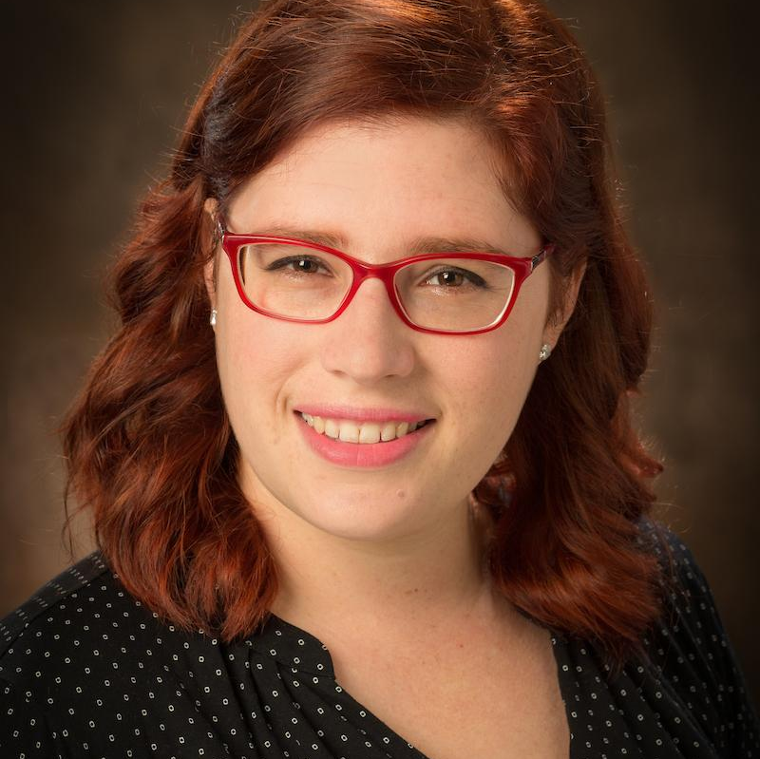
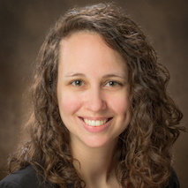
Our Team
CARA
GINNY
Acquisitions & Access Librarian;
content expert
Science Librarian;
instruction expert
Notes:
Ginny instructional D
Knew that having a partner with an instructional background would help me elevate the training as well as make it more engaging. Also they could help me streamline it, plus they would have a selector’s perspective!
I approached Ginny for a few reasons. We have worked well together in the past. She is a great partner and follows through on work. She trained me to take over her Co-chairship. She also recently was able to rework her role so she focuses more on instruction and research and She has had major success in migrating a good portion of her general instruction to either embedded librarianship or reusable modules. She was one of those to dive head first into online instruction sync and async.when the pandemic hit. So I had confidence in her skills and that she would be able to guide me to the best solution. She also just went through tenure so she may have more time to work on a project that is a bit outside her scope.

Slide 13
Our Plan
Review platforms
STEP 1: Fall 22
Outline & Create content
STEP 2: Dec-Spring 23
Expand training
STEP 3: Current
Notes:
Platform and presentation of information can be just as important as the actual information; if learners aren't engaged and learning from a usable platform, instruction won't be as effective, they won't retain the information as well
Let’s talk about step 1. We identified 3 platforms

Slide 14
Moodle
PROS
A colleague had successfully used this to deploy training for copyright & saw it used by many, beyond their institution!
Can be accessible by many, without mediation
Would be good if we aimed to share beyond Miami
CONS
Can come with a steep learning curve
Full implementation requires institutional hosting
Might be something to try at a later date

Slide 15
Canvas
PROS
Library has used the LMS for creating modules for courses
Accessibility checkers available
Supports multimodal instruction well
Would be specific to Miami
CONS
Acquisitions training may not fit the current library canvas course, as it’s aimed at educating students
Requires approval from outside the library to gain a canvas course for ourselves
Would need to add users to course
Would require moving away from current Springshare-focused training and info
Notes:
Have libguides which we direct people to for ordering info currently

Slide 16
LibWizard
PROS
We have access to it and no plans to cease working with Springshare
Already have TS & Acquisitions LibGuides
Partner has experience working with it!
Locally managed
Extra local expertise available
High level of control of content
Can accommodate multimodal modules
Ease of access, users can interact on their own
Easy to build
CONS
Formatting is limited

Slide 17
Initial topics
 | Pre/Post Test | Basics | Login | Selecting | Evaluating | Review, Delete, & Folders
Audience | Full users | 1st time | All | Selector Focus | Acq Focus | Selector Focus
Topics | Set of questions based of key content | LibGuide, emails, & Key players | Login, Searching, & tips | Cart, Express, Unlisted, & … | Already owned, status, fund, ILS, Dups, & eBooks | Incorporated into Selecting
Content | Questions | Text, Questions, Game | Video, Image, text, Activities | Videos, Text, Activities, Questions | Text, LibGuide, Image, Activities | –
Notes:
GOBI specific & print focused 1st

Slide 18

What would you start with?
Notes:
Discussion slide for audience

Slide 19
03: Execution and Assessment
03
Execution & Assessment
Making the content & feedback from users

Slide 20
Divide & Conquer
5
4+
4
CARA
GINNY
Videos
Testing LibWizard
Exploring formats
Adding Pretest questions
Login, delete, GOBIexpress, Unlisted, add to a folder
Activities
There are at least 1 activity per module, but also additional question to reinforce concepts
Screenshots & incorporating LibGuides
Used annotated Screenshots to highlight content being discussed, users look through both LibGuides
Notes:
I started working on the content we decided to pursue which consisted of
As I started making things I would check in with Ginny to make sure we were on the same path.
Ginny focused on working with LibWizard. She created a folder in the tutorials section as stand alone sections and tested building the formats we discussed- this is where the format limitations came in libwizard seemed more designed for question is a side panel with a libguide or other main content on the left. So we had to work on how I was thinking about the training to better align with the capabilities of the software.
Based on her work I was able to fill out the modules with the content I was creating.

Slide 21
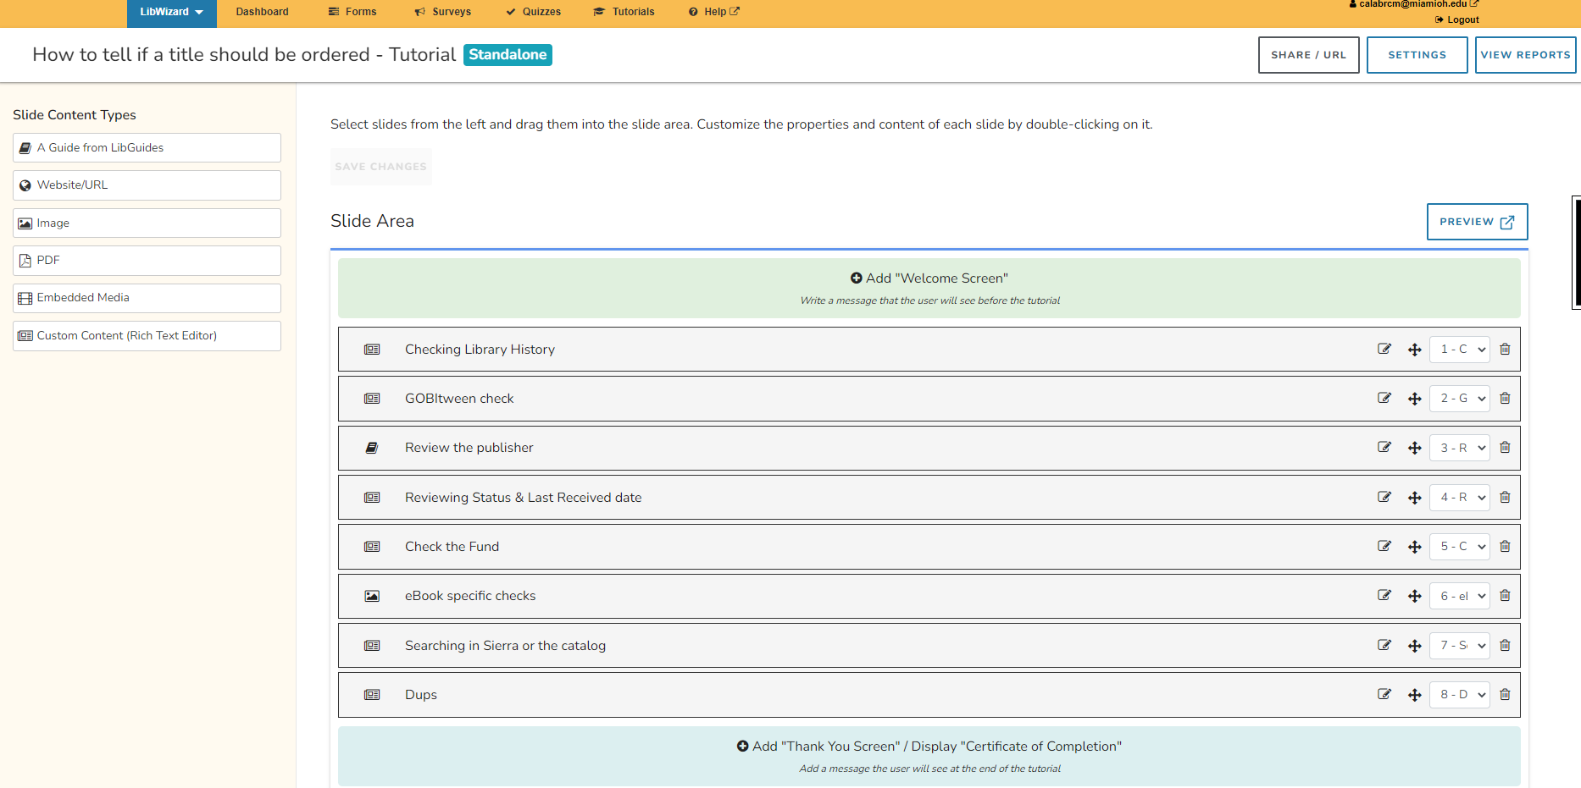
LibWizard tutorial: setup

Slide 22
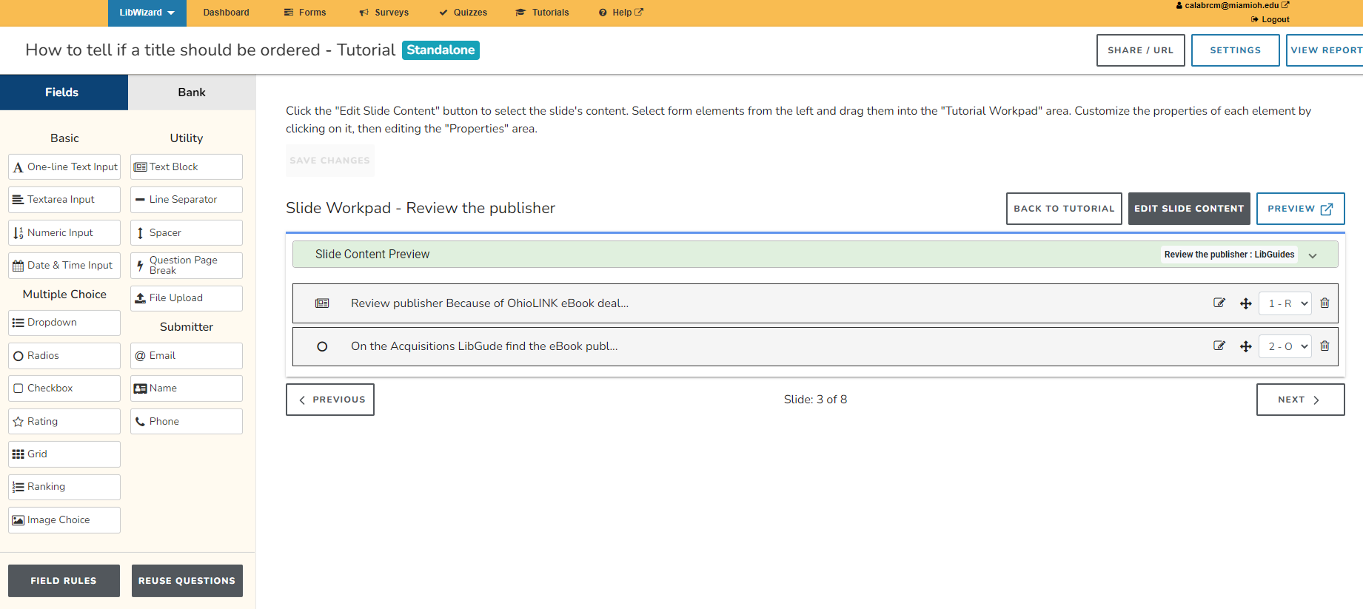
LibWizard tutorial: example activity

Slide 23
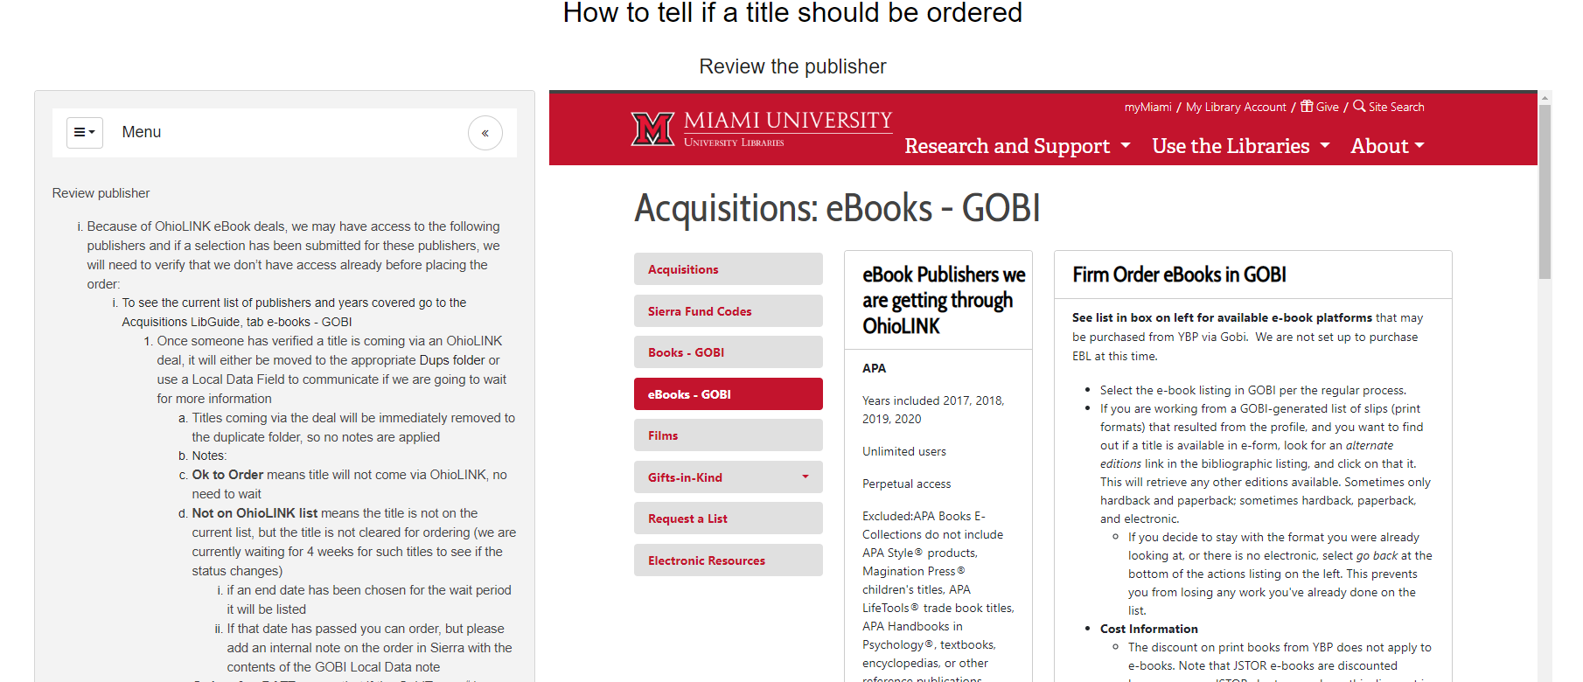
LibWizard tutorial: example of how activity looks

Slide 24
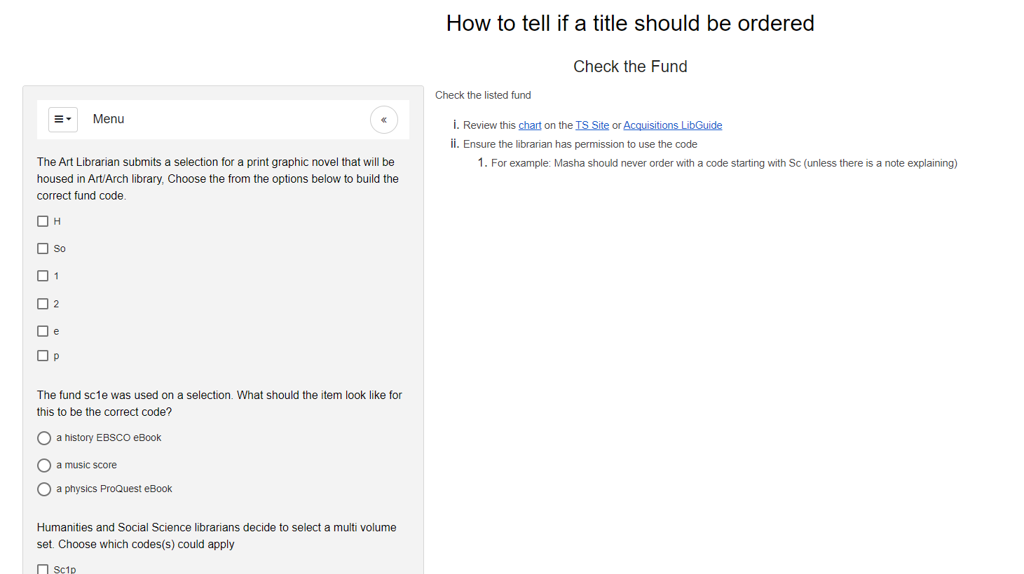
LibWizard activity: example quiz

Slide 25
Feedback
Staff
Librarian
Pretest feedback
“let you know what you got wrong…helps in my learning”
Login & Searching
Positive reviews
Pretest feedback
“add a link in the wrap-up page (after submitting) that moves users to the next section”
Login & Searching
“presentation is not intuitive…video modeling the activity”
Notes:
Selecting Items
How do you feel about the length of these videos? (check all that apply)
held my attention, informative
For reviewing selections portion, how did you feel about the amount of text vs the information provided?
It was an appropriate amount of text for what was being described

Slide 26
Feedback (continued)
Staff
Librarian
New training is preferred over the current procedures
links in the sidecar portion should open in a new tab
“Additional screenshots or videos to highlight the important bits”
New training is preferred over the current procedures
Videos are useful! “...much easier than reading the notes”
Make sure to video have sound
Notes:
Better directions & 1st question for tracking “why are you taking this module?”
“I think the sections that mostly or exclusively have text for the main content should have some additional screenshots or videos to highlight the important bits. there are just so many links in GOBI that it's difficult to follow the text and match it to what we're supposed to be doing”

Slide 27
What’s Next
01
07
02
05
08
03
06
09
04
Finish GOBI Module
Additional Modules
Parts of a selection
Streaming Video
In process, looking to collaborate with a Web Librarian on adding a tetris like game
Design Needs
Swank, Kanopy, Docuseek
Accessibility
ERA
Notifications
How to set up
Work with Accessibility Liaison & tools to improve
How and When to use
Ordering
Display/Release
Niche Vendors
Acq focused
Test out display methods, roll out training, & more QA testing
R2, Casalini, Amalivre, Puvill, Harrassowitz, Leisure Collection, etc
eBooks Expanded
Acq Team has expressed confusion with evaluating whether we can order from specific eBook vendors
Notes:
Try to color code? 1-4 yellow 5-6 blue 7-9 red

Slide 28
Recommended training paths: GOBI
Parts of a Selection [incomplete]
Notifications [future]
Ordering [future]
eBooks [future]
Pretest
Basics
Login
Selecting
Evaluating
Post test
Staff Refresh
Staff Onboarding
Selectors Refresh
Selector Onboarding
Notes:
Exploring where to place the training and suggest training workflow
The obvious place is on the Acq libguide in a new tab
Could add to the new TS google site

Slide 29
Thanks!
DO YOU HAVE ANY QUESTIONS?
Cara Calabrese | Ginny Boehme calabrcm@miamioh.edu | boehmemv@miamioh.edu
Miami University

