Slide 1
Looking through the Prism: changing from collection development to collection strategy
By
Kate Seago, Director of Acquisitions
University of Kentucky Libraries

Slide 2
agenda
INTRODUCTION
HISTORY
CHANGES
FUTURE
SUMMARY

Slide 3

University of Kentucky
Mission includes teaching, research and service
Public, land-grant university
Undergraduate, graduate and professional schools, medical college with teaching hospital
32,710 Students as of Fall 2022
3,088 Faculty as of Fall 2022
11,041Employees as of Fall 2022

Slide 4

UK Libraries
Libraries include Young, M.I. King Special Collection, Science & Engineering, Little Fine Arts, Medical Center, Education.
Law Library is under College of Law
ARL, CRL, and ASERL Library
Regional Depository Collection
FY22 Expenditures $11,963,736
State Collection Budget FY23 - $6,735,336
Endowments for Collections FY 23 - $3,963,935
Collection size is 5,866,790
Faculty & Staff around 190

Slide 5
History – Collection Policy
Collection policy delineates levels of collecting and where collections are housed
Collection policy includes a statement about diversity, equity and inclusion
Remains print oriented, ownership oriented and tries to be all things to all people

Slide 6
History – Budget Management
Budget is divided by historic subject allocations
Budget is fully allocated
Continuations on onetime funding
Extremely difficult to manage packages, adding new subjects and new formats

Slide 7
Collection Policy vs Strategy
Policies can be very proscriptive describing what to do but not responding well to changes in funding, formats or needs
Strategies are ways to view the current situation and make decisions that will meet the institutions values and needs
  Use rubrics in decision making
  Diversity, equity and inclusion is a value with a rubric, part of each decision
  Looking both university wide and each subject in proportion

Slide 8

Collection Policy - Delay

Slide 9
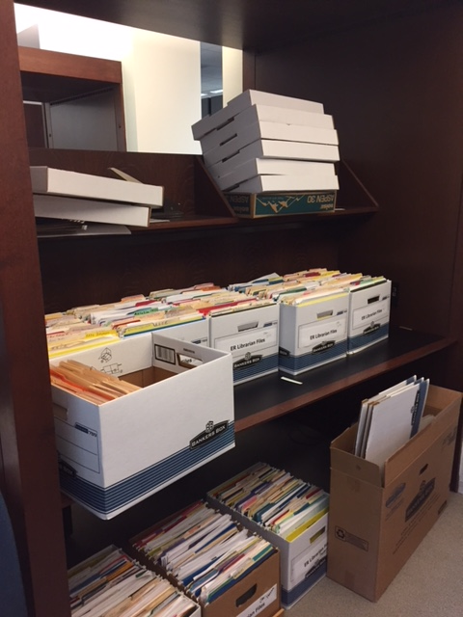
Changes in Acquisitions
Paper to Online Workflows
  Vendor
  Licenses
  Invoicing
Aligning the Budget
  Creating general funds
  Reducing subject funds
  Finding flexibility

Slide 10
ACQUISITIONS – Moving Online
Slowly dismantled paper files, trusting the online records
Finding effective ways to use PDF for signatures, list licenses, etc.
Creating successful online documents

Slide 11
STEP ONE
With our reset to our FY19 base budget by FY22, UK Libraries shift from using onetime funds for continuations to using only funding from our base budget and endowments

Slide 12
Budget Reductions
Asked each area to identify approximately 18% reduction over 3 years
Discussion with vendors about sustainability and keeping their share and presence with the UK Campus users same, just a smaller pie
Discussion with academic liaisons about access versus ownership.
Taking a deeper look at the usage and open access

Slide 13
STEP TWO
UK Libraries started participating in more multiyear deals to reduce annual increases and create continuity and stability

Slide 14
Changing philosophy
Advocating for a predictable base budget with incremental cost of living
Advocating with vendors for under 3% increase
  Offering onetime purchases
  Multi-year deals
Shifting to E-preferred with a few exceptions
Continuing to look at usage, turn aways and open access options

Slide 15
STEP THREE
Consolidation of funds
Remove package titles from subject funds
Merge Medical Center with Main Campus
Create broad subject funds

Slide 16
Changing the Budget
Touchy topic about changing funding model
Talked a lot about making the changes and why
Pulled 4 packages to start with
Increased access
  Complete Cambridge and SAGE
  Added Embase
  Add requested titles to Springer and Elsevier
  Added AM Explorer

Slide 17
Spending down endowments
The Pandemic left us with a bump in interest
Demonstrate need on an ongoing basis, the Libraries needed to reduce the carry-forward in endowments
Spending spree
  Lexington Herald Leader backfile
  SAGE Research methods
  Nature backfile
  NAACP Digital Archive

Slide 18
BUDGET CHANGES
STATE BUDGET
Merge Medical and Main into a single State Budget
Create centralized funds for continuations
Create centralized funds for onetime purchases​
Endowments
Spending more of interest annually
Creating spending pools for subject teams
Provide more flexibility

Slide 19
Collection Values Coming
November 2023
  Establish rubrics
July 2023
  Collection Values
JANUARY 2024
  Test values & rubrics
MARCH 2024
  Planning for renewals
JUNE 2024
  Communicate changes

Slide 20
Collection Advisory Committee
Redefine the relationship to the academic liaisons
New charge including values & rubrics

Slide 21

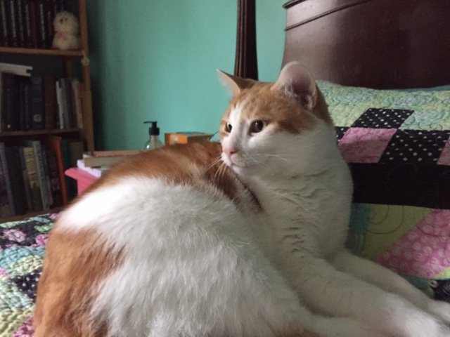
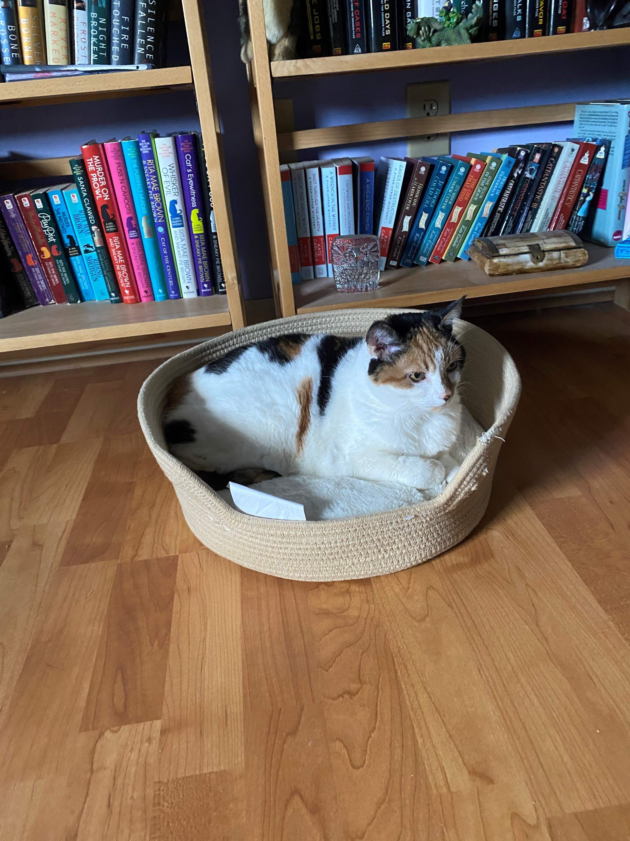

The Tuna Gang
Callie
Oliver
ZeldA
HONEYBEAR
Zoom Specialist
Accounting
Wellness Consultant
Intern

Slide 22
thank you
Kate Seago
Director of Acquisitions
kseago@uky.edu

