Slide 1
Cataloging & interlibrary loan: Cross sections in Service By Presley Dyer

Slide 2
About me
Received my MLIS from Valdosta State University in 2014.
Worked as a library assistant at an academic and public library before joining Tennessee State University (TSU) in 2018.
Library liaison to the Physical Therapy, Health Admin, and Dental Hygiene Departments.
Catalog Librarian until my title changed in 2022 to Cataloging and Interlibrary Loan Librarian.

Slide 3
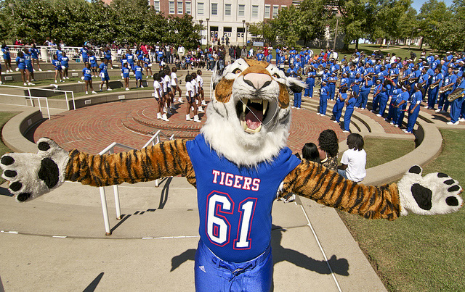
ABOUT TSU
Land-grant HBCU in Nashville
Classified as R2: Doctoral Universities – High research activity
83 majors in undergraduate and graduate colleges
Approximately 8,000 students
Two campuses-Main and Avon Williams (located downtown)

Slide 4
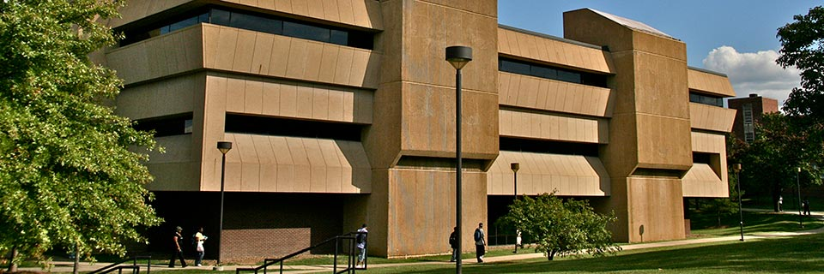
Martha Brown-Lois Daniel Library
Built in 1976, the Library has 82,000 square feet.
Houses nearly 200,000 print books and provides access to 329,000 ebooks.
Currently, 22 library employees.
Including myself, five employees work in technical services.
I provide the ILL services at Brown-Daniel, and the technical services librarian does so at AWC.

Slide 5
Our library systems
The Library has used the ILS Sierra since its implementation in 2005.
The Library migrated from OCLC’s ILL management system Iliad to Tipasa in 2019.

Slide 6
Tipasa
OCLC’s global, cloud-based, interconnected web architecture
Reflecting upon their Tipasa experiences, the two former ILL librarians noted (Porter 2019):
Efficiency of the service workflow:
Article Exchange Email Notifications
Access from anywhere
Issues:
No built-in feature to route requests to our downtown satellite library (and vice versa) when items are requested from the different collections.
Lack of having an undo shipping feature to reverse the action of sending an item to a lender by accident.

Slide 7
ILL 101
Tipasa training: https://help.oclc.org/Resource_Sharing/Tipasa/Tipasa_training
Firefly (Tennessee’s Library Courier): https://www.tenn-share.org/firefly/
Survey: https://tnstate.libwizard.com/f/ILLSurvey
Policies: https://tnstate.libguides.com/website/services/interlibrary-loan

Slide 8
Example of ill cataloging record

Slide 9
CHALLENGES
Incorrect holdings data in OCLC; long overdue OCLC Holding Reclamation Project
Limited staffing with accessibility
Miscommunication and misunderstanding across all departments
Limited time
Outdated ILS with only the basic modules purchased
Outdated ILS with only the basic modules purchased
Incorrect holdings data in OCLC; long overdue OCLC Holding Reclamation Project
Limited staffing with accessibility
Limited time
Miscommunication and misunderstanding across all departments

Slide 10
Importance of ILL statistics
“Serves as a sample case for the overall health of the physical collection” (DeVet et al., 2023).
“Characterized by complex processes and interlinked systems that, while often ‘automated’ in some capacity, are still labor-intensive for staff” (Schmidt, 2017).
“Staff working in ILL generally have limited training in formal data analysis” (Decker, 2021).

Slide 11
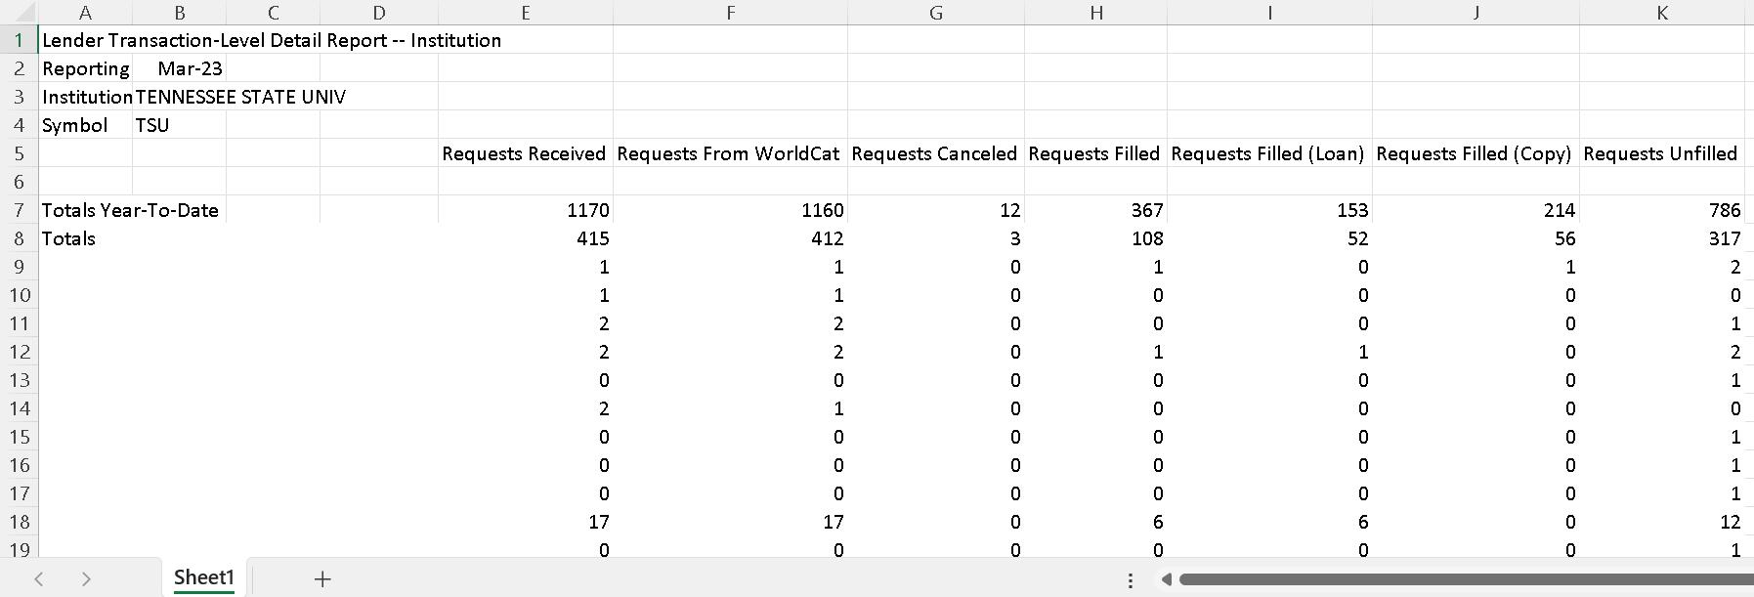
discrepancies

Slide 12
TSU Lender Activity Overview Report: October 2021-March 2023

Slide 13
OVERVIEW OF UNFILLED REQUESTS

Slide 14
ILL LENDING CANCELATIONS

Slide 15
Document Delivery
statistics
Request Patron Status | Document Delivery Filled Count
Faculty | 4
FACULTY | 154
Graduate Student | 40
library | 2
N/A | 48
STAFF | 4
TSU Affiliated User | 2
Grand Total | 254

Slide 16
DOCUMENT DELIVERY
User could not find the desired item in the library’s collection and submitted an ILL request, although its readily available in our collection.
Discovery confusion and technical issues, such as broken links and paywalls, drive users to use the ILL service (Lounsberry, 2020).
Convenience and ease of access facilitate user laziness? (Decker, 2021).
“Does ILL have a future in aiding patrons with discovery” (Espe & Wisniewski, 2019).

Slide 17
Solutions to ILL cancelations and Document Delivery
If not owned, immediately remove holdings from the OCLC bibliographic record.
Send the systems librarian an email when encountering catalog technical issues and inconsistencies.
Add OCLC Local Holding Records (LHRs) to reduce the lacking volume among serial requests.
Setting ILL deflections for noncirculating collections, such as reference and on-reserve items, and items too new to loan.
Notify users when their requests can be found in the collection with an instructional tutorial.
Conduct an ILL workshop that goes over the process of searching the catalog, library linking to Google Scholar, and submitting the ILL form.

Slide 18
SUMMARY

Slide 19
Questions and/or Suggestions?
Presley Dyer
adyer4@tnstate.edu
THANK YOU!

Slide 20
references
Decker, E. N. (2021). ”Making Sense of the Lending Fill Rate in Interlibrary Loan: Investigating Causes for Low Fill Rates and Developing Potential Remedies,” Journal of Library Resource Sharing, 30:1-2, 3-18, DOI: 10.1080/1072303X.2021.1929642
Espe, T. W., & Wisniewski, R. M. (2019). ”Unnecessary Requests: Examining Patrons’ Reliance on Interlibrary Loan for Electronically Owned Items at an Academic Library,” Journal of Interlibrary Loan, Document Delivery & Electronic Reserve, 28:1-2, 35-45, DOI: 10.1080/1072303X.2019.1655514
Schmidt, L. (2017). ”The Invisible Employee: Success and Fragility of Automating Interlibrary Loan,” Journal of Interlibrary Loan, Document Delivery & Electronic Reserve, 26:3-5, 181-192, DOI: 10.1080/1072303X.2018.1465011
Porter, T. D. (2020). Migrating from ILLiad to Tipasa, Journal of Access Services, 17:2, 83-95, DOI: 10.1080/15367967.2020.1725768Katherine E. DeVet, Ryan Litsey & Robert O. Devet (2023) To be or not to be… on shelf: Demonstrating catalog and shelf integrity using interlibrary loan statistics, Journal of Access Services, DOI: 10.1080/15367967.2023.2191852
DeVet, K. E., Litsey, R., & Devet, R. O. (2023). To be or not to be… on shelf: Demonstrating catalog and shelf integrity using interlibrary loan statistics, Journal of Access Services, DOI: 10.1080/15367967.2023.2191852
Lounsberry, M. (2020). Troubleshooting Electronic Resources from an Interlibrary Loan Perspective, Technical Services Quarterly, 37:3, 223-238, DOI: 10.1080/07317131.2020.1768699

Slide 21
images
TSU Tiger: https://www.tnstate.edu/activities/gallery.aspx
Brown-Daniel Lirary: https://www.facebook.com/tennstlibraries/
Mail: https://www.vecteezy.com/free-vector/fast-mail
Lightbulbs: https://www.vecteezy.com/free-vector/idea
Question Marks: https://www.freepik.com/free-vector/question-mark-sign-speech-bubble-style_7082692.htm#query=question%20mark&position=11&from_view=search&track=ais

