Slide 1
A new read deal
@aj_boston
ovgtsl | richmond | 2023

Slide 2
Ongoing challenges require creative solutions

Slide 3
1. Schol comm goals
help to make outputs from institutional authors open access

Slide 4
2. Tech service goals
get the most content for the best value on behalf of your users within set budgets

Slide 5
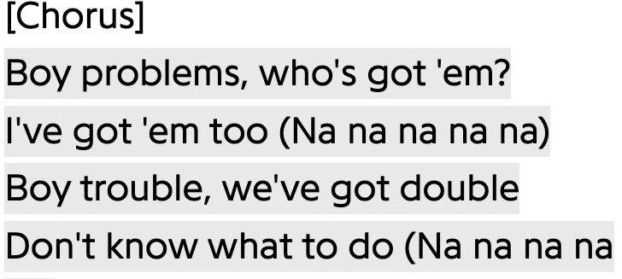
Problems
Boy Problems, Carly Rae Jepsen (2015)

Slide 6
Big Deals
what’s the bfd?

Slide 7
Cancel?

Slide 8
A new read deal (1)
full publisher catalog use based cost one flat use rate
bulk discount pre-purchased
+”open” mechanisms

Slide 9
Read and let read
Letting users read everything from a publisher is maximum coverage.
Paying only for the articles that users do read is maximum value.

Slide 10
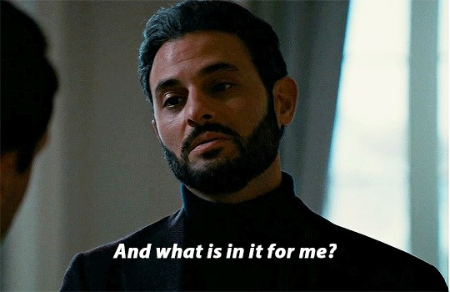
And what’s in it for me, Ken?

Slide 11
Use charged at single rate
Use
Historical CPU (“$10”)
Negotiated Integer (“2”)
$10 ÷ 2 = $5
10 X 2 = 20 (articles)
20 X $5 = $100
$100 X 2 years

Slide 12
A new read deal (2)
full publisher catalog use based cost one flat use rate
bulk discount pre-purchased
+”open” mechanisms

Slide 13
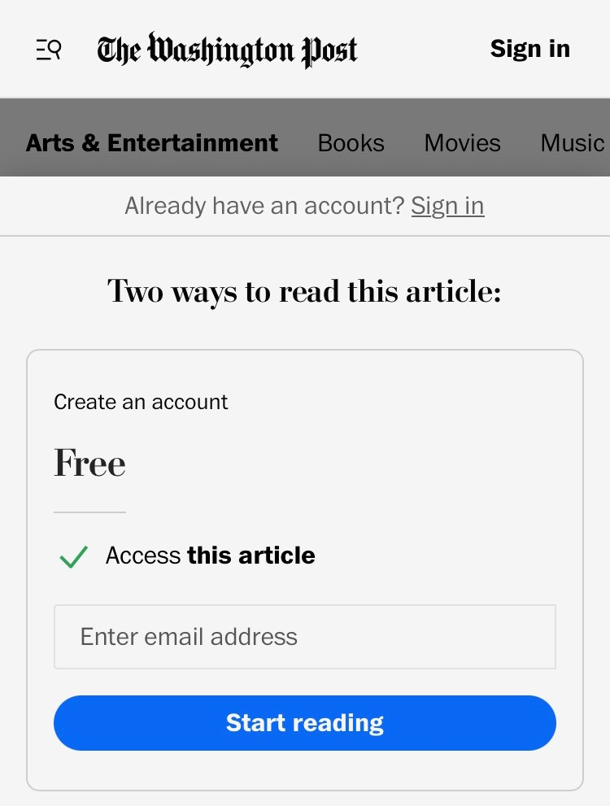
“The BRONZE BORDER”
Public Access to Subscription Content

Slide 14
“The GOLDEN GATEWAY”
Crowdfunding Open Access

Slide 15
A new read deal (3)
full publisher catalog use based cost one flat use rate
bulk discount pre-purchased
+”open” mechanisms

Slide 16
@aj_boston aboston@murraystate.edu

